Slide 1
Mental Modal and Metaphors
Notes:
https://www.pxfuel.com/en/free-photo-jmhvn
Public domain

Slide 2
Learning Goals
Understand …
Why it is hard for developers to spot usability issues.
How mental model, conceptual model, and metaphor relate
Be able to explain
the terms mental and conceptual model,
The difference between mental and conceptual model,
what metaphors are, why they are useful, and where their limitations are.
Mental Models and Metaphors

Slide 3
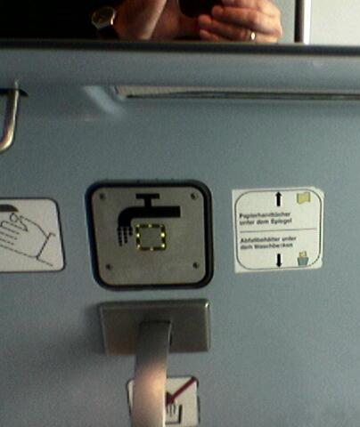
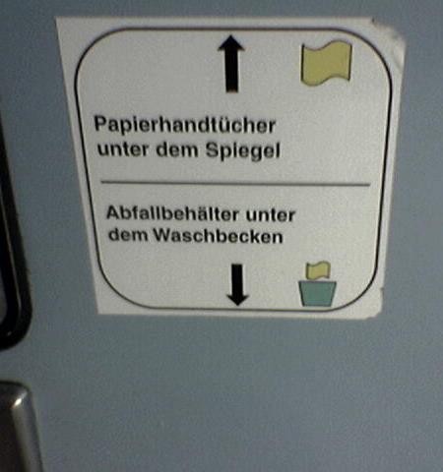
Why is Something Easy to Use?
Signs and explanations for things that are usually obvious are an indicator for a potential design problem.
(German Rail IC-Train)
Mental Models and Metaphors
Notes:
Fotos Albrecht Schmidt

Slide 4
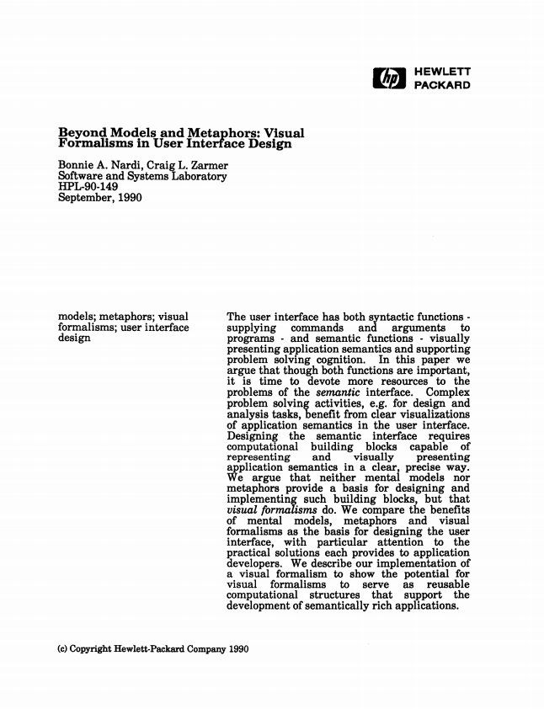
What is a Mental Model
How the user thinks it works
‘In human-computer interaction research, the notion of "mental models" has come to be a very general catch-phrase for anything having to do with end users' knowledge of an application (van der Veer, 1990). There is a feeling that if we could "capture" mental models, then we could build good interfaces […] But many […] are much less convinced of the alleged benefits of mental models and of our ability to use them for reasoning or other complex cognition. […] Researchers who have investigated mental images have been struck by how incomplete and inflexible they are…’
Nardi, B. A., & Zarmer, C. L. (1993). Beyond models and metaphors: Visual formalisms in user interface design. Journal of Visual Languages & Computing, 4(1), 5-33.
Mental Models and Metaphors
Notes:
http://citeseerx.ist.psu.edu/viewdoc/download?doi=10.1.1.93.3271&rep=rep1&type=pdf

Slide 5
Mental Model
How the user reasons and understands
Kenneth Craik (1943) ‘the mind constructs "small-scale models" of reality that it uses to anticipate events, to reason, and to underlie explanation’
Users acquire mental models by
Interaction / observation
Explanation
Two types
Functional – users know what to do, but not why
Structural – users know why to do something
William Hudson. Mental Models, Metaphor and Design (2003).UK UPA and HCI2003
http://www.syntagm.co.uk/design/articles/mmmad.pdf
Mental Models and Metaphors
Notes:
Strategy 1: heating is on or off – will heat till temperature is reached
Strategy 2: heating is gradual – the higher you put it the more it heats
William Hudson. Mental Models, Metaphor and Design (2003).UK UPA and HCI2003
http://www.syntagm.co.uk/design/articles/mmmad.pdf

Slide 6
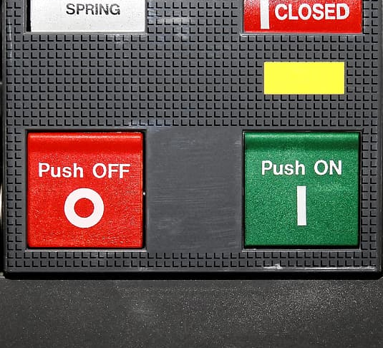
Mental Model
Example: Central Heating
You came back and it is only 15°C in your room. You want a room temperature of 21°C. What do you do?
You put the thermostat to 21°C and wait
You put the thermostat to max (=35°) and switch it back to 21° once it is warm?
What different mental models do people have who chose strategy 1 or 2?
William Hudson. Mental Models, Metaphor and Design (2003).UK UPA and HCI2003
http://www.syntagm.co.uk/design/articles/mmmad.pdf
Mental Models and Metaphors
Notes:
Strategy 1: heating is on or off – will heat till temperature is reached
Strategy 2: heating is gradual – the higher you put it the more it heats
William Hudson. Mental Models, Metaphor and Design (2003).UK UPA and HCI2003
http://www.syntagm.co.uk/design/articles/mmmad.pdf
Free Image, Public domain
https://www.pikrepo.com/fpcxg/selective-focus-photography-of-water-flowing-on-faucet
https://www.pikrepo.com/fvudc/switchgear-control-cabinet
https://p0.pikrepo.com/preview/757/588/selective-focus-photography-of-water-flowing-on-faucet.jpg

Slide 7
Mental Model
Definition by Jakob Nielson
’A mental model is what the user believes about the system at hand.’
‘A mental model is based on belief, not facts: that is, it's a model of what users know (or think they know) about a system such as your website. Hopefully, users' thinking is closely related to reality because they base their predictions about the system on their mental models and thus plan their future actions based on how that model predicts the appropriate course.’
‘It's a prime goal for designers to make the user interface communicate the system's basic nature well enough that users form reasonably accurate (and thus useful) mental models.’
Jakob Nielsen. Mental Models on October 17, 2010
https://www.nngroup.com/articles/mental-models/
Mental Models and Metaphors

Slide 8
Mental Model
Definition by Jakob Nielson
‘Individual users each have their own mental model. […] different users might construct different mental models of the same user interface. Further, one of usability's big dilemmas is the common gap between designers' and users' mental models. Because designers know too much, they form wonderful mental models of their own creations…, leading them to believe that each feature is easy to understand. Users' mental models of the UI are likely to be somewhat more deficient, making it more likely for people to make mistakes and find the design much more difficult to use.
Jakob Nielsen. Mental Models on October 17, 2010
https://www.nngroup.com/articles/mental-models/
Mental Models and Metaphors

Slide 9
Conceptual Model
The model the designers wants the user to have
“A conceptual model is a high-level description of how a system is organized and operates.” Johnson, J., & Henderson, A. (2002). Conceptual models: begin by designing what to design. interactions, 9(1), 25-32.
The conceptual model
is deliberately designed
it allows to user to understand and operate the UI
it draws on prior knowledge of the user
is communicated through the interface and interaction design
William Hudson. Mental Models, Metaphor and Design (2003).UK UPA and HCI2003
http://www.syntagm.co.uk/design/articles/mmmad.pdf
Mental Models and Metaphors
Notes:
http://www.syntagm.co.uk/design/articles/chapter_09_hudson.pdf

Slide 10
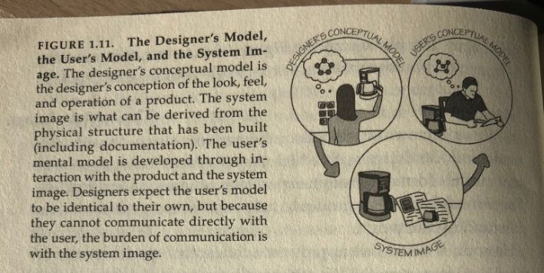
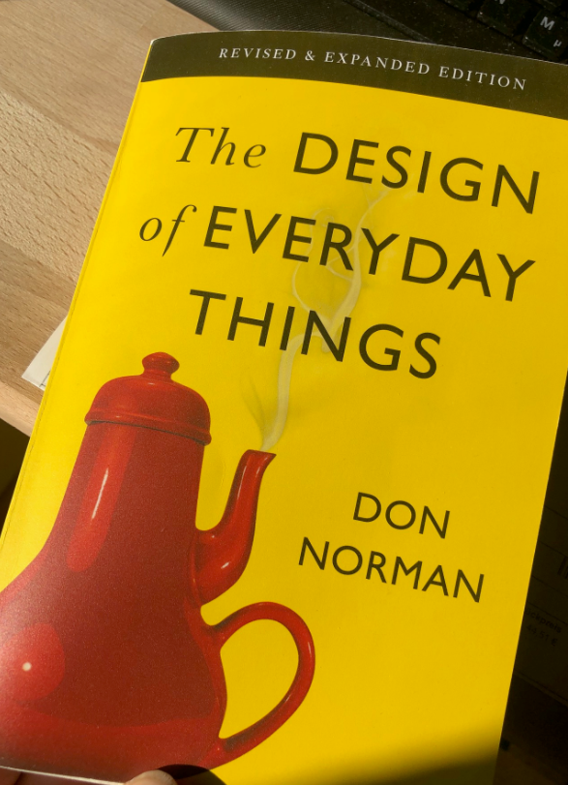
Designer Model, User Model, and System Model
Don Norman
Norman, D. A. (2013). The design of everyday things: Revised and expanded edition. New York: Doubleday.
Notes:
Photo Albrecht Schmidt

Slide 11
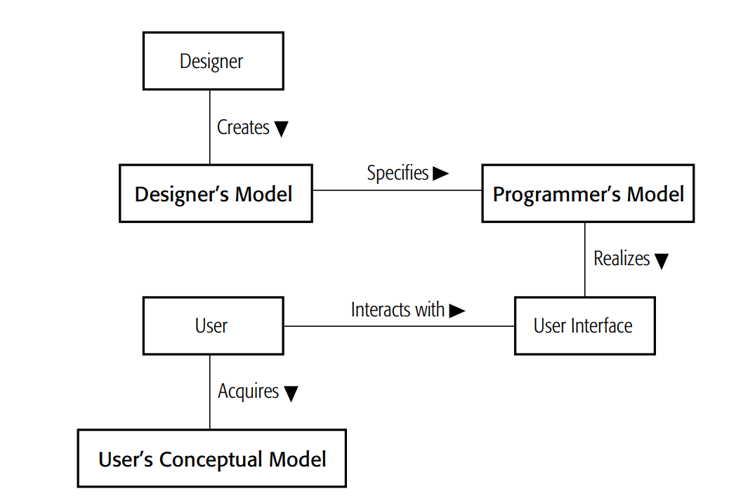
Models – Designer, Programmer, User
Hudson, W. (2001). Toward unified models in user-centered and object-oriented design. Object Modeling and User Interface Design: Designing Interactive Systems, 313-362.
Mental Models and Metaphors
Notes:
http://www.syntagm.co.uk/design/articles/chapter_09_hudson.pdf

Slide 12
Clarification of Terms
Different things with the same intention
Mental Model = User Model = User’s Conceptual Model
Conceptual Model = Designer Model
System Model = Programmer’s Conceptual Model = Programmer’s Model = Implementation Model
Notes:
Strategy 1: heating is on or off – will heat till temperature is reached
Strategy 2: heating is gradual – the higher you put it the more it heats
William Hudson. Mental Models, Metaphor and Design (2003).UK UPA and HCI2003
http://www.syntagm.co.uk/design/articles/mmmad.pdf

Slide 13
Metaphors
Build on what the users know
‘Given the analogy, the new user can draw upon his knowledge about the familiar situation in order to reason about the workings of the mysterious new computer system. For example, if the new user wants to understand about how the computer file system works, he need only think about how an office filing cabinet works and then carry over this same way of thinking to the computer file system’
Frank Halasz and Thomas P. Moran. 1982. Analogy considered harmful. In Proceedings of the 1982 Conference on Human Factors in Computing Systems (CHI ’82). Association for Computing Machinery, New York, NY, USA, 383–386. DOI:https://doi.org/10.1145/800049.801816
Mental Models and Metaphors
Notes:
http://www.syntagm.co.uk/design/articles/chapter_09_hudson.pdf

Slide 14
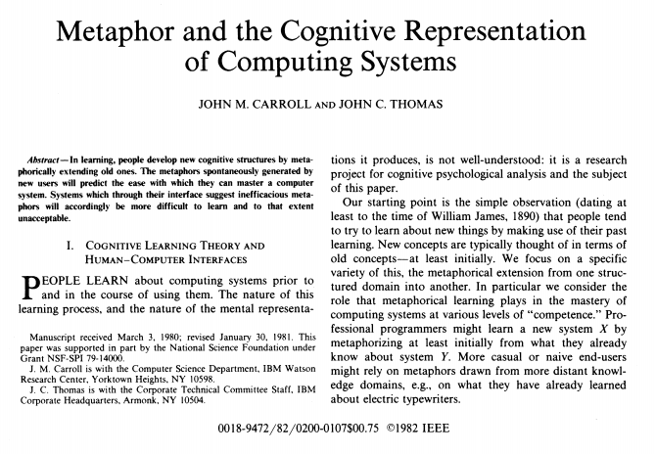
Metaphors
Build on what the users know
‘If people employ metaphors in learning about computing systems, the designers of those systems should anticipate and support likely metaphorical constructions to increase the ease of learning and using the system.’
Carroll, J. M., & Thomas, J. C. (1982). Metaphor and the cognitive representation of computing systems. IEEE Transactions on systems, man, and cybernetics, 12(2), 107-116.
Mental Models and Metaphors
Notes:
http://www.syntagm.co.uk/design/articles/chapter_09_hudson.pdf

Slide 15
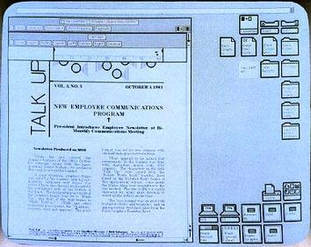
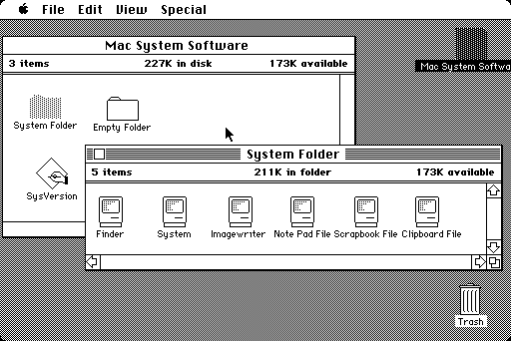
Metaphors - Examples
Desktop Metaphor – Alan Kay at Xerox Parc
Mental Models and Metaphors
Notes:
https://en.wikipedia.org/wiki/File:Apple_Macintosh_Desktop.png
Fair use

Slide 16
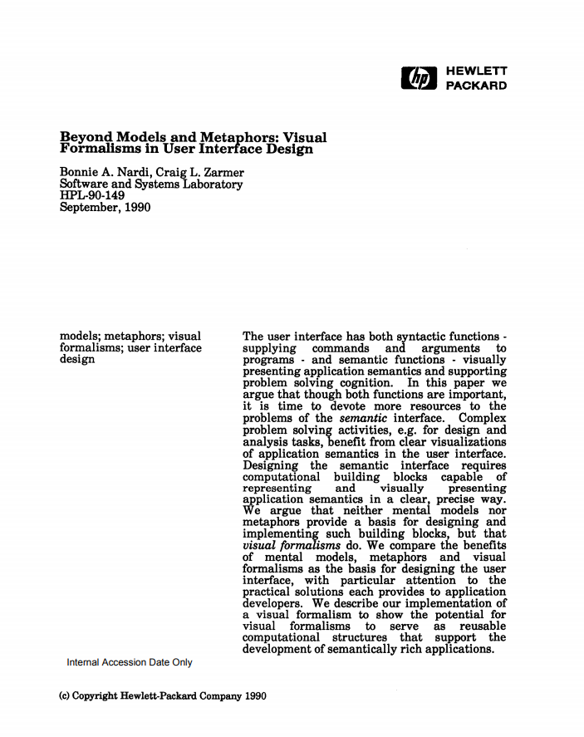
Metaphors
… are also causing problems
‘However, metaphors suffer from numerous problems that make them unsuitable for expressing rich application semantics, and inappropriate for the reusable computational structures we seek. […] Metaphors are slippery things, and not just because they contain irrelevancies (do we set the trash can out for garbage pick-up on Friday mornings?) and incompletenesses with respect to the domain they are meant to represent. […] Metaphors tempt us to over-generalize and to forget distinctions that we should be remembering.’
Nardi, B. A., & Zarmer, C. L. (1993). Beyond models and metaphors: Visual formalisms in user interface design. Journal of Visual Languages & Computing, 4(1), 5-33.
Mental Models and Metaphors

Slide 17
Metaphors
Mini Exercise
Search for examples of user interface designs that draw on metaphors?
Where do these metaphors work well?
Where are they limited?
A starting point for your search could be the early Book shelf app on iPads / iOS
Mental Models and Metaphors

Slide 18
Did you understand this block?
Can you answer these questions?
What is a mental model?
What is the difference between functional and structural mental models?
What is a conceptual model?
What is the difference between a mental and a conceptual model?
What are metaphors? What are their advantages and what are their limitations?
Mental Models and Metaphors

Slide 19
References
Nardi, B. A., & Zarmer, C. L. (1993). Beyond models and metaphors: Visual formalisms in user interface design. Journal of Visual Languages & Computing, 4(1), 5-33.
William Hudson. Mental Models, Metaphor and Design (2003).UK UPA and HCI2003. http://www.syntagm.co.uk/design/articles/mmmad.pdf
Jakob Nielsen. Mental Models on October 17, 2010. https://www.nngroup.com/articles/mental-models/
Norman, D. A. (2013). The design of everyday things: Revised and expanded edition. New York: Doubleday.
Hudson, W. (2001). Toward unified models in user-centered and object-oriented design. Object Modeling and User Interface Design: Designing Interactive Systems, 313-362.
Frank Halasz and Thomas P. Moran. 1982. Analogy considered harmful. In Proceedings of the 1982 Conference on Human Factors in Computing Systems (CHI ’82). Association for Computing Machinery, New York, NY, USA, 383–386. DOI:https://doi.org/10.1145/800049.801816
Carroll, J. M., & Thomas, J. C. (1982). Metaphor and the cognitive representation of computing systems. IEEE Transactions on systems, man, and cybernetics, 12(2), 107-116.
Mental Models and Metaphors
Notes:
William Hudson. Mental Models, Metaphor and Design (2003).UK UPA and HCI2003
http://www.syntagm.co.uk/design/articles/mmmad.pdf

Slide 20
License
This file is licensed under the Creative Commons Attribution-Share Alike 4.0 (CC BY-SA) license:
https://creativecommons.org/licenses/by-sa/4.0
Attribution: Albrecht Schmidt
For more content see: https://hci-lecture.de

