Slide 1
Human Centered Design
ISO 9241-210
Notes:
https://www.publicdomainpictures.net/en/view-image.php?image=23150&picture=crowd-of-people
Menschzentrierte Gestaltung interaktiver Systeme

Slide 2
Learning Goals
Understand …
The terms user centered design (UCD) and human centered design (HCD)
The general structure of the ISO 9241 Ergonomics of human–system interaction
The ISO 9241-210 Human-centered design for interactive systems
The problems of user centered design
Be able to explain
Rationale for adopting human-centered design according to ISO 9241-210
Principles and activities of human-centered design according to ISO 9241-210
The separation between interaction design and technical realization
Human Centered Design

Slide 3
User Centered Design vs. Human Centered Design
The terms are used interchangeable
Human centered is the more modern term
With the term “human centered” the focus should be on the person as a whole not only the user
Human Centered Design

Slide 4
ISO Standards and DIN Norms
Human Centered Design
Notes:
https://pixabay.com/de/photos/industrie-bolzen-verschluss-3075420/
https://pixabay.com/de/photos/schraube-schraubenmutter-metall-2117600/
Pixabay LicenseFreie kommerzielle Nutzung Kein Bildnachweis nötig

Slide 5
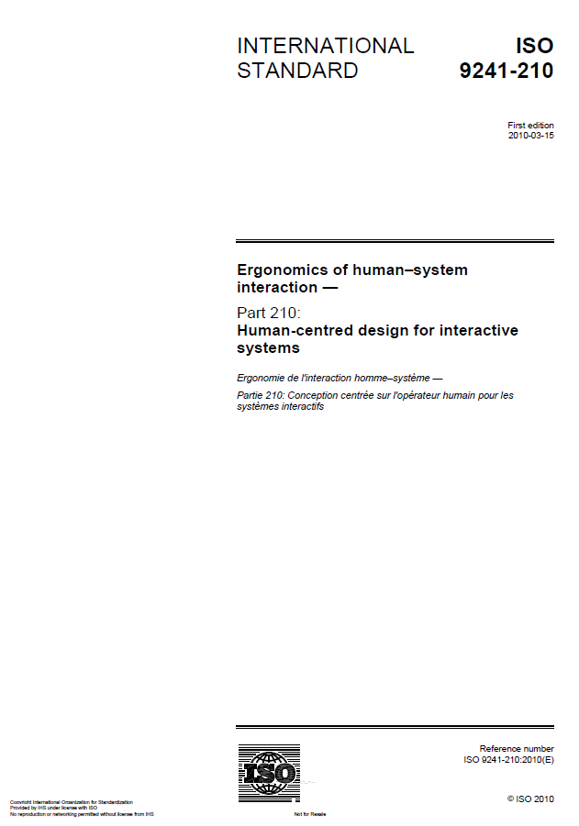
ISO 9241 Ergonomics of human–system interaction
Many parts with specific focus
Part 1: General introduction
Part 2: Guidance on task requirements
Part 3: Visual display requirements
Part 4: Keyboard requirements
…
Part 110: Dialogue principles
Part 151: Guidance on World Wide Web user interfaces
Part 171: Guidance on software accessibility
Part 210: Human-centered design for interactive systems
…
Part 420: Selection procedures for physical input devices
Part 910: Framework for tactile and haptic interaction
Part 920: Guidance on tactile and haptic interactions
ISO 9241 Ergonomics of human–system interaction
Human Centered Design

Slide 6
ISO 9241 Ergonomics of human–system interaction
Part 210: Human-centered design for interactive systems
Table of Contents
Scope
Terms and definitions
Rationale for adopting human-centered design
Principles of human-centered design
Planning human-centered design
Human-centered design activities
Sustainability and human-centered design
Conformance
ISO 9241-210:2019(en) Human-centered design for interactive systems
Human Centered Design

Slide 7
ISO 9241-210 Human-centered design for interactive systems
3. Rationale for adopting human-centered design
“Using a human-centered approach to design and development has substantial economic and social benefits for users, employers and suppliers. Highly usable systems and products tend to be more successful both technically and commercially.“
“Systems designed using human-centred methods improve quality, for example, by:
a) increasing the productivity of users and the operational efficiency of organizations;
b) being easier to understand and use, thus reducing training […] costs;
c) increasing usability for people with a wider range of capabilities […]
d) improving user experience;
e) reducing discomfort and stress;
f) providing a competitive advantage […]
g) contributing towards sustainability objectives.”
ISO 9241-210:2019(en) Human-centered design for interactive systems
Human Centered Design

Slide 8
ISO 9241-210 Human-centered design for interactive systems
4. Principles of human-centered design
a) the design is based upon an explicit understanding of users, tasks and environments […]
b) users are involved throughout design and development […]
c) the design is driven and refined by user-centered evaluation […]
d) the process is iterative […]
e) the design addresses the whole user experience […]
f) the design team includes multidisciplinary skills and perspectives”
ISO 9241-210:2019(en) Human-centered design for interactive systems
Human Centered Design

Slide 9
ISO 9241-210 Human-centered design for interactive systems
6. Human-centered design activities
“a) understanding and specifying the context of use”
What are the tasks or objectives associated with the design?
“b) specifying the user requirements”
What expectations or requirements must the design accommodate?
“c) producing design solutions”
prototyping, rendering, mockup building, implementation
“d) evaluating the design”
Conduct initial evaluations, usability testing, and ergonomic assessment
ISO 9241-210:2019(en) Human-centered design for interactive systems
Human Centered Design

Slide 10
ISO 9241-210 Human-centered design for interactive systems
6. Human-centered design activities
Plan the human-centered design process
Design solution meets the user requirements
Understand and specify the context of use
Iterative
where
appropriate
Evaluate designs against requirements
Specify the user and organizational requirements
Product design solutions to meet the user requirements
ISO 9241-210:2019(en) Human-centered design for interactive systems
Human Centered Design

Slide 11
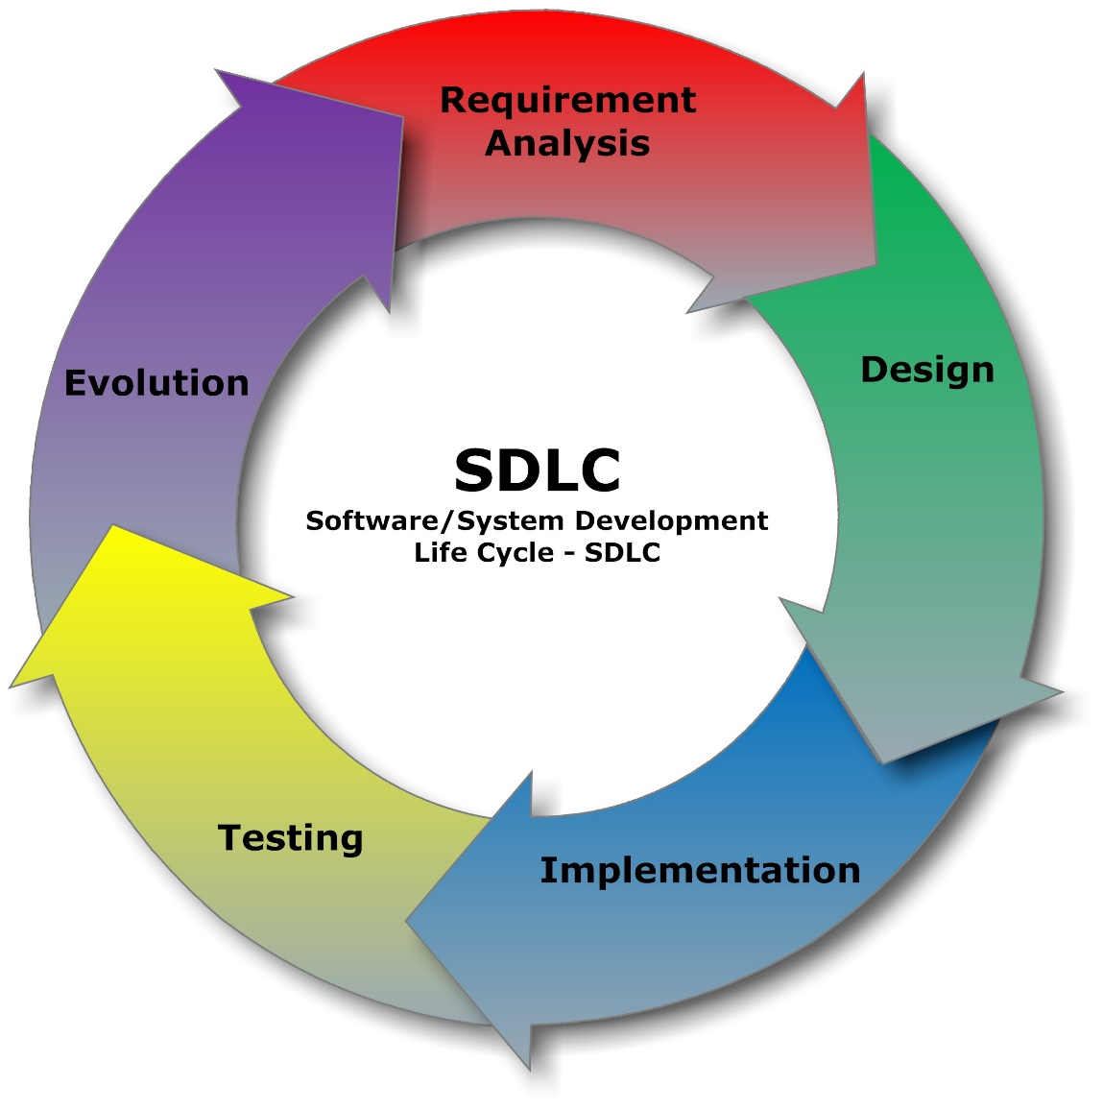
Software Process vs Human Centered Design Process
Mini-Exercise
Will the human centered design process work well with the waterfall model?
Does it fit agile software development methods?
Requirements
Design
Implementation
Verification
Maintenance
Cliffydcw / CC BY-SA
Human Centered Design
Notes:
https://upload.wikimedia.org/wikipedia/commons/1/19/SDLC_-_Software_Development_Life_Cycle.jpg

Slide 12
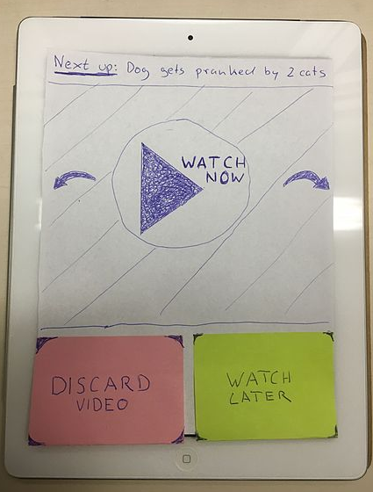
Separation between interaction design and technical realization
Separation into a two stage process for interactive applications
1st – Concept development and Interaction design (quick iterations)
Application and interaction concept
Interaction design
Prototypes to evaluate the concept and interaction design
2nd – technical realization (slow iterations)
Technical analysis
Technical specification (e.g. architecture, platform)
Implementation
Evaluation and Quality management
Human Centered Design
Notes:
Tobe101 / CC BY-SA (https://creativecommons.org/licenses/by-sa/4.0)
https://commons.wikimedia.org/wiki/File:Paper_Prototype_on_iPad.jpg
https://pxhere.com/en/photo/918274

Slide 13
Problems of User Centered Design
Users may expect disadvantages (e.g. being replaced by software)
Users may have conflicting views
Users may be wrong
Users may be resistant to change
In a “business environment” you are expected to create a system with regards to the goals specified and this is unfortunately NOT necessarily the system users would like to have
There is often a trade-off between the goals of employers (customer) and employees (user)
Human Centered Design

Slide 14
How easy is it to work in multidisciplinary teams?
Many people are involved in the process of designing and implementing an interactive product
Different background (e.g. design, business, CS, marketing, administration)
Different and conflicting low level objectives objectives
Communication can be very difficult!
To be able to work in a team is essential!
Team work is a skill that can be learned
Human Centered Design

Slide 15
Did you understand this block?
Can you answer these questions?
What is the ISO 9241-210 standard about?
What are potential problems of user centered design
What is the rationale for adopting human-centered design according to ISO 9241-210
Name the Principles and activities of human-centered design according to ISO 9241-210
How do the design activities according to ISO 9241-210 relate to each other? Make a sketch.
Explain how interaction design and technical realization can be separated and why this may be useful.
Human Centered Design

Slide 16
References
ISO 9241 Ergonomics of human–system interaction
ISO 9241-210:2019(en) Human-centered design for interactive systems
Human Centered Design

Slide 17
License
This file is licensed under the Creative Commons Attribution-Share Alike 4.0 (CC BY-SA) license:
https://creativecommons.org/licenses/by-sa/4.0
Attribution: Albrecht Schmidt
For more content see: https://hci-lecture.de

