Slide 1
Eight Golden Rules
Photo: Gold&Co, Goldankauf Wien, Handel mit Edelmetallen
according to Ben Shneiderman
Notes:
Gold&amp;Co, Goldankauf Wien, Handel mit Edelmetallen / CC BY-SA (https://creativecommons.org/licenses/by-sa/4.0)
https://commons.wikimedia.org/wiki/File:Goldundco-Anlagegoldbarren.jpg

Slide 2
Learning Goals
Know the Golden Rules according to B. Sheiderman
Understand …
The meaning of the Golden Rules
How these Golden Rules help to improve the quality of user interfaces
Be able to …
explain the Golden Rules and give examples
discuss user interface designs with regard to these Golden Rules
Eight Golden Rules
Notes:
Name the Eight Golden Rules?
Give an example for offering informative feedback.
In which contexts may offering feedback be problematic?
Where is easy reversal of action on principle not possible?
How can consistency help with the learnability of systems?
Name three areas in the design of user interfaces where consistency should be realized?

Slide 3
Principles for UI-Design
By by Ben Shneiderman et al.
Principle 1: Recognize User Diversity
Principle 2: Follow the Eight Golden Rules
Principle 3: Prevent Errors
Eight Golden Rules

Slide 4
Principles for UI-Design
By by Ben Shneiderman et al.
Principle 1: Recognize User Diversity
Principle 2: Follow the Eight Golden Rules
Principle 3: Prevent Errors
Shneiderman, B., Plaisant, C., Cohen, M., Jacobs, S., Elmqvist, N., & Diakopoulos, N. (2016). Designing the user interface: strategies for effective human-computer interaction. Pearson. http://www.cs.umd.edu/hcil/DTUI6/
Eight Golden Rules

Slide 5
Follow the 8 Golden Rules*
[*we list 9 here, there are different versions]
Strive for consistency
Seek universal usability
Offer informative feedback
Design dialogues to yield closure
Prevent Errors
Permit easy reversal of actions
Keep users in control
Reduce short-term memory load
Enable frequent users to use shortcuts (was 2.)
https://www.cs.umd.edu/~ben/goldenrules.html
Shneiderman, B., Plaisant, C., Cohen, M., Jacobs, S., Elmqvist, N., & Diakopoulos, N. (2016). Designing the user interface: strategies for effective human-computer interaction. Pearson. http://www.cs.umd.edu/hcil/DTUI6/
Eight Golden Rules

Slide 6
Strive for consistency
“Consistent sequences of actions should be required in similar situations;
identical terminology should be used in prompts, menus, and help screens;
and consistent color, layout, capitalization, fonts, and so on, should be employed throughout.
Exceptions, such as required confirmation of the delete command or no echoing of passwords, should be comprehensible and limited in number”
https://www.cs.umd.edu/~ben/goldenrules.html
Shneiderman, B., Plaisant, C., Cohen, M., Jacobs, S., Elmqvist, N., & Diakopoulos, N. (2016). Designing the user interface: strategies for effective human-computer interaction. Pearson. http://www.cs.umd.edu/hcil/DTUI6/
Eight Golden Rules

Slide 7
Strive for consistency
Example: Consistency across applications
Eight Golden Rules
Notes:
Consistency across applications (office)

Slide 8
Strive for consistency
Example: Inconsistent Semantics
Eight Golden Rules
Notes:
Consistency across applications (office)

Slide 9
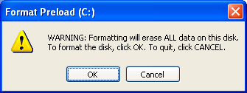
Inconsistencies
Always strive for consistency?
Dragging file operations?
folder on same disk vs. folder on different disk
file to trash can vs. disk to trash can
Fitts’ Law suggests bigger buttons for more often used operations
Inconsistency across platforms, e.g.
MacOS vs. Windows
Websites on different platforms
Mobile device vs. TV vs. PC
Inconsistency could be used for getting attention
Mock-up example
Eight Golden Rules

Slide 10
Seek universal usability
… see Principle 1
“Recognize the needs of diverse users and design for plasticity, facilitating transformation of content.
Novice to expert differences,
age ranges, disabilities, international variations,
technological diversity
[…] spectrum of requirements that guides design.”
https://www.cs.umd.edu/~ben/goldenrules.html
Shneiderman, B., Plaisant, C., Cohen, M., Jacobs, S., Elmqvist, N., & Diakopoulos, N. (2016). Designing the user interface: strategies for effective human-computer interaction. Pearson. http://www.cs.umd.edu/hcil/DTUI6/
Eight Golden Rules
Notes:
Adding features for novices, such as explanations, and features for experts, such as shortcuts and faster pacing, enriches the interface design and improves perceived quality.

Slide 11
Offer informative feedback
“For every user action, there should be an interface feedback.
For frequent and minor actions, the response can be modest, whereas
for infrequent and major actions, the response should be more substantial.”
https://www.cs.umd.edu/~ben/goldenrules.html
Shneiderman, B., Plaisant, C., Cohen, M., Jacobs, S., Elmqvist, N., & Diakopoulos, N. (2016). Designing the user interface: strategies for effective human-computer interaction. Pearson. http://www.cs.umd.edu/hcil/DTUI6/
Eight Golden Rules

Slide 12
Offer informative feedback
Eight Golden Rules

Slide 13
Offer informative feedback
Will ubiquitous computing change this?
Feedback vs. Calm Computing
Eight Golden Rules
Notes:
https://cdn.pixabay.com/photo/2017/01/24/18/02/smart-home-2005993_960_720.png
https://pixabay.com/de/illustrations/smart-home-haus-technik-multimedia-2005993/

Slide 14
Design dialogues to yield closure
“Sequences of actions should be organized into groups with a beginning, middle, and end.
Informative feedback at the completion of a group of actions gives users the satisfaction of accomplishment, a sense of relief […]
For example, e-commerce websites move users from selecting products to the checkout, ending with a clear confirmation page that completes the transaction.”
Important for actions that are not immediate and span over a longer time or multiple steps
https://www.cs.umd.edu/~ben/goldenrules.html
Shneiderman, B., Plaisant, C., Cohen, M., Jacobs, S., Elmqvist, N., & Diakopoulos, N. (2016). Designing the user interface: strategies for effective human-computer interaction. Pearson. http://www.cs.umd.edu/hcil/DTUI6/
Eight Golden Rules

Slide 15
Prevent Errors
As much as possible, design the interface so that users cannot make serious errors […]
If users make an error, the interface should offer simple, constructive, and specific instructions for recovery“
Detecting errors
Different options how to handle it:
Involve the user with dialogs (current practice)
Prevent the error or its consequences on system level (e.g. create backups/versions when a file is overwritten, keep all files that have been created by the user)
https://www.cs.umd.edu/~ben/goldenrules.html
Shneiderman, B., Plaisant, C., Cohen, M., Jacobs, S., Elmqvist, N., & Diakopoulos, N. (2016). Designing the user interface: strategies for effective human-computer interaction. Pearson. http://www.cs.umd.edu/hcil/DTUI6/
Eight Golden Rules
Notes:
For example, users should not have to retype an entire name-address form if they enter an invalid zip code but rather should be guided to repair only the faulty part.
Create UI that make it hard to make errors
Menus instead of commands
Options instead of text fields
Detect errors or possible errors
This rule is related to “easy reversal of actions”
Make it hard for the user to make errors
Examples – Detecting errors
Leaving a editor without saving
Writing to a file that already exists

Slide 16
Permit easy reversal of actions
As much as possible, actions should be reversible.
This feature relieves anxiety, since users know that errors can be undone, and encourages exploration […]
The units of reversibility may be a single action, a data-entry task, or a complete group of actions”
Providing UNDO functions
Possibly with infinite depth
Over sessions
Not trivial (conceptually as well as technically)
write a text, copy it into the clipboard, undo the writing, the text is still in the clipboard…
https://www.cs.umd.edu/~ben/goldenrules.html
Shneiderman, B., Plaisant, C., Cohen, M., Jacobs, S., Elmqvist, N., & Diakopoulos, N. (2016). Designing the user interface: strategies for effective human-computer interaction. Pearson. http://www.cs.umd.edu/hcil/DTUI6/
Eight Golden Rules
Notes:
As a basic rule – all actions should be reversible
Providing UNDO functions (possibly with infinite depth)
Allow undo of groups of actions
Undo is not trivial if user is not going sequential
E.g. write a text, copy it into the clipboard, undo the writing → the text is still in the clipboard!
Reversal of action becomes a usage concept
Browser back-button is used for navigation (for the user a conceptual reversal of action)
Formatting of documents – e.g. “lets see how this look, … don’t like it, … go back to the old state”

Slide 17
Permit easy reversal of actions
Discussion: Why is this not simple?
What is the cost?
Memory?
Complexity?
Why is UNDO sometimes not easy to implement and it may be even impossible?
https://www.cs.umd.edu/~ben/goldenrules.html
Shneiderman, B., Plaisant, C., Cohen, M., Jacobs, S., Elmqvist, N., & Diakopoulos, N. (2016). Designing the user interface: strategies for effective human-computer interaction. Pearson. http://www.cs.umd.edu/hcil/DTUI6/
Eight Golden Rules
Notes:
As a basic rule – all actions should be reversible
Providing UNDO functions (possibly with infinite depth)
Allow undo of groups of actions
Undo is not trivial if user is not going sequential
E.g. write a text, copy it into the clipboard, undo the writing → the text is still in the clipboard!
Reversal of action becomes a usage concept
Browser back-button is used for navigation (for the user a conceptual reversal of action)
Formatting of documents – e.g. “lets see how this look, … don’t like it, … go back to the old state”

Slide 18
Permit easy reversal of actions
In Ubiquitous Computing?
As a basic rule – all actions should be reversible
When is this not possible?
Communication applications (e.g. email)
Smart environments
Machines
Cars
In certain settings processes and basic physical laws prevent reversal of actions. Here an interaction layer (buffering user interaction) may be possible – but not always (e.g. breaks, emergency stop)
Eight Golden Rules
Notes:
https://cdn.pixabay.com/photo/2017/03/15/20/29/technology-2147367_960_720.jpg
As a basic rule – all actions should be reversible
Providing UNDO functions (possibly with infinite depth)
Allow undo of groups of actions
Undo is not trivial if user is not going sequential
E.g. write a text, copy it into the clipboard, undo the writing → the text is still in the clipboard!
Reversal of action becomes a usage concept
Browser back-button is used for navigation (for the user a conceptual reversal of action)
Formatting of documents – e.g. “lets see how this look, … don’t like it, … go back to the old state”

Slide 19
Keep users in control
“Experienced users strongly desire the sense that they are in charge of the interface and that the interface responds to their actions.
They don’t want surprises or changes in familiar behavior”
Avoid non-causality
The system should be predictable
Current developments (AI, Ubicomp) are in contrast:
Intelligent agents
Smart environments
https://www.cs.umd.edu/~ben/goldenrules.html
Shneiderman, B., Plaisant, C., Cohen, M., Jacobs, S., Elmqvist, N., & Diakopoulos, N. (2016). Designing the user interface: strategies for effective human-computer interaction. Pearson. http://www.cs.umd.edu/hcil/DTUI6/
Eight Golden Rules

Slide 20
Or just feeling in control
Keep users in control
People have to complete tasks under noisy conditions
Group A can switch off the noise (remark: if the switch is used, the study results cannot be used)
Group B has no influence over the noise
What happens?
Urban Stress: Experiments on Noise and Social Stressors. DC Glass, JE Singer - 1972 - Academic Press
Eight Golden Rules

Slide 21
Or just feeling in control
Keep users in control
People have to complete tasks under noisy conditions
Group A can switch off the noise (remark: if the switch is used, the study results cannot be used)
Group B has no influence over the noise
What happens?
Group A performed significantly better than the group B
Feeling in control helps
Urban Stress: Experiments on Noise and Social Stressors. DC Glass, JE Singer - 1972 - Academic Press
Eight Golden Rules

Slide 22
Reduce short-term memory load
“Humans’ limited capacity for information processing in short-term memory requires that designers avoid interfaces in which users must remember information from one display and then use that information on another display.”
“rule of thumb is that people can remember ‘seven plus or minus two chunks’ of information”
The system should remember, not the user
Make information that is required visible
Recognition is easier than recall, use memory aids (visual or audio)
https://www.cs.umd.edu/~ben/goldenrules.html
Shneiderman, B., Plaisant, C., Cohen, M., Jacobs, S., Elmqvist, N., & Diakopoulos, N. (2016). Designing the user interface: strategies for effective human-computer interaction. Pearson. http://www.cs.umd.edu/hcil/DTUI6/
Eight Golden Rules
Notes:
Examples that create problems
Multi-page forms where the user has to know at form N what she filled in in form N-1
Abbreviations introduced in one step and used in the following (e.g. user selects a destination – as the name of a city – and the system does the following steps by showing the airport code)

Slide 23
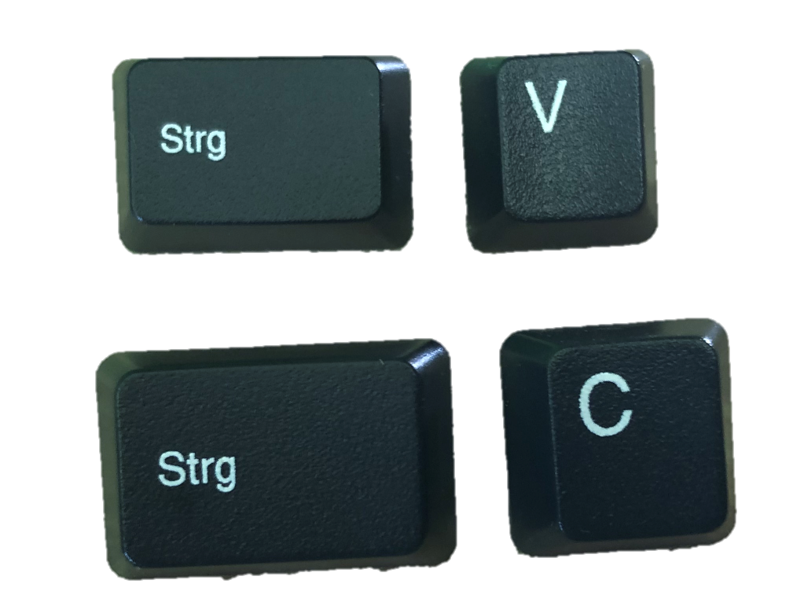
Enable frequent users to use shortcuts
Improves speed for experienced users
Shortcuts on different levels
Access to single commands, e.g. CTRL+S or toolbar
Customizing of commands and environments, e.g. printer pre-set (duplex, A4, …)
Reusing actions performed, e.g. history in command lines, macro functionality
Shortcuts to single commands are related to consistency
CTRL+X, CTRL+C, CTRL+V in Microsoft applications for cut, copy and paste
However CTRL+S (saving a document) is only implemented in some applications…
https://www.interaction-design.org/literature/article/shneiderman-s-eight-golden-rules-will-help-you-design-better-interfaces
Eight Golden Rules

Slide 24
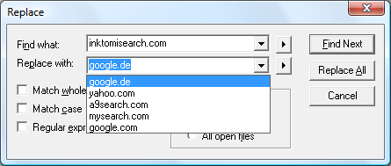
Keyboard shortcuts and History
Example: Enable frequent users to use shortcuts
Eight Golden Rules

Slide 25
Keyboard shortcuts and Toolbars
Example: Enable frequent users to use shortcuts
Eight Golden Rules

Slide 26
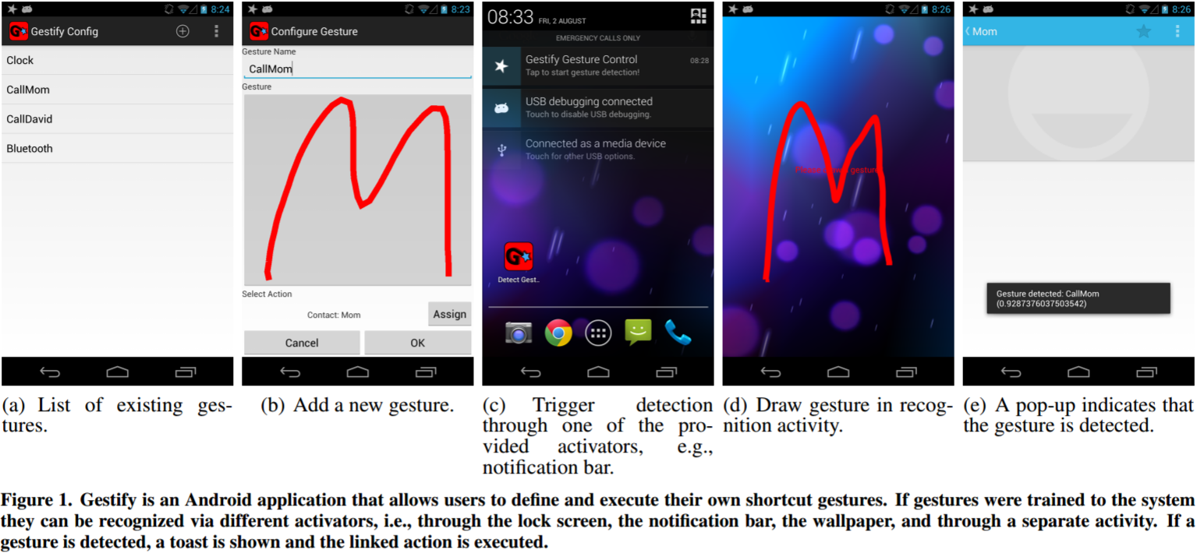
Shortcut Gestures on Smartphones
Example: Enable frequent users to use shortcuts
Poppinga, B., Sahami Shirazi, A., Henze, N., Heuten, W., & Boll, S. (2014, September). Understanding shortcut gestures on mobile touch devices. In Proc. of the 16th int. conf. on Human-computer interaction with mobile devices & services (pp. 173-182). ACM.
Eight Golden Rules

Slide 27
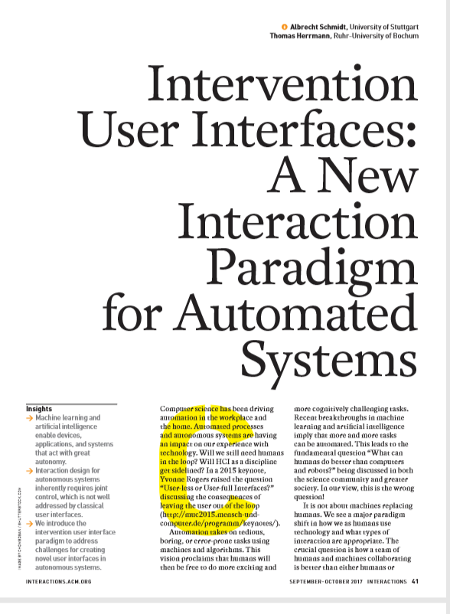
How can humans stay in control?
“In the future, we believe that a large class of automated and autonomous systems allow for joint control, where the majority of decisions are automated but where users can intervene.
Schmidt, A., & Herrmann, T. (2017). Intervention user interfaces: a new interaction paradigm for automated systems. interactions, 24(5), 40-45.
Eight Golden Rules

Slide 28
How can humans stay in control?
Design Principles for Intervention user interfaces
Ensure expectability and predictability.
Communicate options for interventions.
Allow easy exploration of interventions.
Easy reversal of automated and intervention actions.
Minimize required attention.
Communicate how control is shared.
Schmidt, A., & Herrmann, T. (2017). Intervention user interfaces: a new interaction paradigm for automated systems. interactions, 24(5), 40-45.
Eight Golden Rules

Slide 29
Types of Design Rules
principles
golden rules
Principles
abstract design rules
Golden rules and heuristics
more concrete than principles
Standards
(very) detailed design rules
Design patterns
generic solution for a specific problem
Style guides
provided for devices, operating systems, widget libraries
Authority: whether or not a rule must be followed or whether it is just suggested
Generality: applied to many design situations or focused on specific application situation.
increasing generality
standards
design pattern
style guides
increasing authority
Eight Golden Rules
Notes:
Name the Eight Golden Rules?
Give an example for offering informative feedback.
In which contexts may offering feedback be problematic?
Where is easy reversal of action on principle not possible?
How can consistency help with the learnability of systems?
Name three areas in the design of user interfaces where consistency should be realized?

Slide 30
Did you understand this block?
Can you answer these questions?
Name the Eight Golden Rules?
Give an example for offering informative feedback.
In which contexts may offering feedback be problematic?
Where is easy reversal of action on principle not possible?
How can consistency help with the learnability of systems?
Name three areas in the design of user interfaces where consistency should be realized?
Eight Golden Rules

Slide 31
Reference
Shneiderman, B. The Eight Golden Rules of Interface Design. https://www.cs.umd.edu/~ben/goldenrules.html
Shneiderman, B., Plaisant, C., Cohen, M., Jacobs, S., Elmqvist, N., & Diakopoulos, N. (2016). Designing the user interface: strategies for effective human-computer interaction. Pearson. http://www.cs.umd.edu/hcil/DTUI6/
Urban Stress: Experiments on Noise and Social Stressors. DC Glass, JE Singer - 1972 - Academic Press
Euphemia Wong. Shneiderman’s Eight Golden Rules Will Help You Design Better Interfaces. https://www.interaction-design.org/literature/article/shneiderman-s-eight-golden-rules-will-help-you-design-better-interfaces
Poppinga, B., Sahami Shirazi, A., Henze, N., Heuten, W., & Boll, S. (2014, September). Understanding shortcut gestures on mobile touch devices. In Proc. of the 16th int. conf. on Human-computer interaction with mobile devices & services (pp. 173-182). ACM.
Schmidt, A., & Herrmann, T. (2017). Intervention user interfaces: a new interaction paradigm for automated systems. interactions, 24(5), 40-45.
Eight Golden Rules

Slide 32
License
This file is licensed under the Creative Commons Attribution-Share Alike 4.0 (CC BY-SA) license:
https://creativecommons.org/licenses/by-sa/4.0
Attribution: Albrecht Schmidt
For more content see: https://hci-lecture.de

