Slide 1
Constraints and Mappings
Notes:
https://pixabay.com/de/photos/mode-modelle-frauen-m%C3%A4dchen-bunte-2561837/

Slide 2
Learning Goals
Understand …
What constraints are in the context of interaction design and user interfaces
How mappings impact the easy of use
Be able to …
use mappings and constraints as mechanisms in the design of user interfaces to prevent errors
Constraints and Mappings

Slide 3
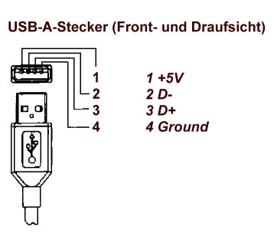
Example: USB
Constraints and Mappings

Slide 4
Physical Constraints & Affordances
USB Memory Stick vs. DVD vs. money
How many ways can you put them in?
If there is more than one option (physically) cater for these cases
Dials vs. Buttons vs. Sliders
Dials are turned
Buttons are pressed
Sliders are pushed
Constraints and Mappings
Notes:
https://pixabay.com/de/photos/geldschein-10-euro-geld-banknote-166307/

Slide 5
Constraints
Physical constraints
Basic physical limitations
Semantic constraints
Assumption to create something meaningful
Cultural constraints
Borders and context provided by cultural conventions
Logical constraints
Restrictions due to reasoning
Applying constraints is a design decision! A Practical way to realise the principle “prevent errors”
Norman, D. A. (2013). The design of everyday things: Revised and expanded edition. New York: Doubleday.
Constraints and Mappings

Slide 6
Cultural Constraints
Universal or culturally specific
Arbitrary conventions that have been learned
Users’ expectations build on cultural constraints
Example Colors
Red
Green
Blue
Constraints and Mappings

Slide 7
Mapping
Relationship between controls and action
Mappings should be
Understandable (e.g. moving the mouse up move the slider up)
Consistent
Recognizable or at least quickly learnable and easy to recall
Natural, meaning to be consistent with knowledge the user already has
Example: cooker
For these issues see also Gestalt theory!
Constraints and Mappings

Slide 8
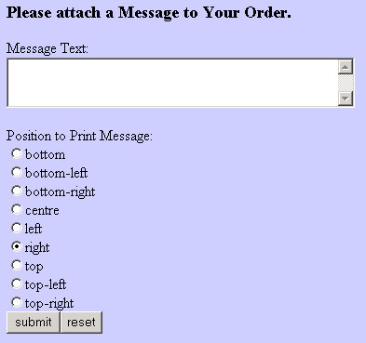
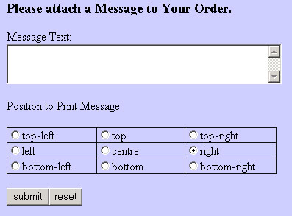
Mapping
Example
Click anywhere on the envelop to place it
Constraints and Mappings

Slide 9
Mapping
Example
“Natural” mappings can be found in many areas
It is not always obvious what the “natural” mapping is
Correlation with cultural constraints
Constraints and Mappings

Slide 10
Did you understand this block?
Can you answer these questions?
What different constrains are relevant for the design of user interfaces?
Explain cultural constraints in the context of Uis.
What is important when we design mappings? How can mappings increase or decrease usability?
Constraints and Mappings

Slide 11
Reference
Norman, D. A. (2013). The design of everyday things: Revised and expanded edition. New York: Doubleday.
Constraints and Mappings

Slide 12
License
This file is licensed under the Creative Commons Attribution-Share Alike 4.0 (CC BY-SA) license:
https://creativecommons.org/licenses/by-sa/4.0
Attribution: Albrecht Schmidt
For more content see: https://hci-lecture.de

