Slide 1
Introduction to Design
Image Source https://torange.biz/stylish-background-40604

Slide 2
Learning Goals
Understanding what design is about
Understanding the complexity of design
Discussing design from different perspectives
Introduction to Design

Slide 3
Definition: Design
A design is
a plan for the construction of an object or system or for the implementation of an activity or process,
or the result of that plan or specification in the form of a prototype, product or process.
Die Gestaltung
Die Gestalt
Cambridge Dictionary of American English
Introduction to Design

Slide 4
Design Disciplines
Architektur
Corporate Design
Datenbankdesign
Fotodesign
Game Design
Grafikdesign
Kommunikationsdesign
Interaktionsdesign
Interface Design
Lichtdesign
Mediendesign
Modedesign, Bekleidungsdesign
Produktdesign
Schmuckdesign
Service Design
Sound Design
Textildesign
Orientierungsdesign
Webdesign
Introduction to Design

Slide 5
Form follows function
form follows function
Louis Sullivan 1896
Image Source https://commons.wikimedia.org/wiki/File:Louis_Sullivan_-_Wainwright_Building,_ Seventh_%2B_Chestnut_Streets,_Saint_Louis,_St._Louis_City_County,_MO.jpg by Paul Piaget
Introduction to Design

Slide 6
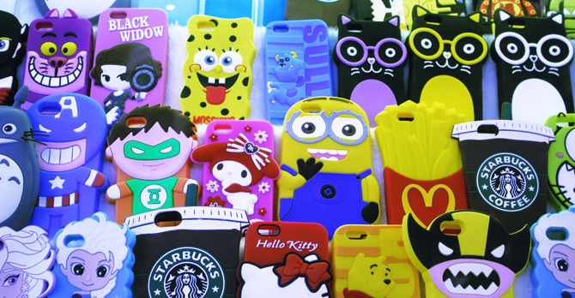
Examples
Image Source https://pxhere.com/en/photo/539113
Introduction to Design
Notes:
Duden: Kitsch: in Inhalt und Form geschmacklos

Slide 7
Examples
Image Source https://www.piqsels.com/sv/public-domain-photo-foqwd
Introduction to Design
Notes:
Duden: Kitsch: in Inhalt und Form geschmacklos

Slide 8
Disfunctional design
Alessi‘s Juicy Salif by Philippe Starck (1990)
Gold plated special edition comes with a little paper saying:
“Don‘t use this juicer to make juice. The acid will ruine the gold plating”
Don Norman: https://www.ted.com/talks/don_norman_3_ways_good_
design_makes_you_happy?language=de#t-49049
Image Source https://de.wikipedia.org/wiki/Alessi_(Design) by Niklas Morberg
Introduction to Design

Slide 9
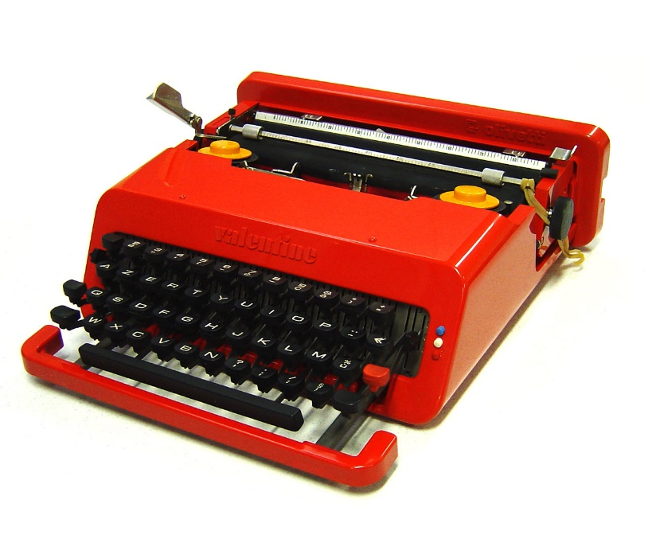
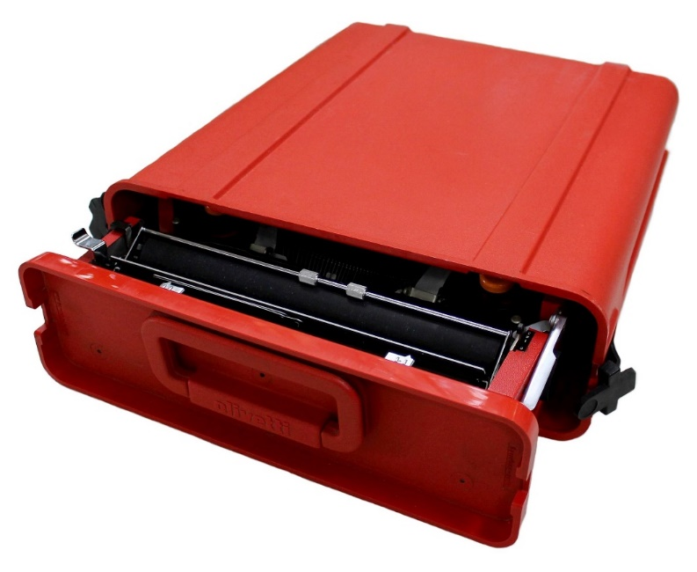
Design milestones
A portable typewriter Olivetti Valentine (1969)
For use “anyplace but an office
Used by David Bowie & Dieter Rahms
Image https://www.flickr.com/photos/bibliodyssey/2459300706 by Paul K
Image https://de.wikipedia.org/wiki/Olivetti_Valentine by Davide Casali
Introduction to Design
Notes:
Bowies Maschine wurde im November 2016 bei Sotheby's für 45.000 Pfund versteigert.

Slide 10
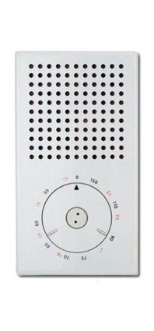
Design milestones
Braun T3 Pocket portable transistor radio by Dieter Rams (1958)
Apple’s iPod by Jonathan Ive: homage to the T3 design
Image Source https://commons.wikimedia.org/wiki/File:Jon_Ive_and_
Dieter_Rams_works.jpg by ArenysDep
Introduction to Design
Notes:
Bowies Maschine wurde im November 2016 bei Sotheby's für 45.000 Pfund versteigert.

Slide 11
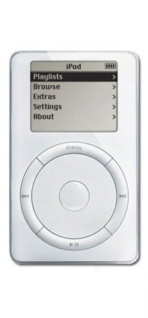
Design milestones
iPod portable music player (2001)
Jonathan Ive: Red Dot Design Award
More than an aesthetic design: entire ecosystem including an online shop
Image Source https://commons.wikimedia.org/wiki/File:Jon_Ive_and_
Dieter_Rams_works.jpg by ArenysDep
Introduction to Design
Notes:
Bowies Maschine wurde im November 2016 bei Sotheby's für 45.000 Pfund versteigert.

Slide 12
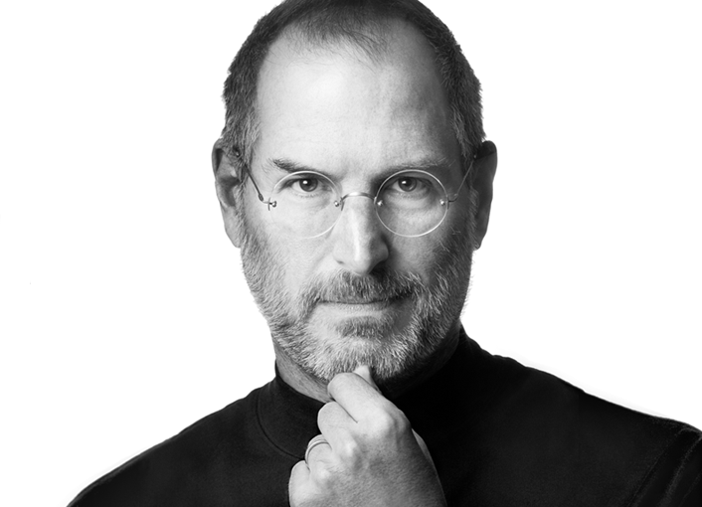
Perspectives on Design
Design is a funny word. Some people think design means how it looks. But of course, if you dig deeper, it's really how it works.
Seve Jobs 1996
Image Source https://www.flickr.com/photos/8010717@N02/6216457030 by Segagman
Introduction to Design

Slide 13
License
This file is licensed under the Creative Commons Attribution-Share Alike 4.0 (CC BY-SA) license:
https://creativecommons.org/licenses/by-sa/4.0
Attribution: Katrin Wolf
For more content see: https://hci-lecture.de

