Slide 1
Color

Slide 2
Affective Design
Don Norman 2001
Image Source https://www.pexels.com/photo/woman-sitting-on-the-floor-using-a-laptop-4050299/ by Vlada Karpovich
Color

Slide 3
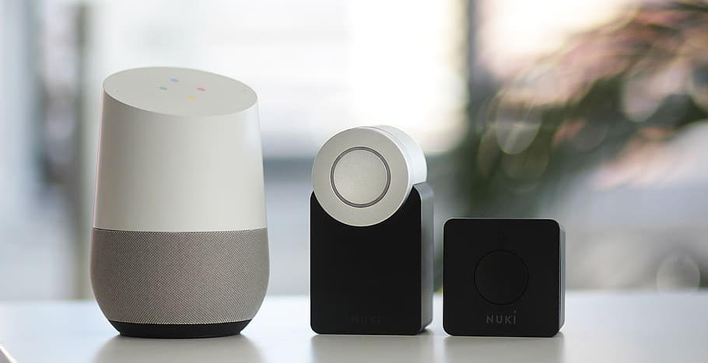
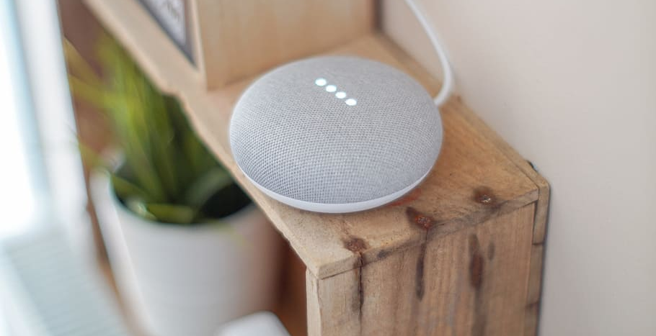
Affective Design
Don Norman 2001
Image Source https://www.wallpaperflare.com/round-grey-speaker-on-brown-board-gadget-google-assistant-google-home-wallpaper-azrel
Image Source https://www.wallpaperflare.com/electronics-speaker-audio-speaker-nuki-smart-lock-alexa-wallpaper-gtirc
Color

Slide 4
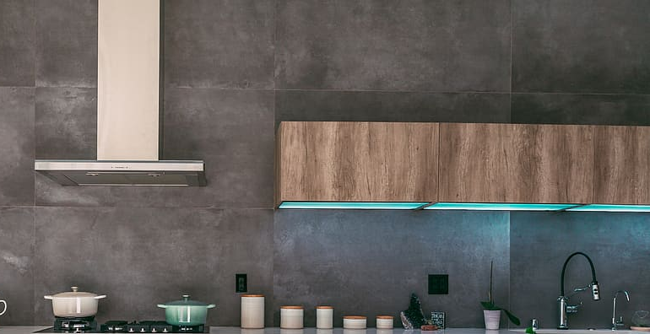
Affective Design
Don Norman 2001
Image Source https://www.wallpaperflare.com/indoors-room-kitchen-minimal-kitchen-le-creuset-modern-kitchen-wallpaper-eagjm
Color

Slide 5
Affective Design
Don Norman 2001
Image Source https://www.wallpaperflare.com/black-2-burner-stove-cooker-design-minimal-imola-italy-table-wallpaper-ekerm
Color

Slide 6
Everyday Product Design
No manuals & no time investment to understand UIs
Lifestyle & design artifacts instead of pure tech devices
Color

Slide 7
Affective Design
Attractive things work better.
Don Norman 2001
https://www.youtube.com/watch?v=RlQEoJaLQRA
Image Source https://www.flickr.com/photos/29022619@N03/6117336152 by Brighton 11
Color

Slide 8
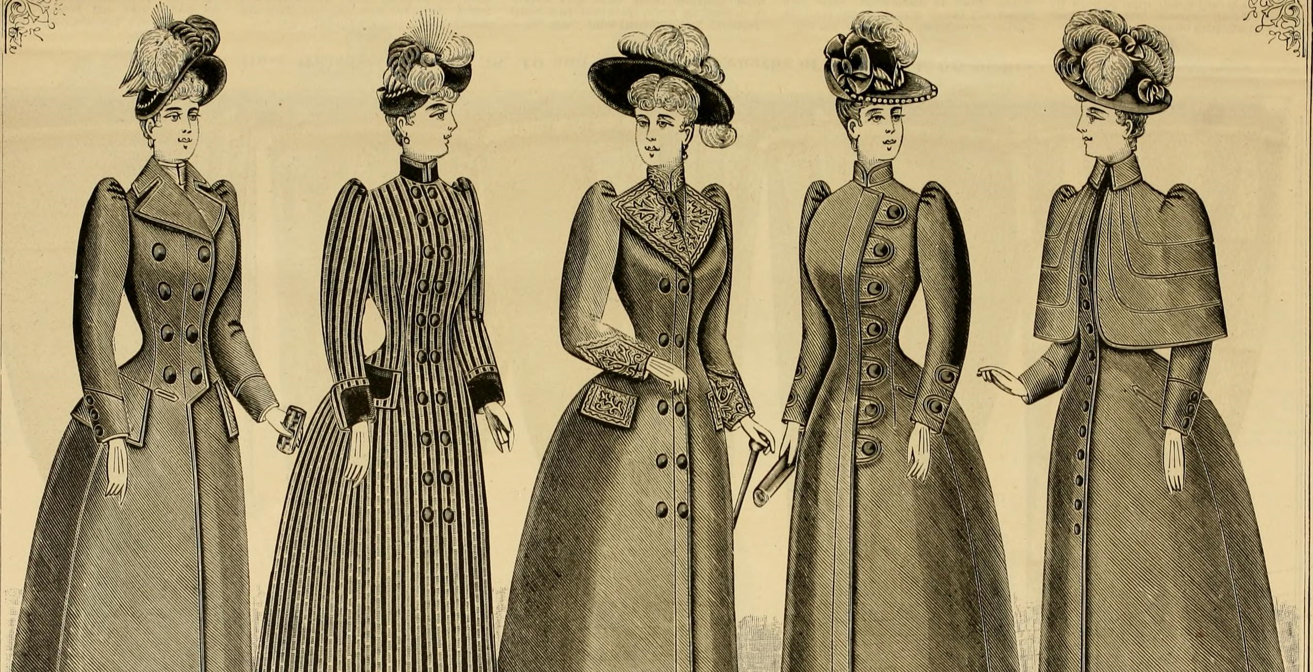
Affective Design
Image Source https://upload.wikimedia.org/wikipedia/commons/1/11/Fall_and_Winter%2C_1890-91_Fashion_Catalogue_-_H._O%27Neill_and_Co._%281890%29_%2814598233778%29.jpg
Color

Slide 9
Learning Goals
Influence of color on perception and cognition
Affects of color
Symbolic meaning of color
Interplay of complementary colors
Color

Slide 10
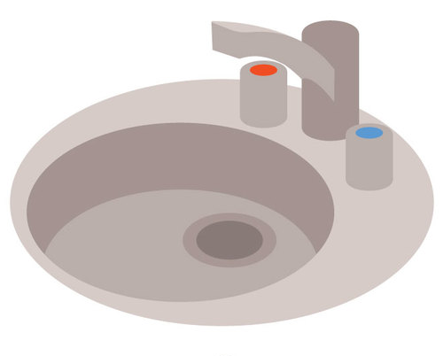
Color
Image Source https://publicdomainvectors.org/de/kostenlose-vektorgrafiken/K%C3%BCchensp%C3%BCle/79158.html
Color

Slide 11
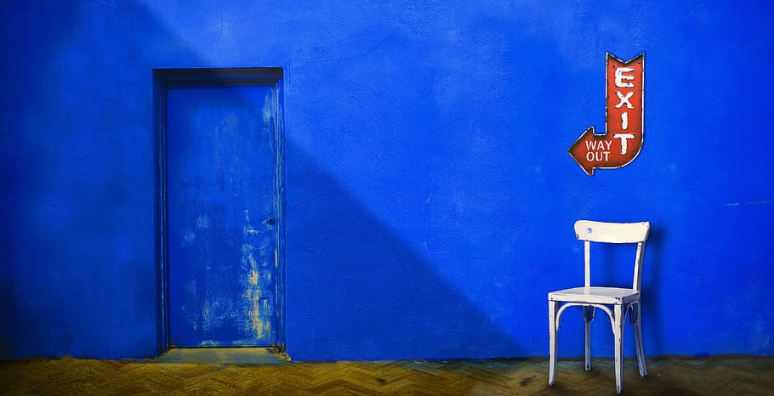
Color
Image Source https://www.wallpaperflare.com/blue-wall-city-and-urban-chair-chairs-color-colour-door-wallpaper-aziep & after https://www.pexels.com/photo/close-up-photography-of-body-of-water-1439227/ by Tim Mossholder
Paper on color affects: Ho, Hsin-Ni. (2015). Color-temperature correspondence and its impact on object temperature perception.
Color

Slide 12
Color
Cold blooded
Image After https://www.needpix.com/photo/20770/chat-language-communication-speech-conversation-message-symbol-sign
Color

Slide 13
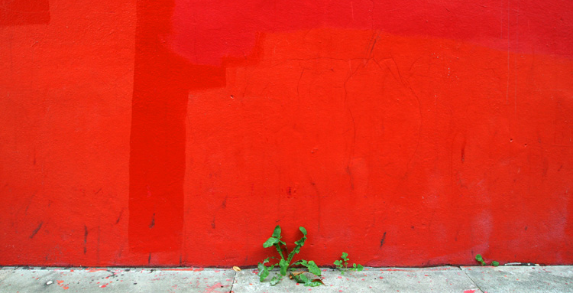
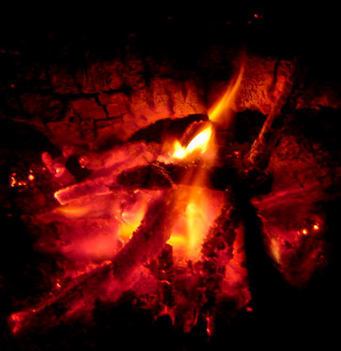
Color
Image Source https://www.flickr.com/photos/fotologic/269171407 by fotologic & https://upload.wikimedia.org/wikipedia/de/c/c8/Glut.jpg by Summi
Color

Slide 14
Color
Warm regards
Image After https://www.needpix.com/photo/20770/chat-language-communication-speech-conversation-message-symbol-sign
Color

Slide 15
Color
Image After https://www.needpix.com/photo/20770/chat-language-communication-speech-conversation-message-symbol-sign.
Color

Slide 16
Color
Image After https://www.needpix.com/photo/20770/chat-language-communication-speech-conversation-message-symbol-sign & https://de.m.wikipedia.org/wiki/Datei:Stop_sign.png by Dbenbenn
Color

Slide 17
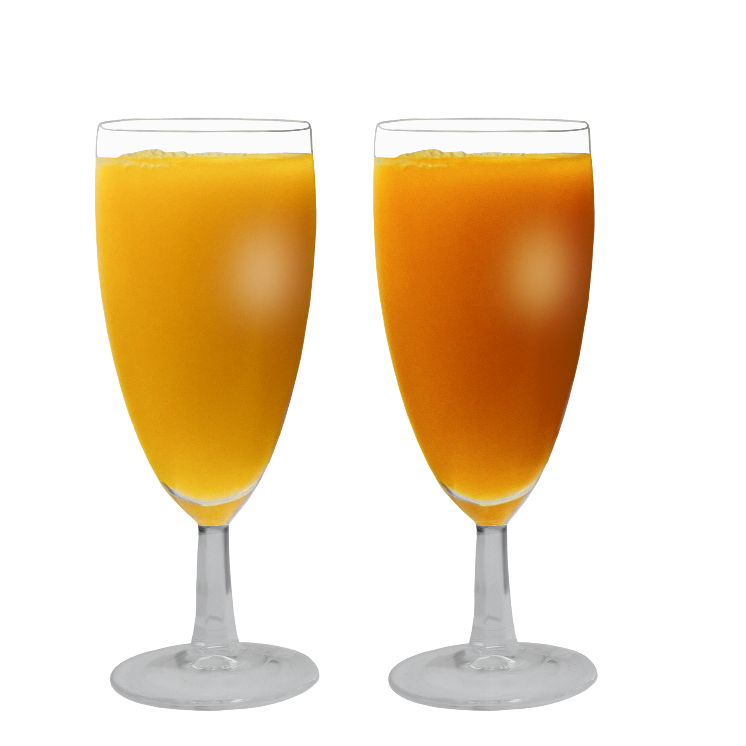
Color
Image After https://www.flickr.com/photos/160866001@N07/48913239888 by Marco Verch
Paper on color affect S. Bayarri, C. Calvo, E. Costell, and L. Duran, "Influence of color on perception ofsweetness and fruit
flavor of fruit drinks," Food Science and Technology International, vol. 7, pp. 399–404, 2001..
Color
Notes:
Color (saturation) enhanced perception of sweet taste in orange drinks and of typical flavors in peach-, kiwifruit-, orange-, and berries-based beverages

Slide 18
Color
The brain integrates visual biasing multimodal perception toward expectations¹
Color biases perception of
Temperature
Taste
Smell
¹ M. O. Ernst and M. S. Banks, "Humans integrate visual and haptic information in a statistically optimal fashion," 2002.
Color

Slide 19
What we have learnt
The brain stores memory in association with emotions (conditioning)
Color (also) biases cognition of cultural meanings as symbols
Black -> dead (in West Europe)
White -> dead (in Japan)
In pre-attentive processing, some colors are harder to filter (red)
attention of some colors (red) is higher
Colors serve as depth cues
blue -> far away
Color
Notes:
Filtering in attention + memory
Depth cues in cognition

Slide 20
Influence of Color
 | Attention | Depth perception | Affection | Symbolic meaning
 | Salient in contrast to dark | Objects appear larger & ligher | Neutral | Innocence (Western world), mourning (JP, CN), purity (Catholicism)
 | Very salient | Objects appear closer | Warm, arousing | Passion, love, fire, blood, power (Renaissance)
 | Salient | Obj. closer | Activating
 | Very salient | Obj. larger | Exhilarating | Sun, light, envy
 | Little salient | Obj. further away | Calming | Spring, hope, paradise, ecology (lately)
 | Very little salient | Obj. appear far away | Cool, depressing | Truth, air, water, loyality, poverty (Renaissance)
 | Little salient | Obj. smaller | Ceremonial | Magic, wealth (antiquity)
 | Not salient |  |  | Earth, autumn, humbleness (Cath.)
 | Salient in contrast to light colors | Objects appear smaller & heavier | Scaring | Mourning (West. W.), night, death, damnation, comtempt for the world
Color
Notes:
Arousing – erregend
Exhilarating – erheiternd
Envy – Neid
Humbleness - Demut
Damnation – Vernichtung
Contempt - Verachtung

Slide 21
Size & Weight
Color

Slide 22
Size and Weight
Color

Slide 23
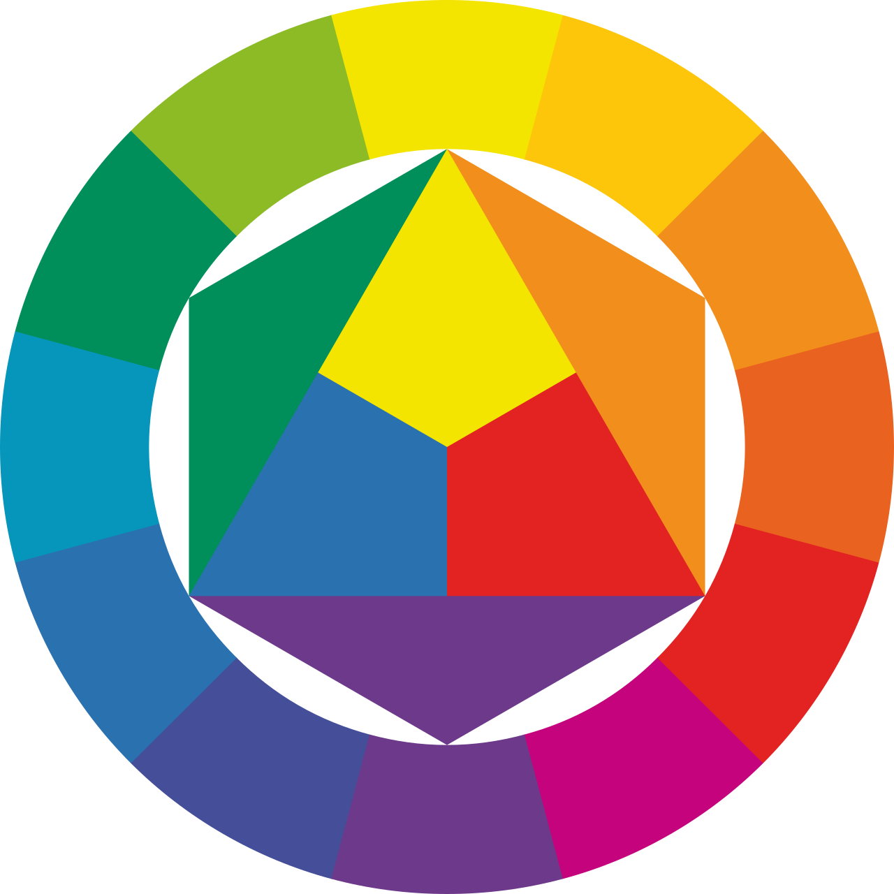
Complementary Colors
Image Source https://de.wikipedia.org/wiki/Farbkreis#/media/Datei:Farbkreis_Itten_1961.svg by SidShakal
Color

Slide 24
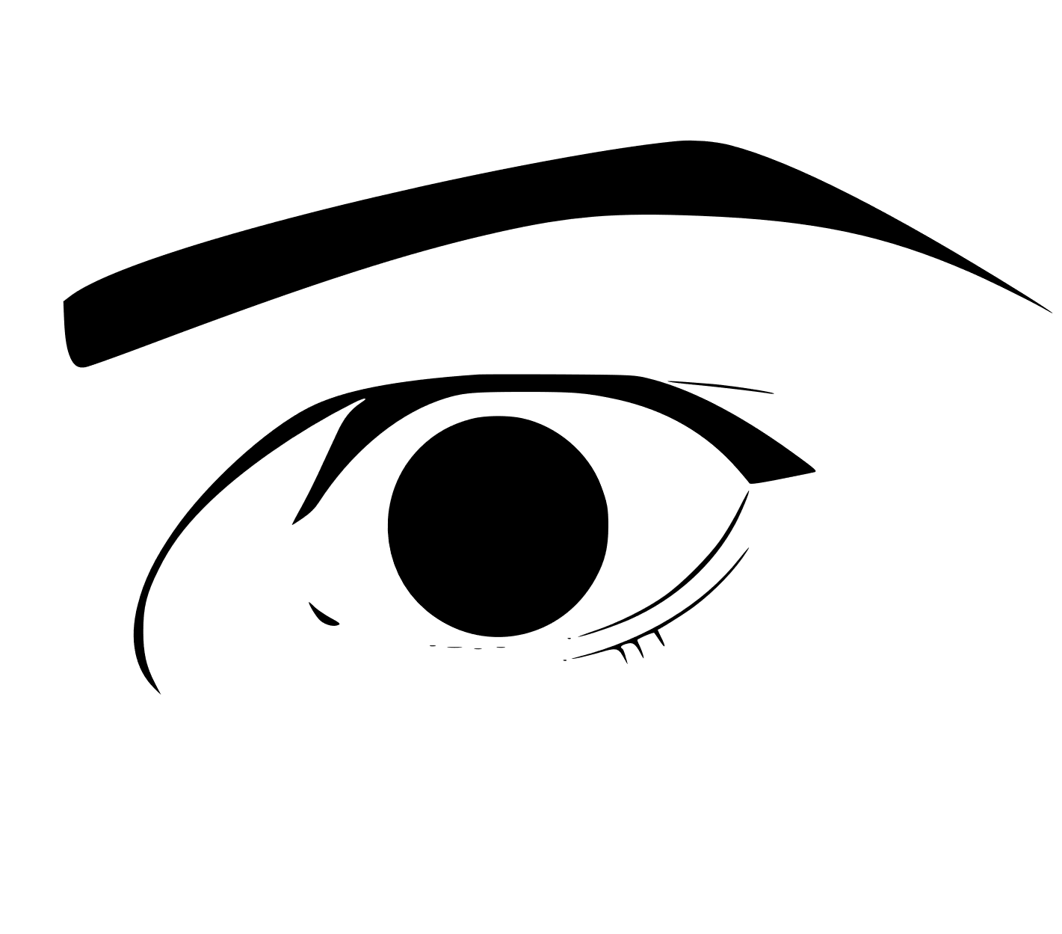
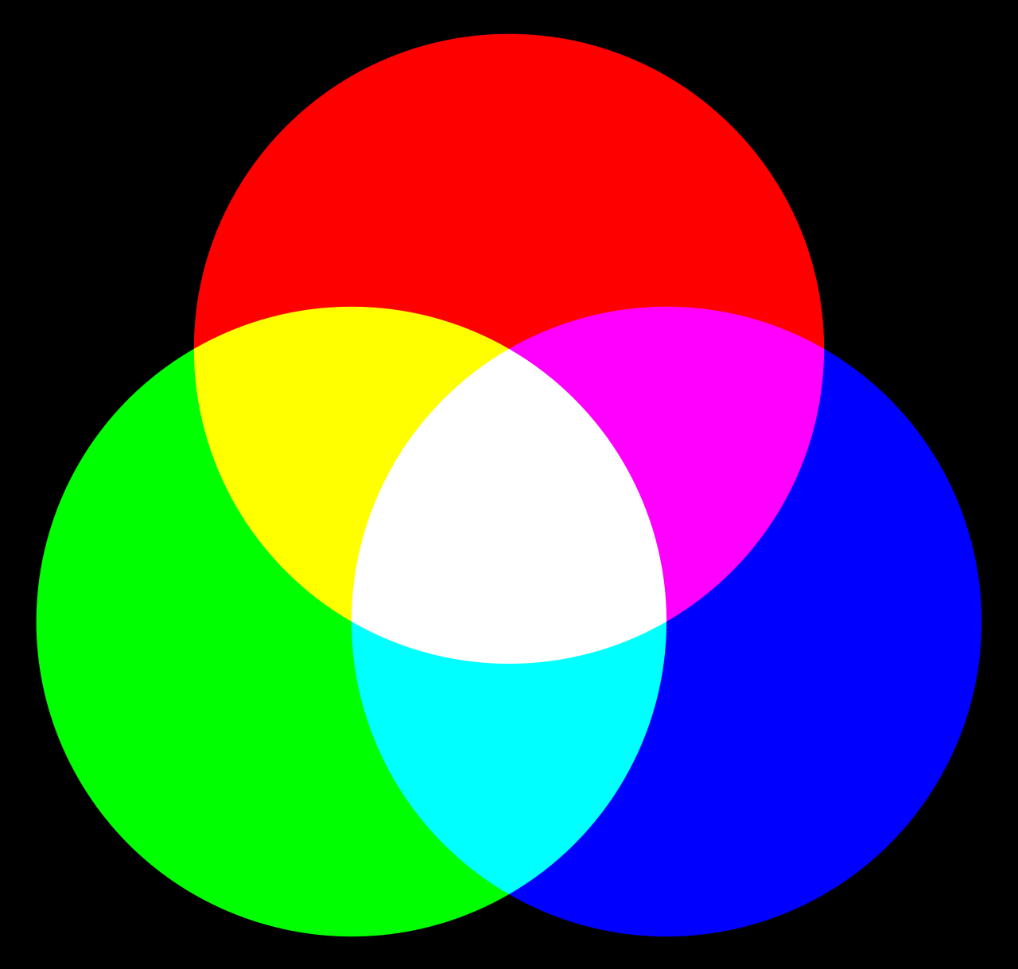
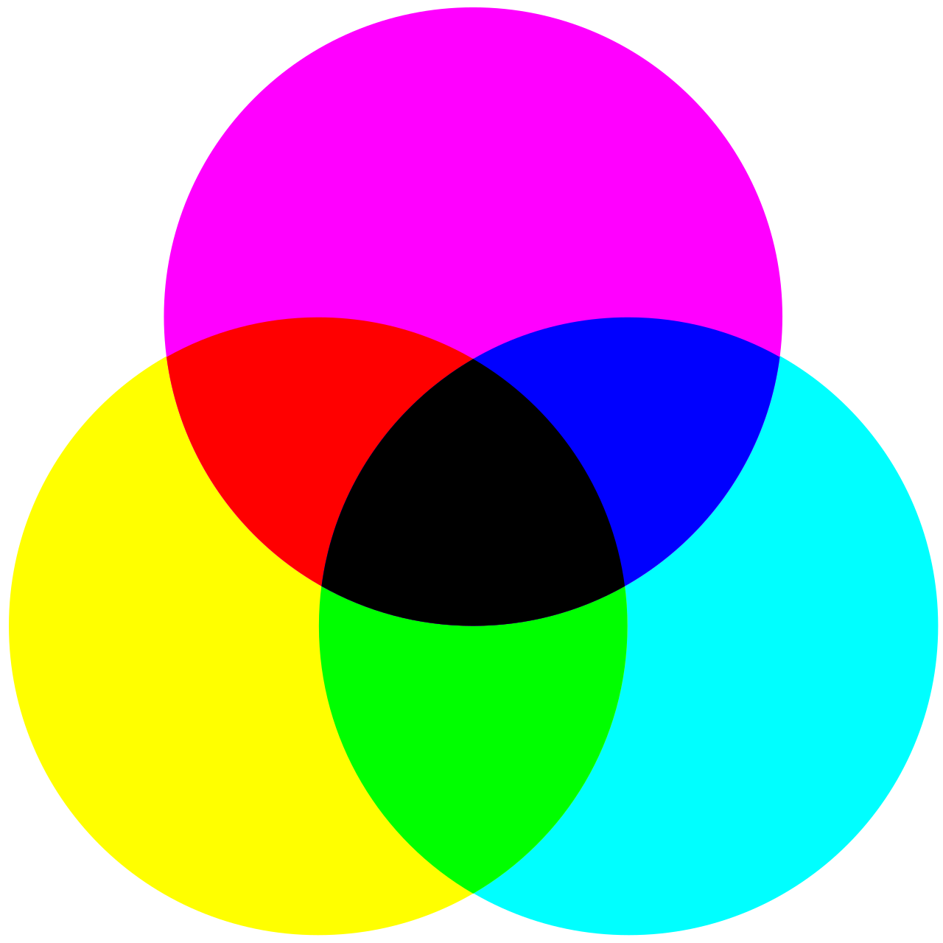
Complementary Colors
Increase their perceived saturation in proximity
Add up to white in the additive color system
Add up to black in the substractive color system
+ + =
Image Source https://svgsilh.com/image/149670.html & https://de.wikipedia.org/wiki/Subtraktive_Farbmischung#/media/Datei:CMY_ideal_version_rotated.svg
by ToBeFree & https://upload.wikimedia.org/wikipedia/commons/b/b6/NIEdot367.jpg by Velocicaptor~commonswiki
Color

Slide 25
Complementary Colors
Image Source https://de.wikipedia.org/wiki/Additive_Farbmischung#/media/Datei:Synthese+.svg by Quark67
Color

Slide 26
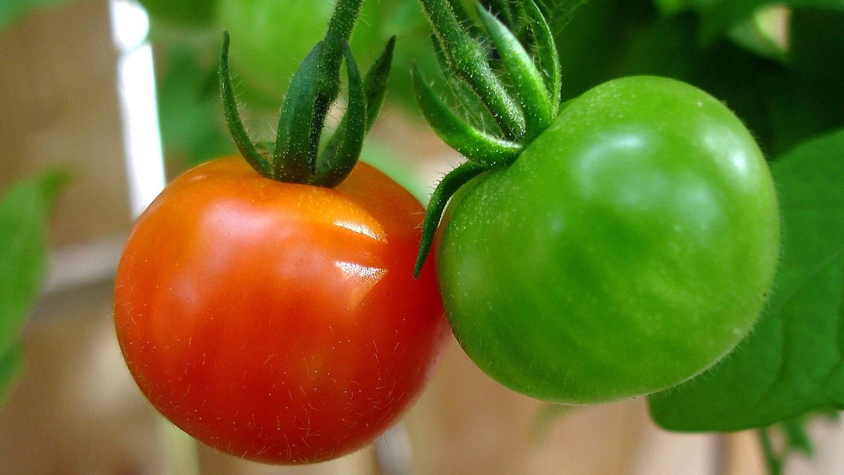
Influence of Color
Image Source https://commons.wikimedia.org/wiki/File:Cherry_tomatoes_red_and_green_2009_16x9.jpg by WikiPedant
Color

Slide 27
License
This file is licensed under the Creative Commons Attribution-Share Alike 4.0 (CC BY-SA) license:
https://creativecommons.org/licenses/by-sa/4.0
Attribution: Katrin Wolf
For more content see: https://hci-lecture.de

