Slide 1
Composition

Slide 2
Learning Goals
Balanced composition
Golden cut
Examples in UI design
Composition

Slide 3
Influence of Composition
Composition

Slide 4
Influence of Composition
Composition

Slide 5
Influence of Composition
Composition

Slide 6
Influence of Composition
Composition

Slide 7
Influence of Composition
Composition

Slide 8
Influence of Composition
Balance -> harmony
Unbalanced composition -> discomfort
Image Source https://www.pxfuel.com/en/free-photo-qjmmb
Composition

Slide 9
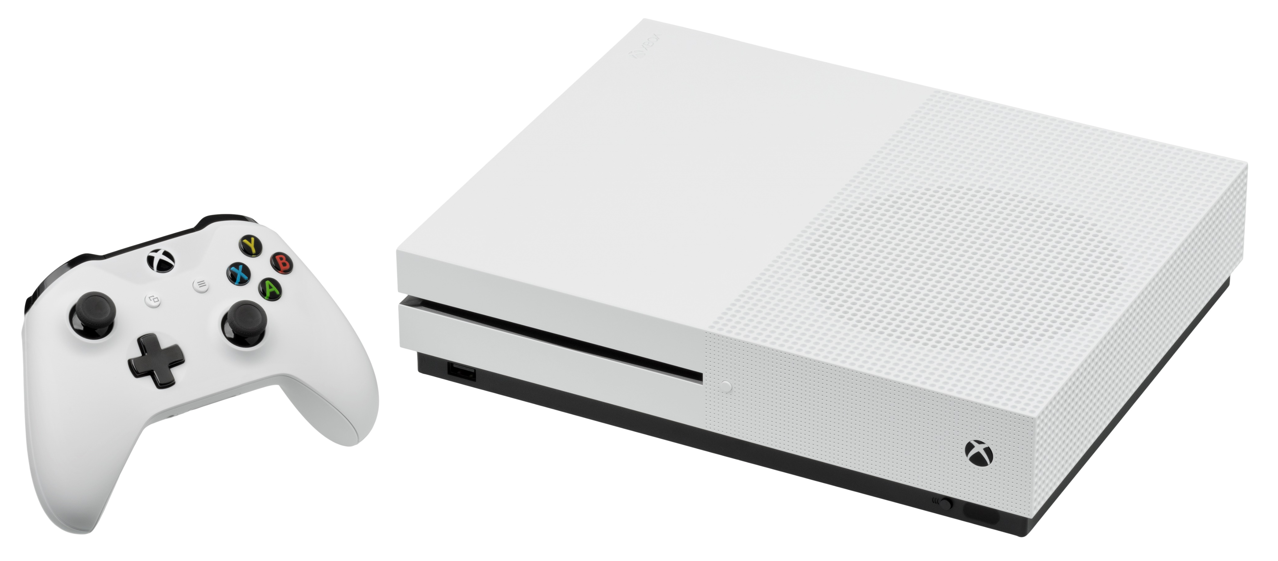
Influence of Composition
Image https://commons.wikimedia.org/wiki/File:Microsoft-Xbox-One-S-Console-wController-L.jpg by Evan-Amos
Composition

Slide 10
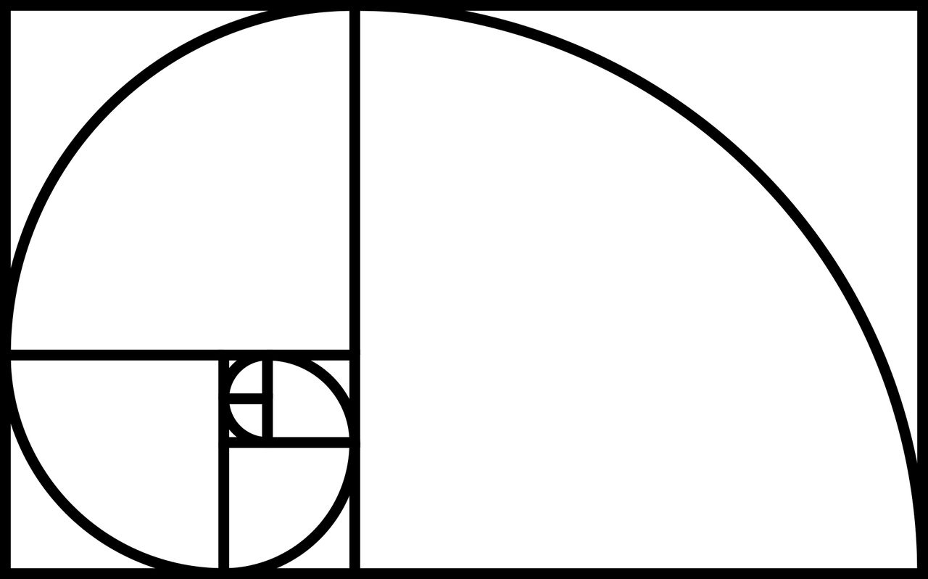
Influence of Composition
ca. 38.2% ca. 61.8%
Image Source https://www.needpix.com/photo/710589/fibonacci-spiral-science-golden-ratio-nature-math-mathematics-sequence
Composition

Slide 11
Influence of Composition
Composition

Slide 12
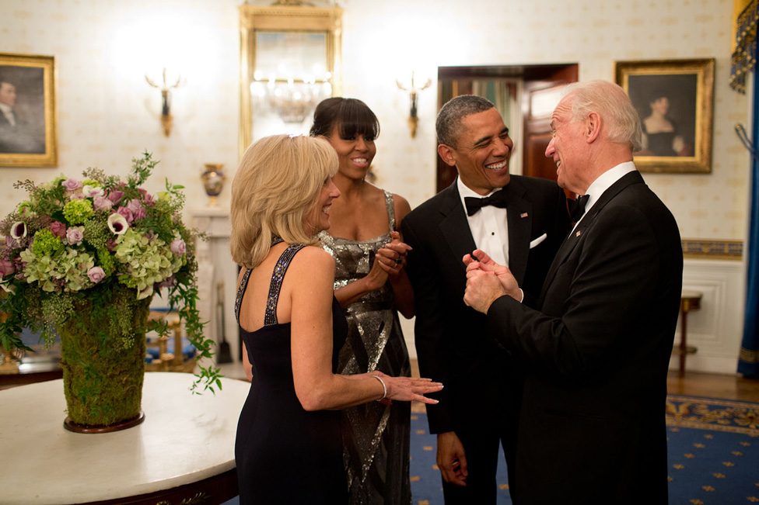
Influence of Composition
https://obamawhitehouse.archives.gov/photos-and-video/2013-photos
Composition

Slide 13
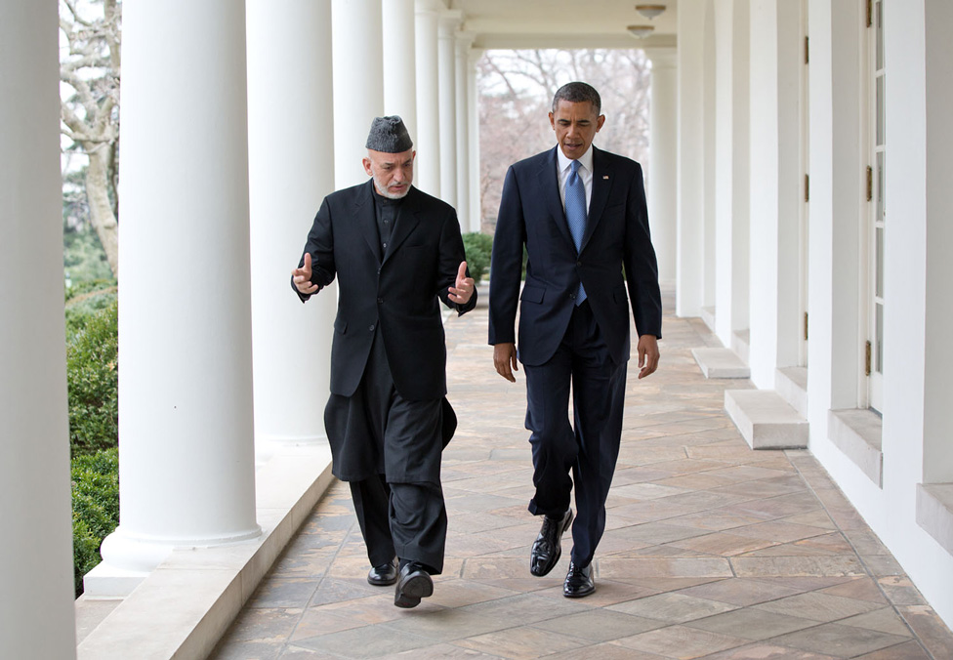
Influence of Composition
https://obamawhitehouse.archives.gov/photos-and-video/2013-photos
Composition

Slide 14
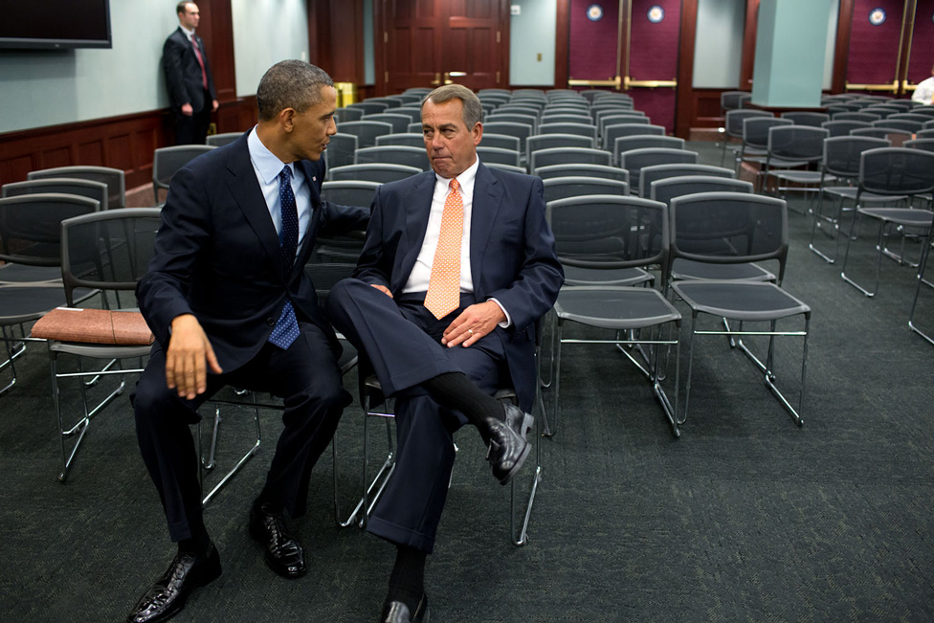
Influence of Composition
https://obamawhitehouse.archives.gov/photos-and-video/2013-photos
Composition

Slide 15
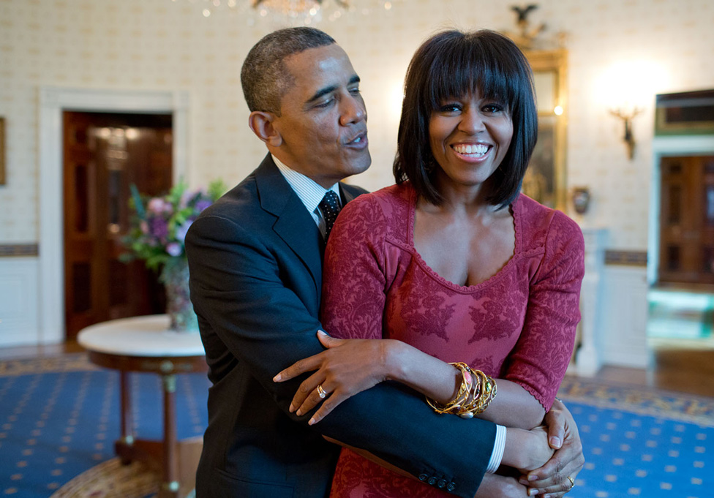
Influence of Composition
https://obamawhitehouse.archives.gov/photos-and-video/2013-photos
Composition

Slide 16
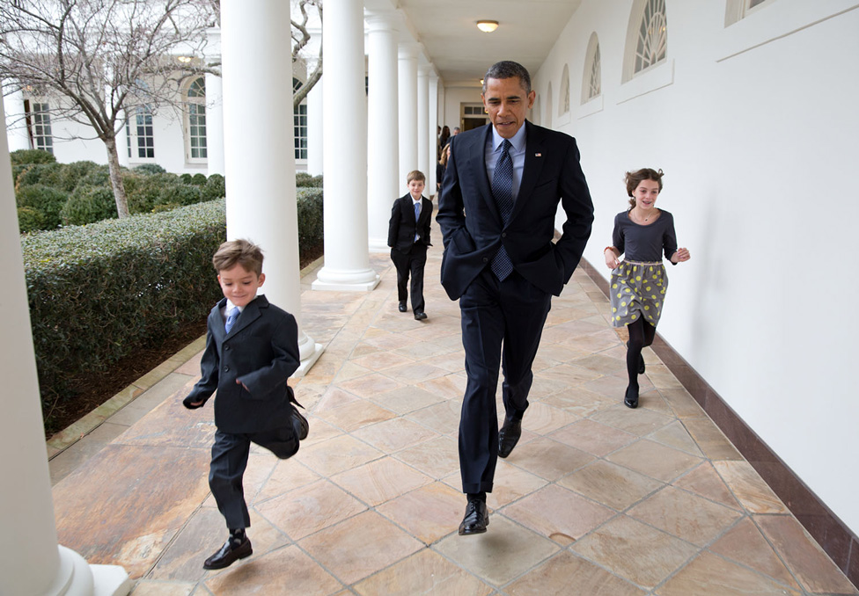
Influence of Composition
https://obamawhitehouse.archives.gov/photos-and-video/2013-photos
Composition

Slide 17
Influence of Composition
https://commons.wikimedia.org/wiki/File:A_few_of_my_best_memories_as_a_Photographer._-_Flickr_-_Christopher.Michel_(20).jpg by Matanya
Composition

Slide 18
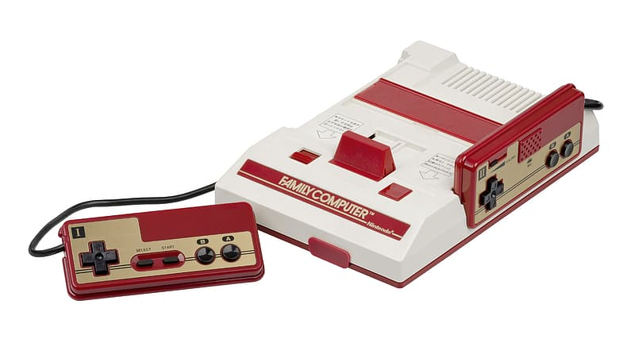
Influence of Composition
Image https://www.pikrepo.com/friuy/white-and-red-family-computer-console-and-two-gamepads
Composition

Slide 19
License
This file is licensed under the Creative Commons Attribution-Share Alike 4.0 (CC BY-SA) license:
https://creativecommons.org/licenses/by-sa/4.0
Attribution: Katrin Wolf
For more content see: https://hci-lecture.de

