Slide 1
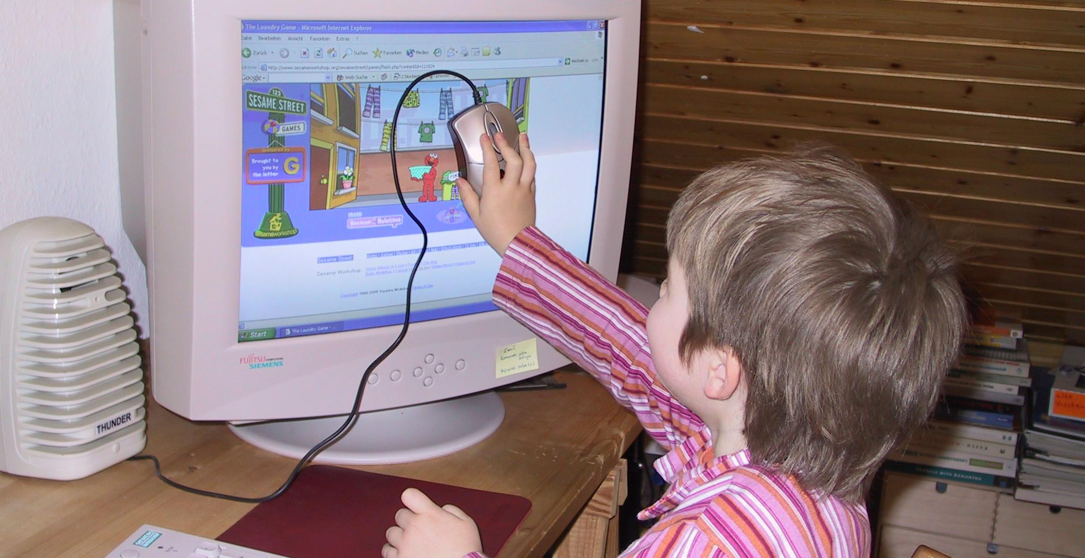
Why is Human-Computer Interaction Important?
Notes:
Foto Albrecht Schmidt,

Slide 2
Learning Goals
Understand …
how user interfaces impacts our interaction and relationship with (digital) technologies
why interaction is relevant from different perspectives (user, companies)
why designing interaction is becoming more relevant as technology advances
Be able to …
explain the economic implications of bad usability
sketch a user interface and discuss different aspects
explain why interaction is a visible innovation
Why is Human-Computer Interaction Important?

Slide 3
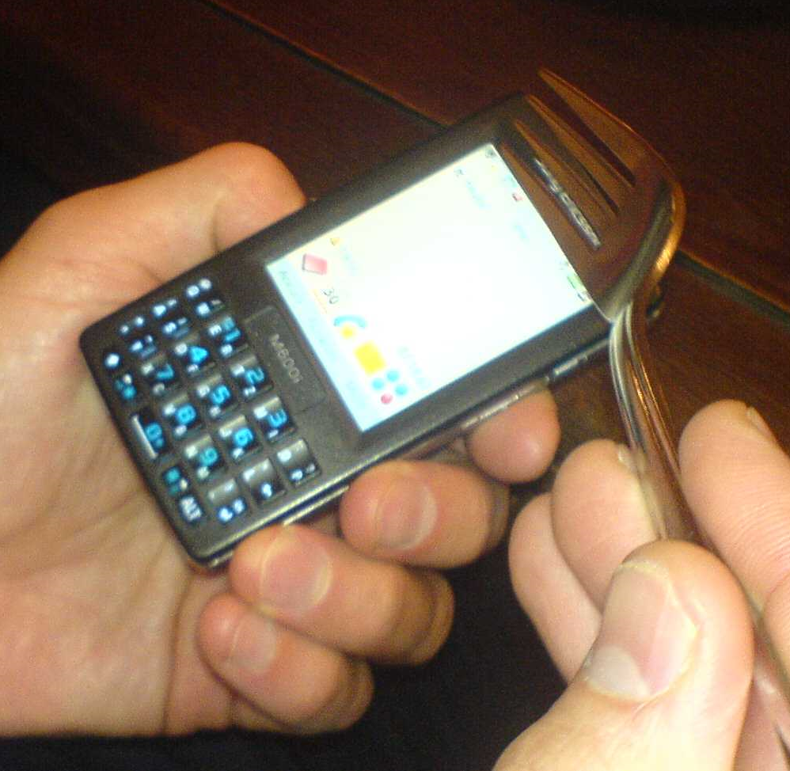
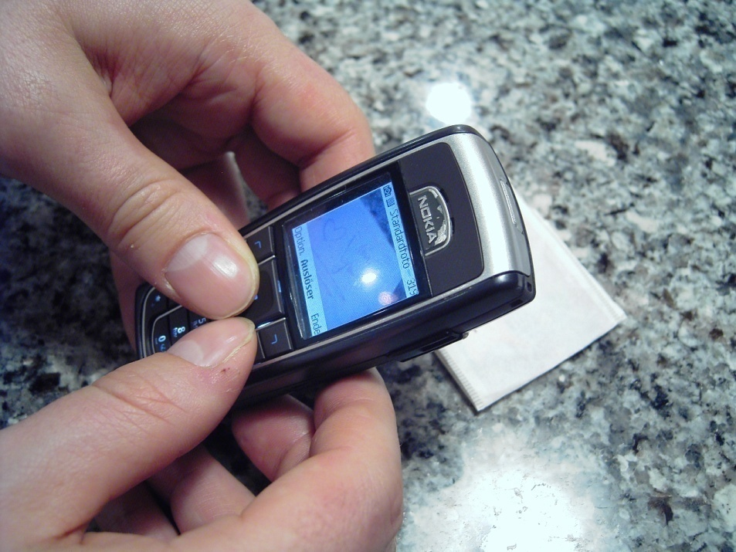
Human-Computer Interaction
How does Human-Computer Interaction impact us?
It determines how we use (digital) products.
For examples it impacts…
what we can do with products and services,
how easy or hard it is to work with a software,
how quickly you can learn to use a system, or
how safe a product is.
It is central to how we feel and what we experience while interacting with digital technologies.
Why is Human-Computer Interaction Important?
Notes:
Fotos Albrecht

Slide 4
Let‘s start with a discussion
Pause the video an write 5 points for each question!
Why is it important that a (digital) product is ease to use?
.
.
.
.
.
What does it mean that a product is usable?
.
.
.
.
.
Why is Human-Computer Interaction Important?

Slide 5
Why is Usability Important?
Products that are easy to use a good for business.
Improving usability can
increase productivity of users,
reduce costs (support, efficiency),
increase sales/revenue (web shop),
enhance customer loyalty, or
win new customers.
Case studies that show the benefit of usability
Usability is often considered as sign of quality
Usability gives a competitive advantage.
Why is Human-Computer Interaction Important?
Notes:
Freies Foto,
https://pixabay.com/de/photos/grafik-diagramm-investitionen-4737109/

Slide 6
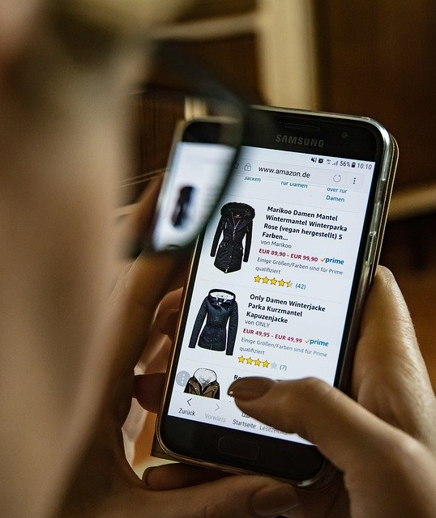
Why Focus on User and Interaction?
How to discriminate your product or service?
Traditionally product discrimination is by functionality and price
Why should a customer pick you, if competitors offer very similar functions (e.g. messaging services) at similar prices (e.g. payed by advertising)?
Your product is easier to use?
You get your tasks done faster?
You have more fun doing what you want to do?
Why is Human-Computer Interaction Important?
Notes:
Freies Foto,
https://pixabay.com/de/photos/online-shopping-kleidung-handy-2900303/

Slide 7
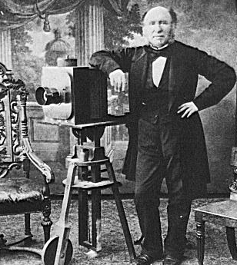
Why Focus on User and Interaction?
Trends that make Human-Computer interaction more important
It becomes harder to discriminate by technology
Availability of bandwidth, storage and processing
New input and output technologies
Computing becomes part of many traditional devices
Willingness for training or learning applications decreases
Life-style technologies are more and more digital
Broad and diverse user groups
Majority of user are not interested in the technology
New understanding of computing
The old question: What can computers do?
The new question: What can humans do with computers?
Book by Ben Shneiderman: Leonardo's Laptop
B. Shneiderman. Leonardo's Laptop: Human Needs and the New Computing Technologies. 2002.
Why is Human-Computer Interaction Important?
Notes:
Foto public domain: https://commons.wikimedia.org/wiki/File:Photographer1850s.png

Slide 8
Economic dimension of Usability?
Importance in the Context of WWW, Apps and New Media?
User Interface is often the central discriminating factor
Often the same product/service is sold at very similar prices
Competition is very close (just another App, browser tab, …)
Comparison is easily possible
Examples: Online-Shop
Users who cannot find the product in the shop cannot buy it
Users who can fill in the payment form are not going to buy
Users who worry if the item fits them are less likely to buy
Typically a direct correlation between usability and sales
“Bad Usability is Like a Leaky Pipe” https://90percentofeverything.com/2006/11/13/bad-usability-is-like-a-leaky-pipe/
Why is Human-Computer Interaction Important?
Notes:
Photo Public Domain
https://pxhere.com/en/photo/819327
https://get.pxhere.com/photo/water-drop-fall-wet-old-summer-environment-spray-natural-metal-fresh-clean-garden-material-drip-fire-hydrant-pour-tap-background-faucet-seep-hose-estate-spout-shiny-connection-dripping-household-valve-plumbing-h20-connector-plumber-irrigate-dingy-plumb-spigot-stopcock-819327.jpg

Slide 9
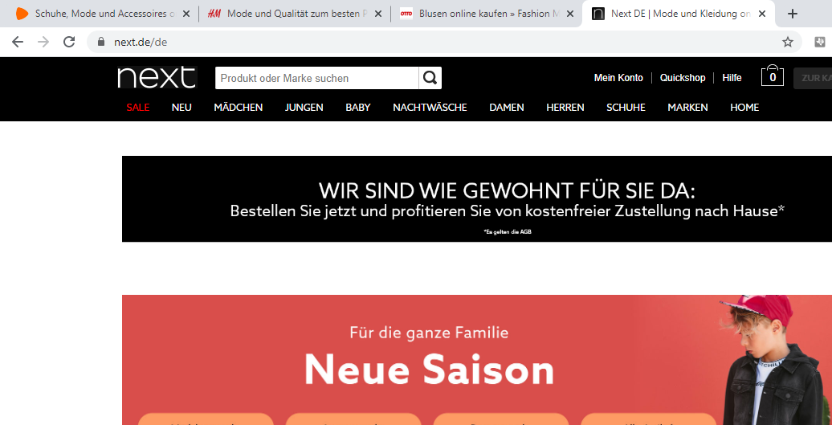
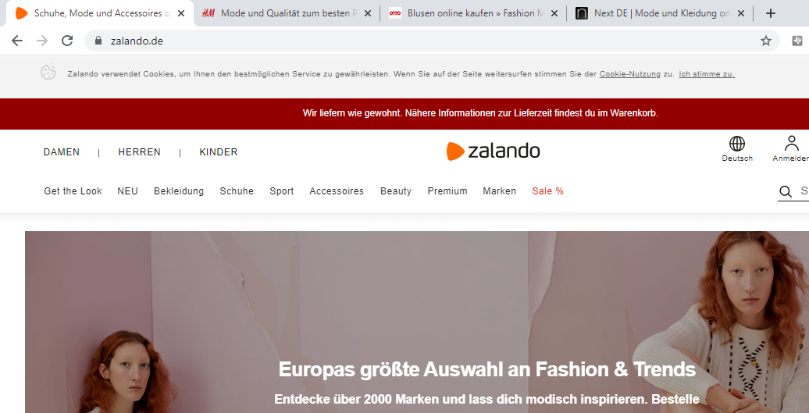
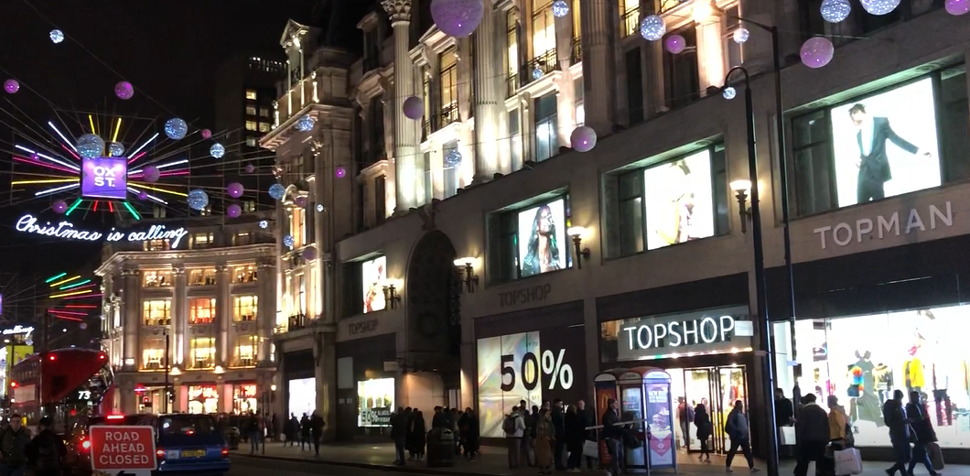
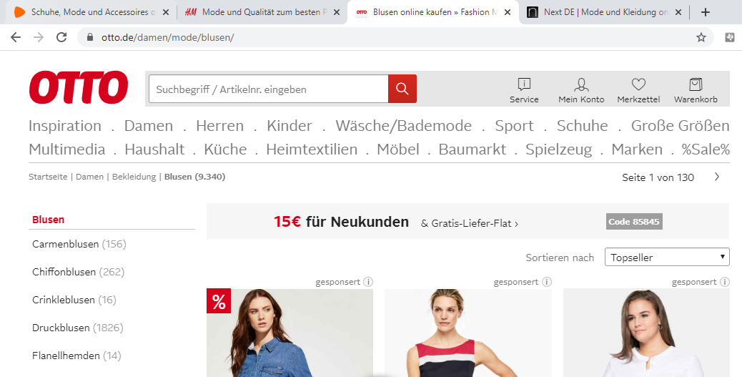
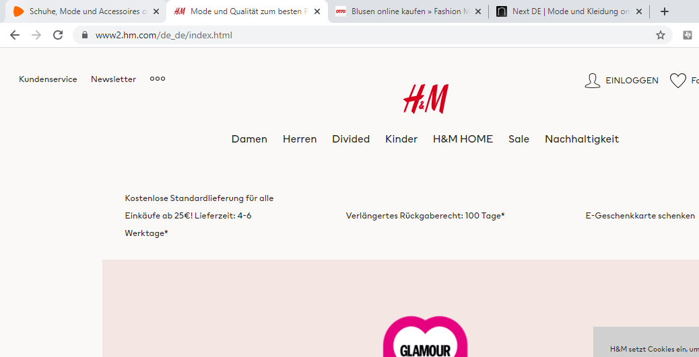
Economic dimension of Usability?
Importance in the Context of WWW, Apps and New Media?
User Interface is often the central discriminating factor
Often the same product/service is sold at very similar prices
Competition is very close (just another App, browser tab, …)
Comparison is easily possible
Examples: Online-Shop
Users who cannot find the product in the shop cannot buy it
Users who can fill in the payment form are not going to buy
Users who worry if the item fits them are less likely to buy
Typically a direct correlation between usability and sales
Why is Human-Computer Interaction Important?
Notes:
Screenshots and Foto Albrecht
Example – page: https://www.zalando.de/; https://www2.hm.com/de_de/index.html; https://www.otto.de/damen/mode/blusen/; https://www.next.de/de

Slide 10
Concerns in Human-Computer Interaction
Science, Engineering, and Design Aspects
The joint performance of tasks by humans and machines
The structure of communication between humans and machines
Human capabilities to use machines (including the learnability of interfaces)
Engineering concerns that arise in designing and building interfaces
The process of specification, design, and implementation of interfaces
Design trade-offs
Algorithms and programming of the user interface itself
Why is Human-Computer Interaction Important?

Slide 11
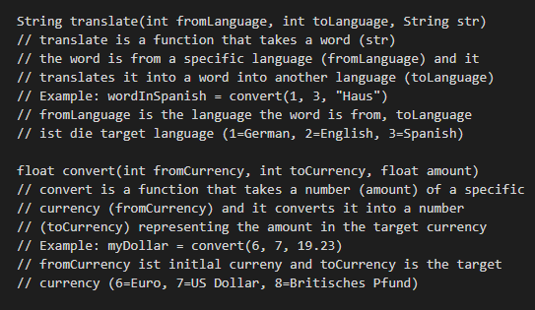
Example: Sketch an Interface
How would a user interface that includes both functions look like? Make sketches for 2 alternative interfaces.
Why is Human-Computer Interaction Important?
Notes:
String translate(int fromLanguage, int toLanguage, String str)
// translate is a function that takes a word (str)
// the word is from a specific language (fromLanguage) and it
// translates it into a word into another language (toLanguage)
// Example: wordInSpanish = convert(1, 3, "Haus")
// fromLanguage is the language the word is from, toLanguage
// ist die target language (1=German, 2=English, 3=Spanish)
float convert(int fromCurrency, int toCurrency, float amount)
// convert is a function that takes a number (amount) of a specific
// currency (fromCurrency) and it converts it into a number
// (toCurrency) representing the amount in the target currency
// Example: myDollar = convert(6, 7, 19.23)
// fromCurrency ist initlal curreny and toCurrency is the target
// currency (6=Euro, 7=US Dollar, 8=Britisches Pfund)

Slide 12
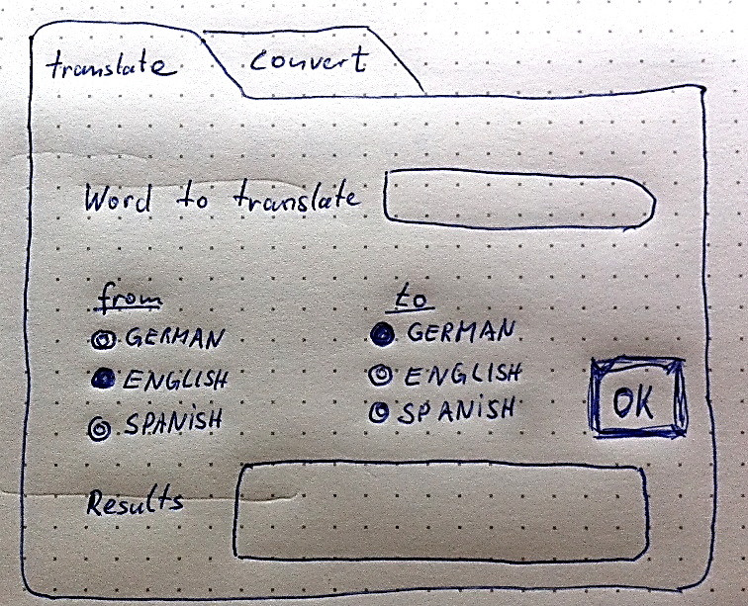
Example: Sketch an Interface
How would a user interface that includes both functions look like? Make sketches for 2 alternative interfaces.
gift
Geschenk
Why is Human-Computer Interaction Important?
Notes:
Sketches Albrecht
String translate(int fromLanguage, int toLanguage, String str)
// translate is a function that takes a word (str)
// the word is from a specific language (fromLanguage) and it
// translates it into a word into another language (toLanguage)
// Example: wordInSpanish = convert(1, 3, "Haus")
// fromLanguage is the language the word is from, toLanguage
// ist die target language (1=German, 2=English, 3=Spanish)
float convert(int fromCurrency, int toCurrency, float amount)
// convert is a function that takes a number (amount) of a specific
// currency (fromCurrency) and it converts it into a number
// (toCurrency) representing the amount in the target currency
// Example: myDollar = convert(6, 7, 19.23)
// fromCurrency ist initlal curreny and toCurrency is the target
// currency (6=Euro, 7=US Dollar, 8=Britisches Pfund)

Slide 13
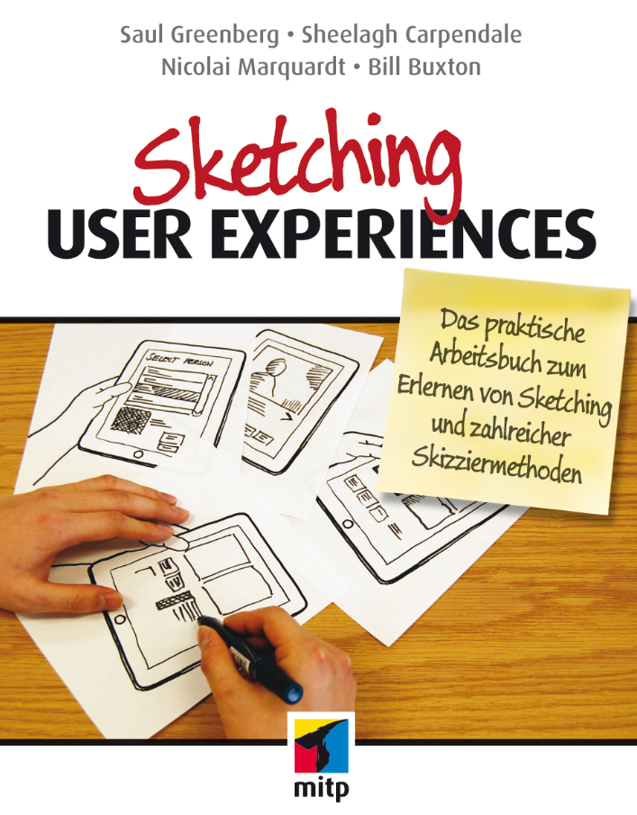
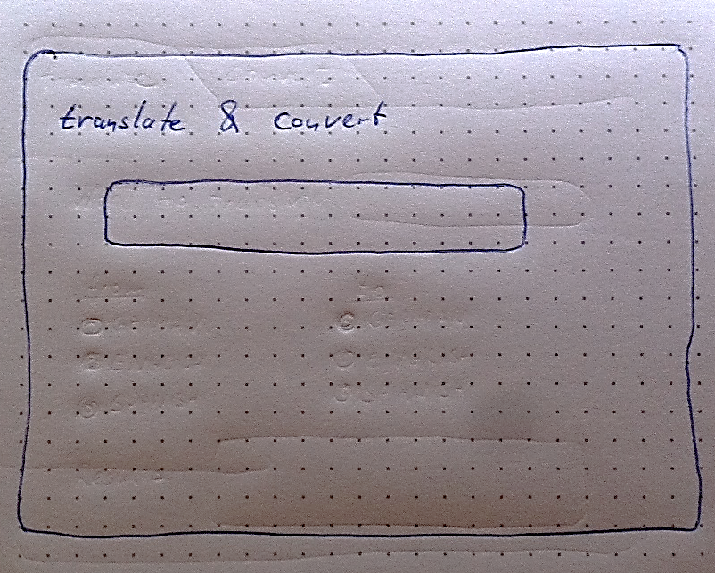
Example: Sketch an Interface
How would a user interface that includes both functions look like? Make sketches for 2 alternative interfaces.
gift
https://www.mitp.de/IT-WEB/Software-Entwicklung/Sketching-User-Experiences.html
das Geschenk : gift : el regalo
das Gift : poison : el veneno
Why is Human-Computer Interaction Important?
Notes:
Sketches Albrecht
String translate(int fromLanguage, int toLanguage, String str)
// translate is a function that takes a word (str)
// the word is from a specific language (fromLanguage) and it
// translates it into a word into another language (toLanguage)
// Example: wordInSpanish = convert(1, 3, "Haus")
// fromLanguage is the language the word is from, toLanguage
// ist die target language (1=German, 2=English, 3=Spanish)
float convert(int fromCurrency, int toCurrency, float amount)
// convert is a function that takes a number (amount) of a specific
// currency (fromCurrency) and it converts it into a number
// (toCurrency) representing the amount in the target currency
// Example: myDollar = convert(6, 7, 19.23)
// fromCurrency ist initlal curreny and toCurrency is the target
// currency (6=Euro, 7=US Dollar, 8=Britisches Pfund)

Slide 14
Example: Sketch an Interface
How would a user interface that includes both functions look like? Make sketches for 2 alternative interfaces.
366
https://www.mitp.de/IT-WEB/Software-Entwicklung/Sketching-User-Experiences.html
€366,00 : £299,56 : $482,80
€447,18 : £366,0 : $589,92
€277,46 : £227,08 : $366,00
Why is Human-Computer Interaction Important?
Notes:
Sketches Albrecht
String translate(int fromLanguage, int toLanguage, String str)
// translate is a function that takes a word (str)
// the word is from a specific language (fromLanguage) and it
// translates it into a word into another language (toLanguage)
// Example: wordInSpanish = convert(1, 3, "Haus")
// fromLanguage is the language the word is from, toLanguage
// ist die target language (1=German, 2=English, 3=Spanish)
float convert(int fromCurrency, int toCurrency, float amount)
// convert is a function that takes a number (amount) of a specific
// currency (fromCurrency) and it converts it into a number
// (toCurrency) representing the amount in the target currency
// Example: myDollar = convert(6, 7, 19.23)
// fromCurrency ist initlal curreny and toCurrency is the target
// currency (6=Euro, 7=US Dollar, 8=Britisches Pfund)

Slide 15
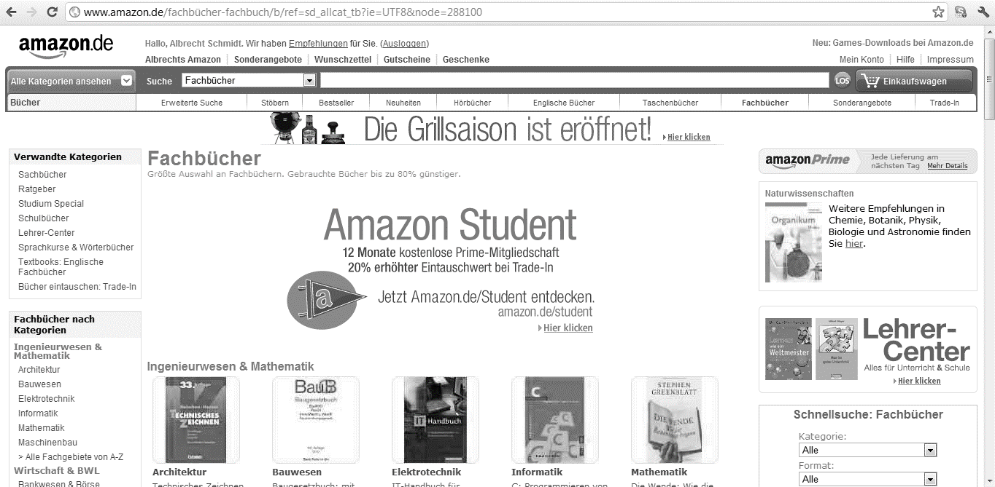
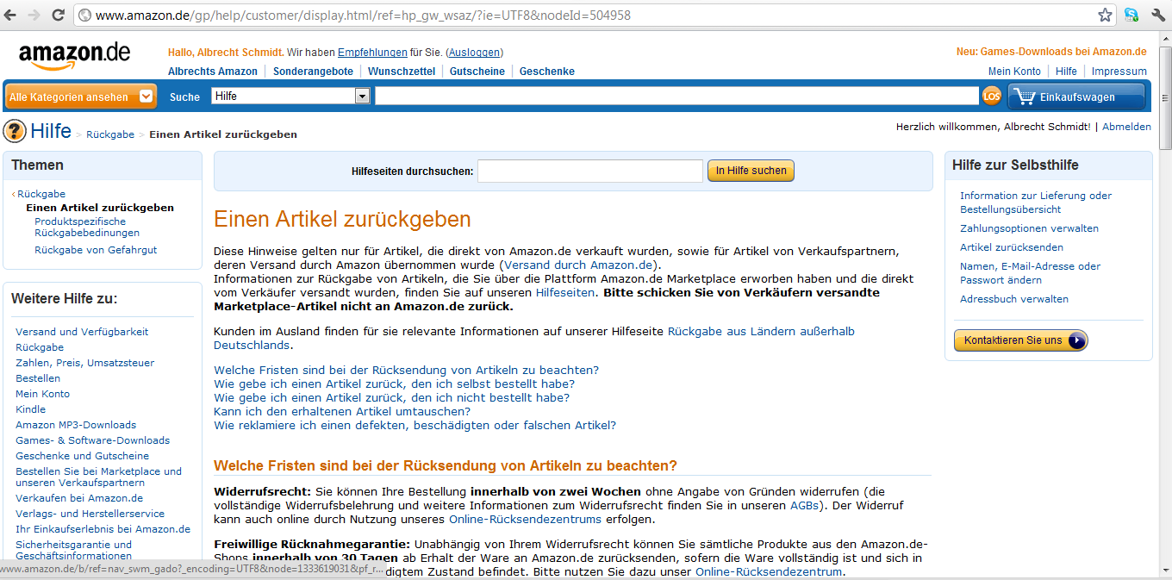
It is NOT Only About the User Interface!
Experience includes the overall product and service
Why is Human-Computer Interaction Important?
Notes:
Screenshots Albrecht

Slide 16
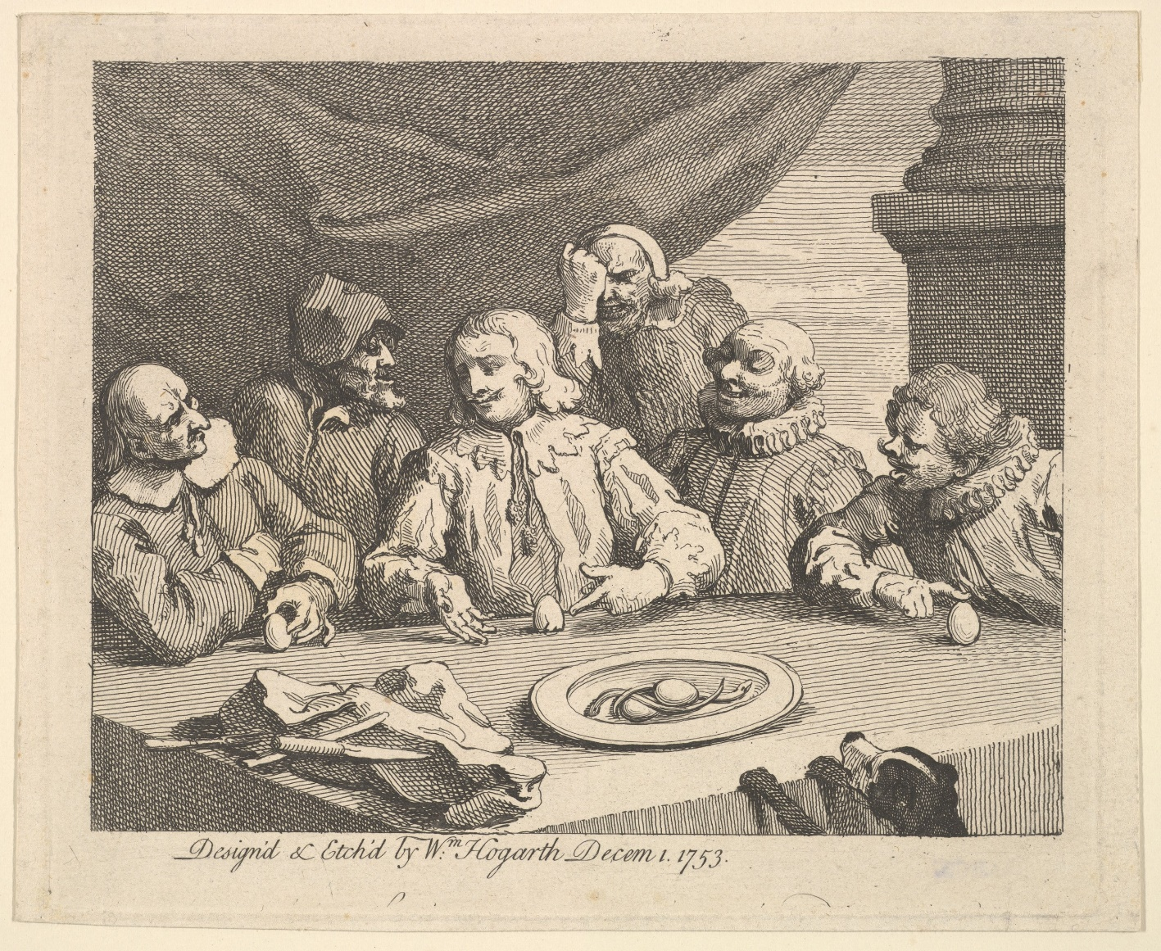
Human-Computer Interaction …it is about visible innovation
What is your Solution?
Problems and challenges in Human-Computer Interaction
often not seen as problem before there is a solution
if problems are identified, they are typically easy to understand by non-experts
Solutions in Human-Computer Interaction
once a solution is there, people will generally not remember that there was a problem
good and in particular great solutions (if found) often appear obvious (once they are there)
The step from problem to solution is however not trivial (but this is often forgotten, once there is a solution)
Why is Human-Computer Interaction Important?
Notes:
Handy, Foto Albrecht Schmidt
Ei des Kolumbus – Public Domain
https://www.metmuseum.org/art/collection/search/398598

Slide 17
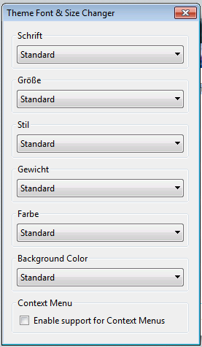
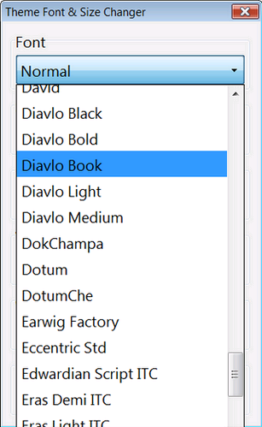
Example: Selection/Menu for Fonts
Is there a Problem? How to improve it?
https://addons.mozilla.org/en-US/firefox/addon/theme-font-size-changer/
Why is Human-Computer Interaction Important?
Notes:
Screenshots Albrecht

Slide 18
Example: Selection/Menu for Fonts
Is there a Problem? How to improve it?
https://addons.mozilla.org/en-US/firefox/addon/theme-font-size-changer/
WordPad/Win7
Why is Human-Computer Interaction Important?
Notes:
Screenshots Albrecht

Slide 19
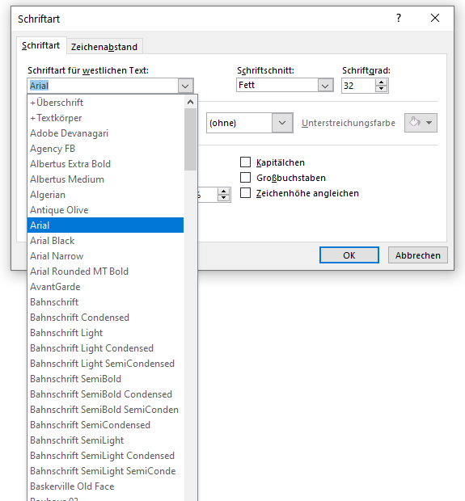
Example: Selection/Menu for Fonts
What is the next step for the Office 365 Dialog Box?
Office 365, 2019
Why is Human-Computer Interaction Important?
Notes:
Screenshots Albrecht

Slide 20
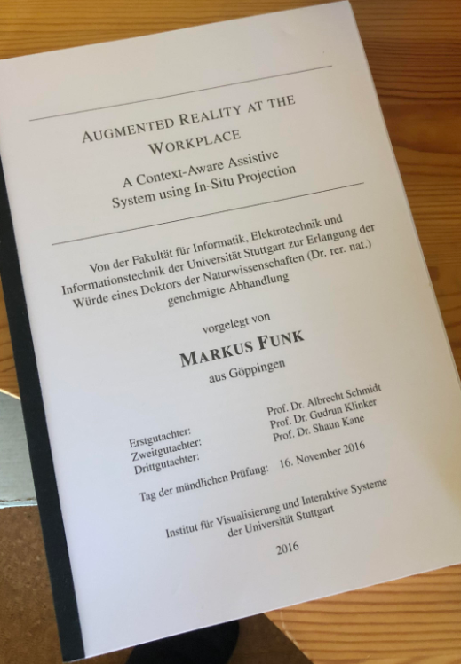
Discussion: How long does it take to write a Thesis or a Book?
On a PC vs. on a Phone
Assume the following
the book has 40.000 words
typing speed for physical keyboard is 40 words per minute
typing speed for phone keyboard is 15 words per minute
Does this calculation make sense?
What are we missing here?
What is different when we write a text message?
Why is Human-Computer Interaction Important?
Notes:
Foto Albrecht

Slide 21
Summary
The interface between the user and the information has become most critical for creating effective, efficient and pleasant systems.
Interface and interaction design defines how we can use devices, services, and applications.
The interface and interaction design impacts the performance of the user.
It is important to understand way people use a system as a tool to achieve their goals.
Human-computer interaction is relevant as it becomes harder to differentiate products based on features.
Good usability is economically important.
Sketching user interfaces and discussing design options and trade-offs is important.
Innovation in Human-Computer interaction is mostly visible.
Why is Human-Computer Interaction Important?

Slide 22
Did you understand this block?
Can you answer these questions?
How does the user interface and interaction design impact the user? Give specific examples.
Explain the economic benefits of a product that is easy to use in the context of a Web based shoe shop.
What advantages can you expect if you improve the usability of an App or web page?
Name some trends that make Human-Computer interaction more important.
Sketch 2 alternative (and different) user interfaces for a world time clock app for a smart watch and discuss the advantages and disadvantages of the designs
Explain with the example of a font menu the improvement of interactive technologies.
Give an example that highlights the statement “Problems in HCI are often not seen as problem before there is a solution.”
Why is Human-Computer Interaction Important?

Slide 23
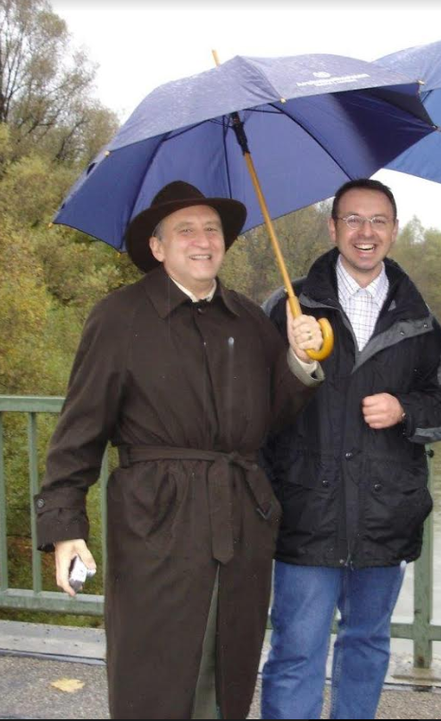
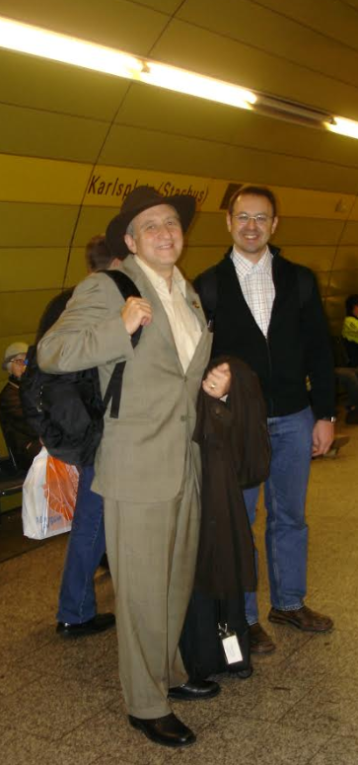
References
B. Shneiderman (2002). Leonardo's Laptop: Human Needs and the New Computing Technologies. http://mitpress.mit.edu/main/feature/leonardoslaptop/index.html
B. Buxton (2010). Sketching user experiences: getting the design right and the right design. Morgan Kaufmann.
Harry Brignull (2006). Bad usability is like a leaky pipe. https://90percentofeverything.com/2006/11/13/bad-usability-is-like-a-leaky-pipe/
Why is Human-Computer Interaction Important?
Notes:
Foto: Albrecht Schmidt, Ben Shneiderman in München, 11/2006; book tour

Slide 24
License
This file is licensed under the Creative Commons Attribution-Share Alike 4.0 (CC BY-SA) license:
https://creativecommons.org/licenses/by-sa/4.0
Attribution: Albrecht Schmidt
For more content see: https://hci-lecture.de

