Slide 1
Terminology - UX
Notes:
Fotos Albrecht

Slide 2
Learning Goals
Understand …
terms related to user experience and interaction design,
descriptions and texts that use these terms.
Be able to explain technical terms, e.g.
Interaction design dimensions according to G. Crampton Smith
User experience and user experience design
Experience economy
Terminology - UX

Slide 3
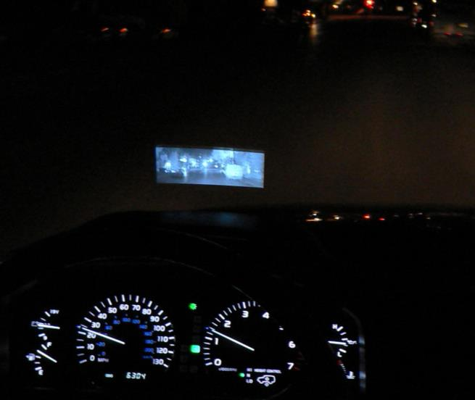
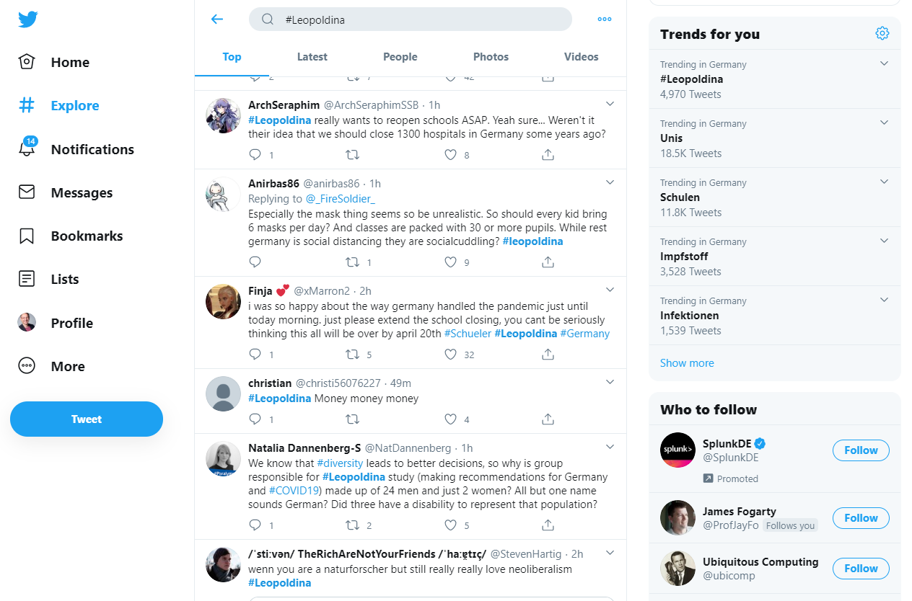
Computers are increasingly defining people’s experiences in the real world
Photo by Jurvetson (CC BY 2.0)
http://www.flickr.com/photos/jurvetson/22226826/
Terminology - UX

Slide 4
User Interface Design vs. Interaction Design vs. User Experience Design
Definition
User Interface Design refers to the conception and design of the user interface, including the choice of modalities, selection of interface elements and their placement in the interface.
“Interaction Design (IxD) is the design of interactive products and services in which a designer’s focus goes beyond the item in development to include the way users will interact with it.” https://www.interaction-design.org/literature/topics/interaction-design
User Experience Design describes the more holistic approach in designing the experience a person will encounter when interacting with a devices, system or application. It considers the user interface design in the broader context of use.
Terminology - UX

Slide 5
The Languages/Dimensions of Interaction Design
Gillian Crampton Smith in “What is Interaction Design”
“1-D includes words and poetry. […]
The 2-D languages that interaction design can borrow from include painting, typography, diagrams, and icons. […]
3-D languages are those of physical, sculptural form. […] If something has a handle, for example, we know we are meant to grab it […]
The fourth dimension is time. The 4-D languages include sound, film, and animation.”
Foreword “What is Interaction Design?”. Interview with Gillian Crampton Smith. Moggridge, Bill, and Bill Atkinson. Designing interactions. Vol. 17. Cambridge, MA: MIT press, 2007. page xvii
Terminology - UX
Notes:
https://www.mockplus.com/blog/post/ux-vs-ui-vs-ia-vs-ixd-4-confusing-digital-design-terms-defined

Slide 6
The 5 Dimensions of Interaction Design
by Yu Siang Teo https://www.interaction-design.org/literature/article/what-is-interaction-design
Originally by Gillian Crampton Smith (4 dimensions); Kevin Silver added the fifth.
1D: Words should be meaningful and simple to understand.
2D: Visual representations supplement the words used to communicate information to users.
3D: Physical objects or space looks at what physical objects do users interact with the product (laptop, mouse, touchscreen, phones, etc.)? These all affect the interaction between the user and the product.
4D: Time refers to media that changes with time (e.g. animation, videos, sounds).
5D: Behaviour includes the mechanism of a product. How do users perform actions?
https://www.interaction-design.org/
Terminology - UX
Notes:
Zusätzlich Verhalten
https://www.mockplus.com/blog/post/ux-vs-ui-vs-ia-vs-ixd-4-confusing-digital-design-terms-defined

Slide 7
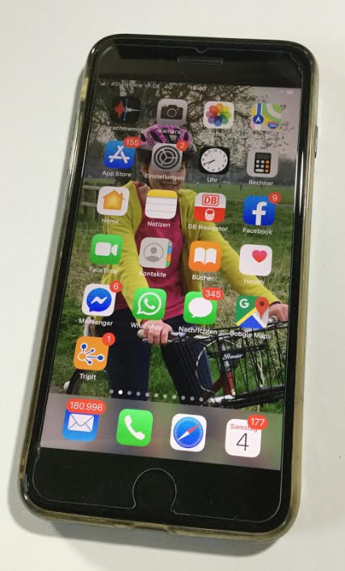
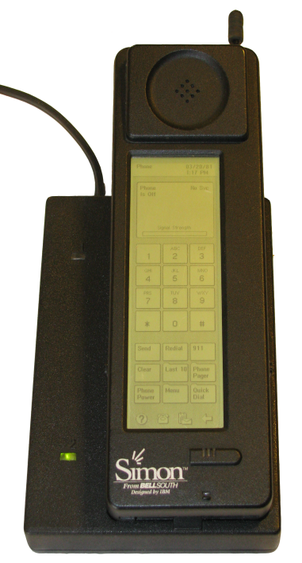
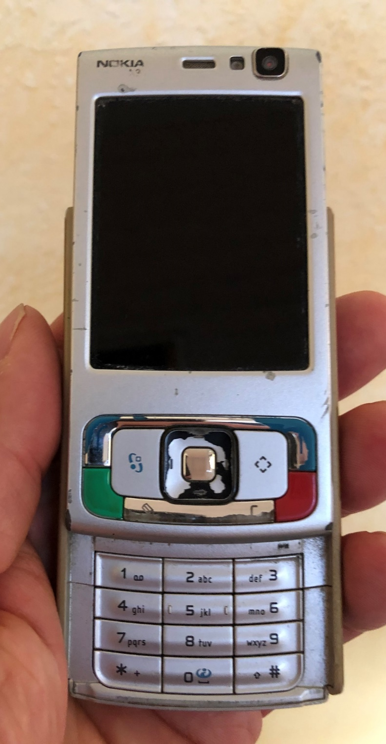
Fashion?
How long does an interface look new? Is there a timeless interaction design?
Photo by Bcos47 (public domain) http://en.wikipedia.org/wiki/File:IBM_Simon_Personal_Communicator.png
Terminology - UX
Notes:
Zusätzlich Verhalten
https://www.mockplus.com/blog/post/ux-vs-ui-vs-ia-vs-ixd-4-confusing-digital-design-terms-defined

Slide 8
Aspects of Product Design
A simplistic view
Product Design
is part of
Interaction Design
influences
Utility
Usability
Likeability
Terminology - UX

Slide 9
Major Factors Influencing the User Experience
A simplistic view
Product Design
Context of Use
User Experience (UX)
Users’ Skills and Expectations
Terminology - UX

Slide 10
One cannot not communicate Every behavior is a form of communication.
Mini-Exercise: Find out who made this statement and in what context?
Terminology - UX
Notes:
https://www.mockplus.com/blog/post/ux-vs-ui-vs-ia-vs-ixd-4-confusing-digital-design-terms-defined

Slide 11
One cannot not communicate Every behavior is a form of communication.
Mini-Exercise: Find out who made this statement and in what context?
Paul Watzlawick
Axioms of communication
https://www.paulwatzlawick.de/axiome.html
Terminology - UX
Notes:
https://www.mockplus.com/blog/post/ux-vs-ui-vs-ia-vs-ixd-4-confusing-digital-design-terms-defined

Slide 12
You cannot not create a User Experience Every design will create a user experience.
Terminology - UX
Notes:
https://www.mockplus.com/blog/post/ux-vs-ui-vs-ia-vs-ixd-4-confusing-digital-design-terms-defined

Slide 13
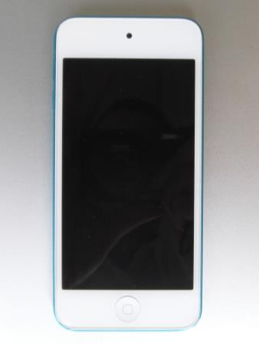
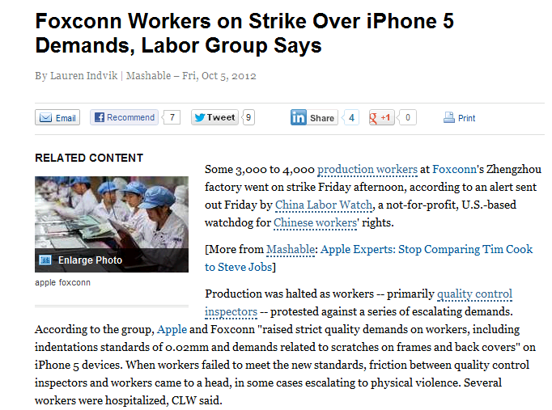
Experiences are never “stand alone” they cannot be assessed in “isolation”
User Experience is contextualized
Terminology - UX

Slide 14
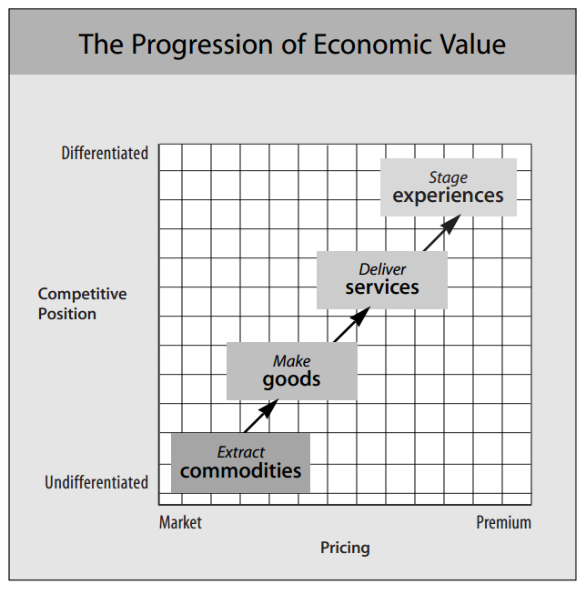
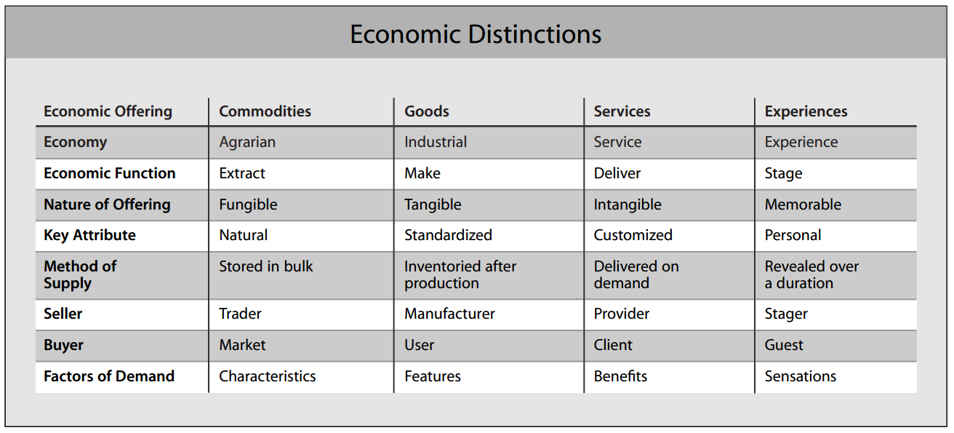
Experience Economy
An Economic Perspective on UX
Pine, B. Joseph, and James H. Gilmore. "Welcome to the experience economy." Harvard business review 76 (1998): 97-105. https://hbr.org/1998/07/welcome-to-the-experience-economy
Terminology - UX

Slide 15
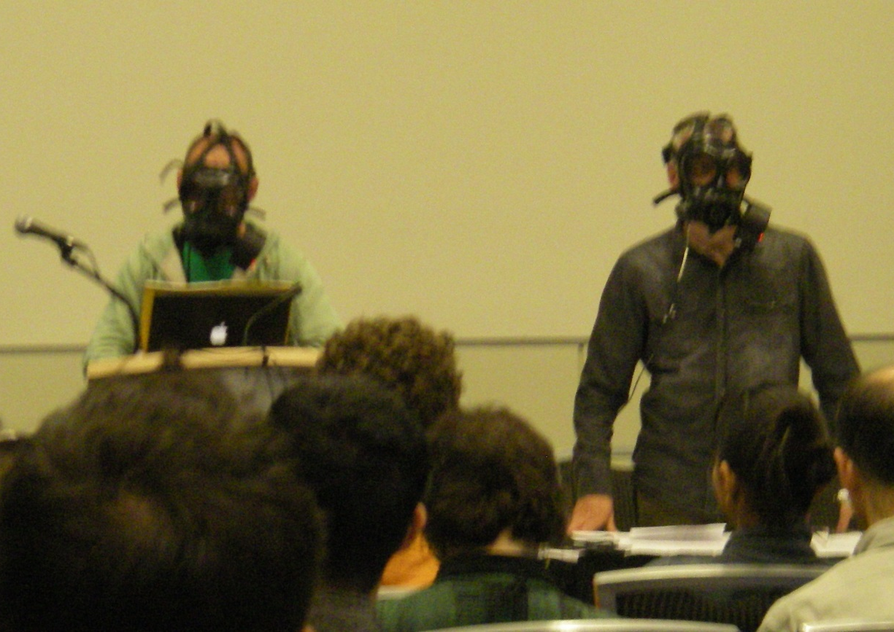
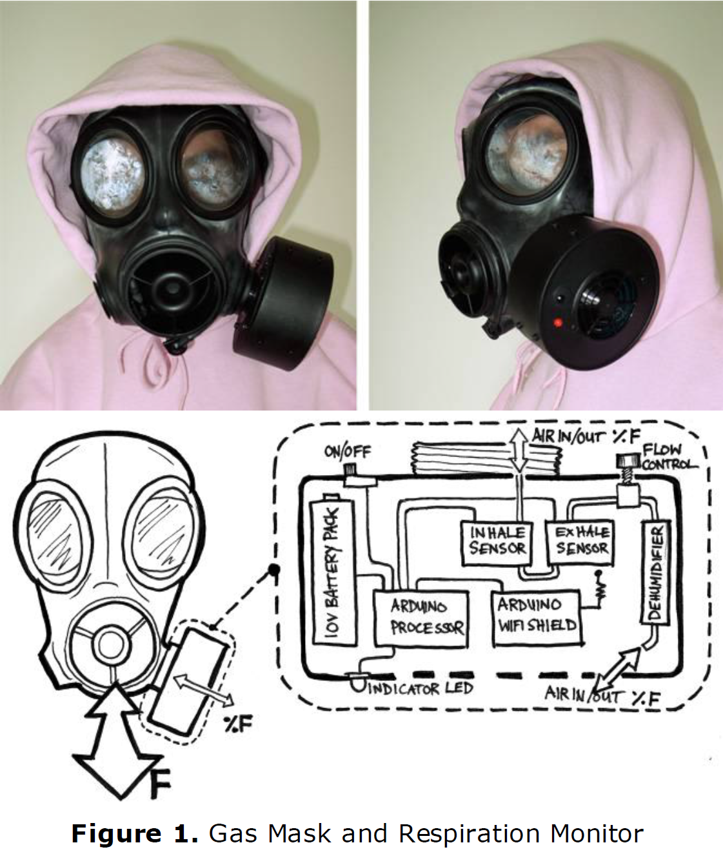
Technology inevitably alters our perception of reality
Image from: http://www.cs.nott.ac.uk/~jqm/?p=501
Marshall, Joe, et al. "The gas mask: a probe for exploring fearsome interactions." CHI'11 Extended Abstracts on Human Factors in Computing Systems. ACM, 2011.
Terminology - UX

Slide 16
Did you understand this block?
Can you answer these questions?
Gillian Crampton Smith proposes 4 dimensions of interaction design. What are they? Provide examples of user interfaces components
Explain the term user experience and name major factors influencing it.
Why is user experience relevant from an economical perspective?
Terminology - UX

Slide 17
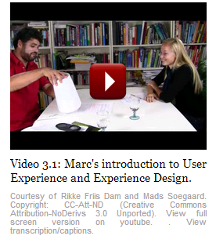
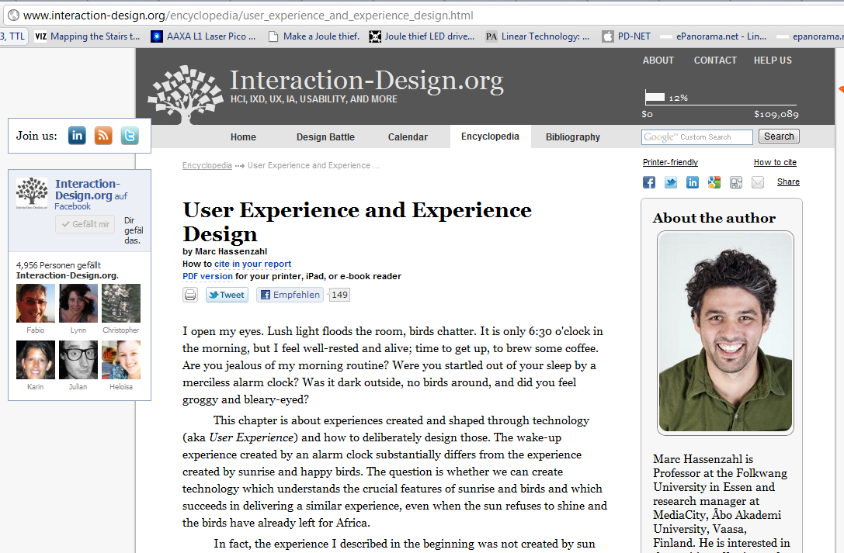
User Experience in Detail
Recommended Additional Material - read or watch
Hassenzahl, Marc (2013): User Experience and Experience Design. In: Soegaard, Mads and Dam, Rikke Friis (eds.). "The Encyclopedia of Human-Computer Interaction, 2nd Ed.". Aarhus, Denmark: The Interaction Design Foundation. http://www.interaction-design.org/encyclopedia/user_experience_and_experience_design.html
Effie Lai-Chong Law, Virpi Roto, Marc Hassenzahl, Arnold P.O.S. Vermeeren, and Joke Kort. 2009. Understanding, scoping and defining user experience: a survey approach. In Proceedings of the 27th international conference on Human factors in computing systems(CHI '09). ACM, New York, NY, USA, 719-728. DOI=10.1145/1518701.1518813 http://doi.acm.org/10.1145/1518701.1518813
Terminology - UX

Slide 18
References
https://www.interaction-design.org/literature/topics/interaction-design
Foreword “What is Interaction Design?”. Interview with Gillian Crampton Smith. Moggridge, Bill, and Bill Atkinson. Designing interactions. Vol. 17. Cambridge, MA: MIT press, 2007. page xvii
https://www.interaction-design.org/literature/article/what-is-interaction-design by Yu Siang Teo
Pine, B. Joseph, and James H. Gilmore. "Welcome to the experience economy." Harvard business review 76 (1998): 97-105. https://hbr.org/1998/07/welcome-to-the-experience-economy
Hassenzahl, Marc (2013): User Experience and Experience Design. In: Soegaard, Mads and Dam, Rikke Friis (eds.). "The Encyclopedia of Human-Computer Interaction, 2nd Ed.". Aarhus, Denmark: The Interaction Design Foundation. http://www.interaction-design.org/encyclopedia/user_experience_and_experience_design.html
Effie Lai-Chong Law, Virpi Roto, Marc Hassenzahl, Arnold P.O.S. Vermeeren, and Joke Kort. 2009. Understanding, scoping and defining user experience: a survey approach. In Proceedings of the 27th international conference on Human factors in computing systems(CHI '09). ACM, New York, NY, USA, 719-728. DOI=10.1145/1518701.1518813 http://doi.acm.org/10.1145/1518701.1518813
Terminology - UX

Slide 19
License
This file is licensed under the Creative Commons Attribution-Share Alike 4.0 (CC BY-SA) license:
https://creativecommons.org/licenses/by-sa/4.0
Attribution: Albrecht Schmidt
For more content see: https://hci-lecture.de

