Slide 1
User Needs
Image Source
User Needs
Notes:
Bedürfnisse der Benutzer
https://commons.wikimedia.org/wiki/File:Hieronymus_Bosch-_The_Seven_Deadly_Sins_and_the_Four_Last_Things.JPG?uselang=de
Picture in Public Domain
Hieronymus Bosch- The Seven Deadly Sins and the Four Last Things

Slide 2
Learning Goals
Understand …
the complexity of user needs and the challenges to uncover them.
the relationship between user needs and technologies available.
how human needs impact the technologies we develop and how technologies influence needs
Be able to explain …
the basics of Maslow’s theory of motivation
the concept of the task-artifact cycle and give examples
User Needs

Slide 3
User Needs
Ask the (potential) users?
User Needs

Slide 4
User Needs- Homer Simpson
Ask the (potential) users?
Show (about 20 sec)
https://www.youtube.com/watch?v=Pw9gaEiQAxY
User Needs

Slide 5
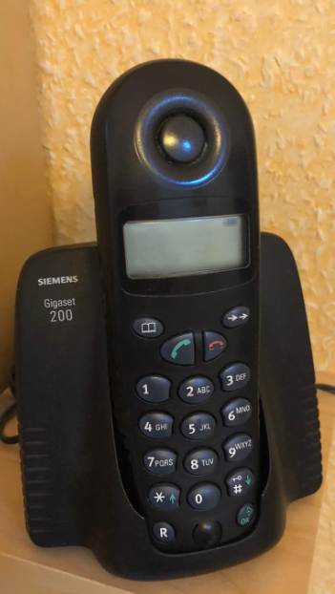
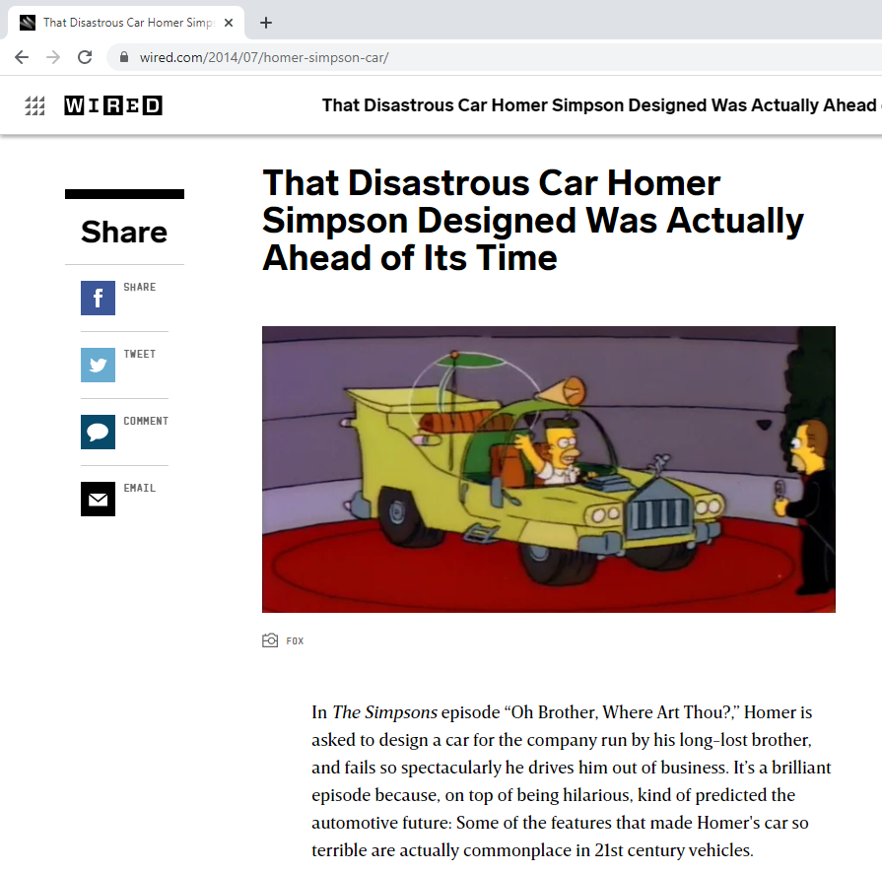
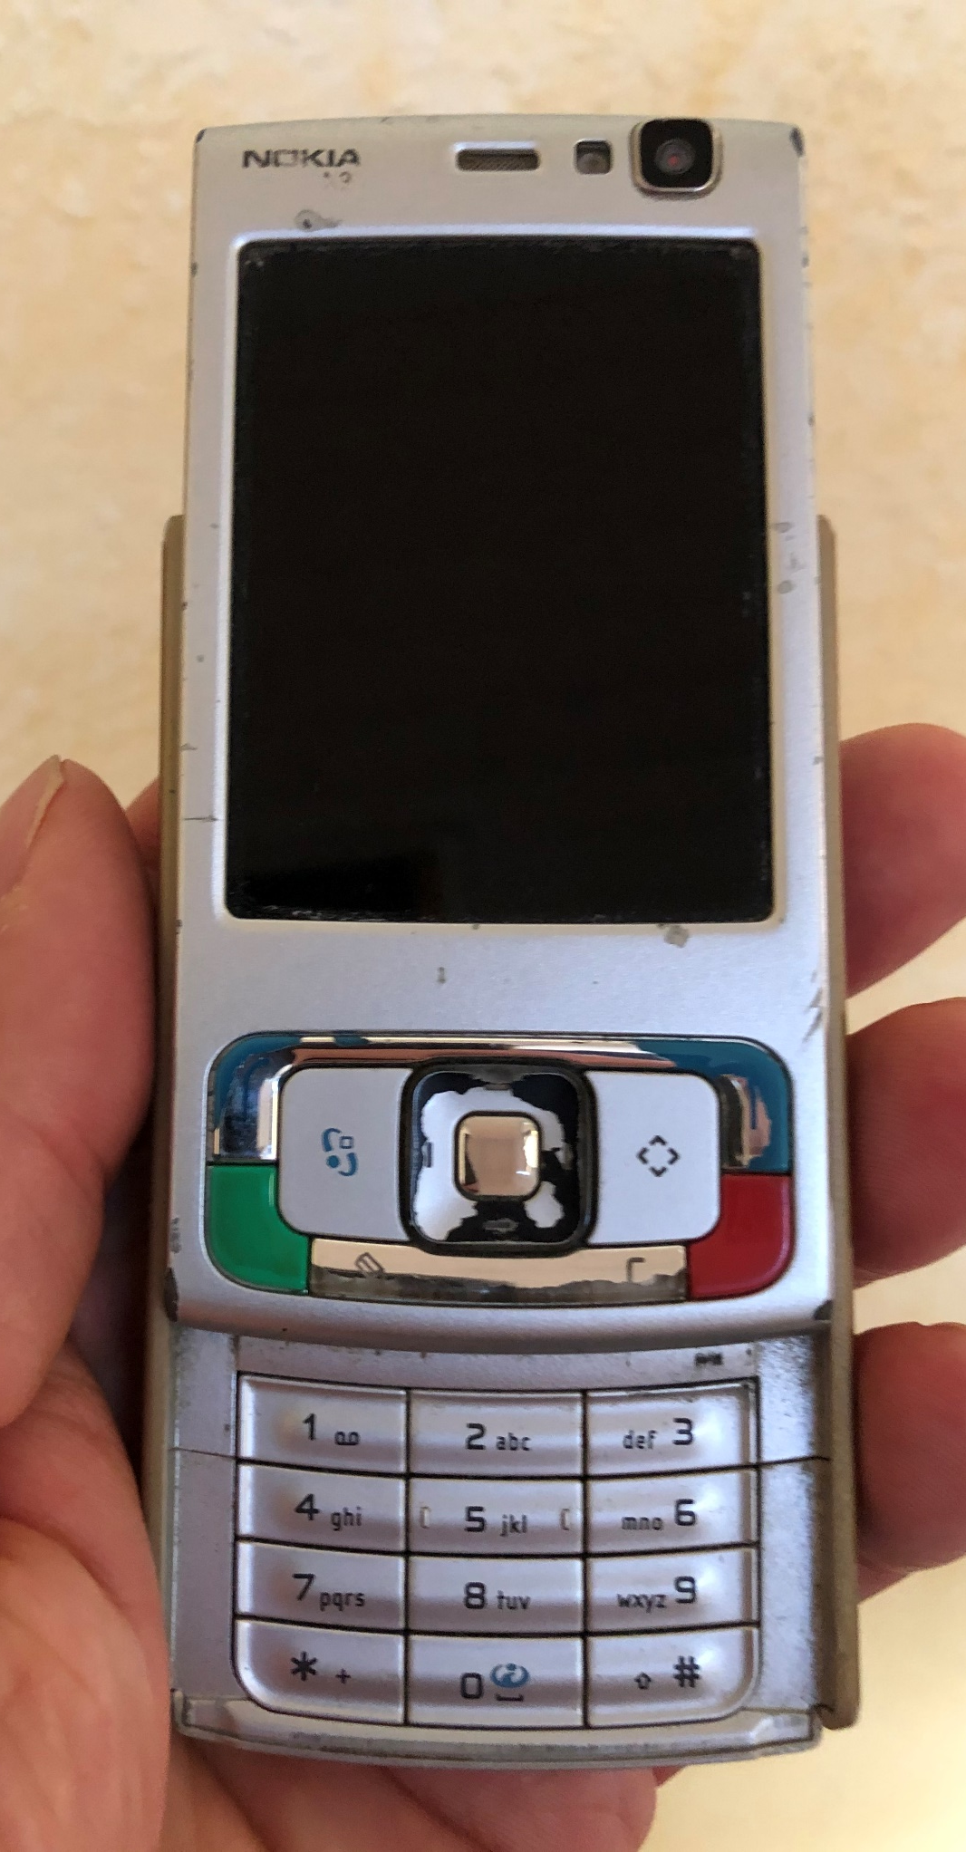
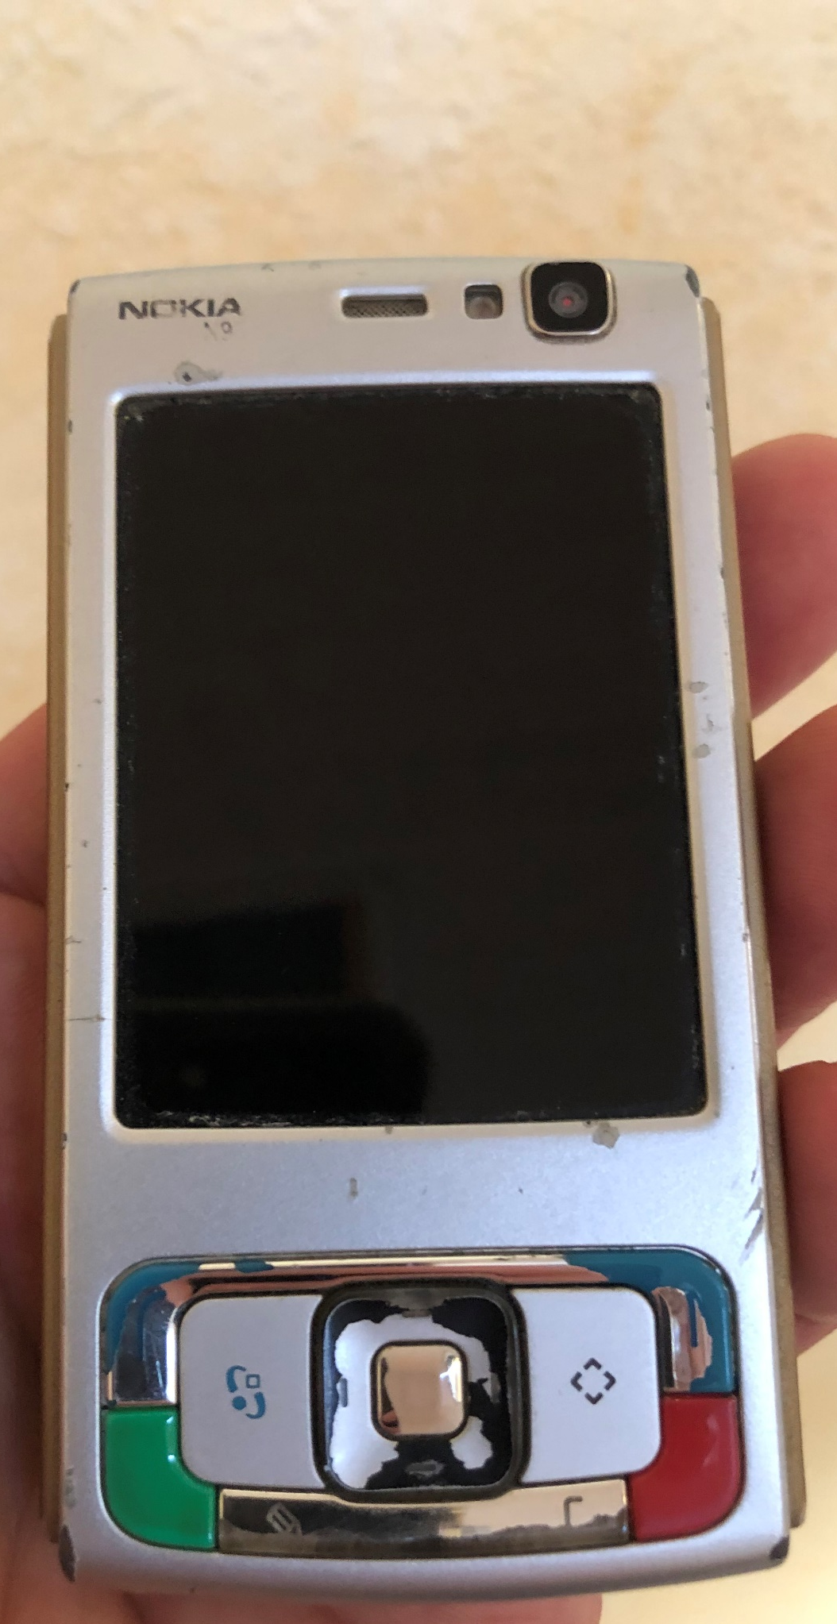
User Needs
Ask the (potential) users?
https://www.wired.com/2014/07/homer-simpson-car/
User Needs
Notes:
Foto Albrecht Schmidt

Slide 6
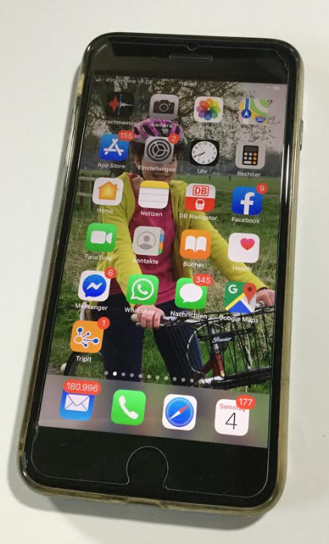
User Needs Current Technologies
Ask the (potential) users?
User Needs
Notes:
Vielleicht brauchen wir die Sachen, die wir wollen gar nicht wirklich?
Vielleicht hat nur die Werbung funktioniert?
Foto Albrecht Schmidt

Slide 7
What do you need to survive?
3 Minutes
3 Days
3 Weeks
User Needs
Notes:
Foto Albrecht Schmidt

Slide 8
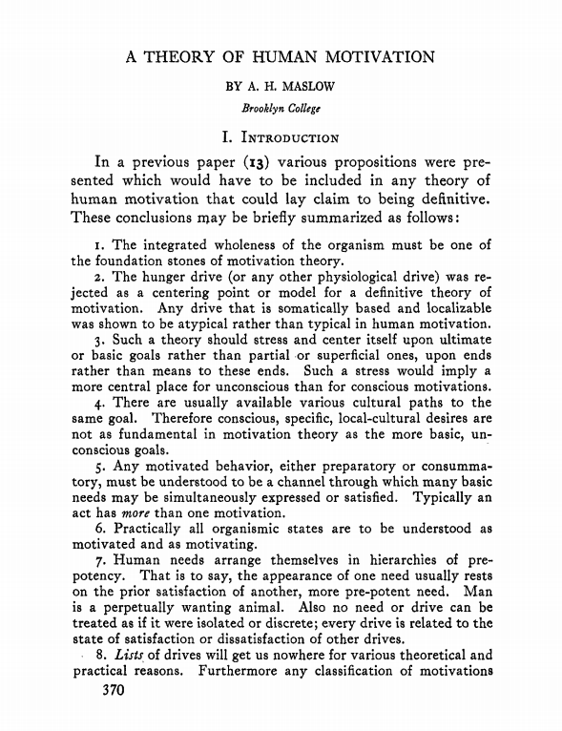
The Theory of Human Motivation
Maslow, A.H. (1943)
Maslow, A. H. (1943). A theory of human motivation. Psychological Review, 50(4), 370–396. https://doi.org/10.1037/h0054346
User Needs

Slide 9
Needs The Theory of Human Motivation
Maslow, A.H. (1943)
5) The Need for Self-Actualization.
4) The Esteem Needs
3) The Love Needs
2) The Safety Needs
1) The 'physiological' Needs
Maslow, A. H. (1943). A theory of human motivation. Psychological Review, 50(4), 370–396. https://doi.org/10.1037/h0054346
User Needs

Slide 10
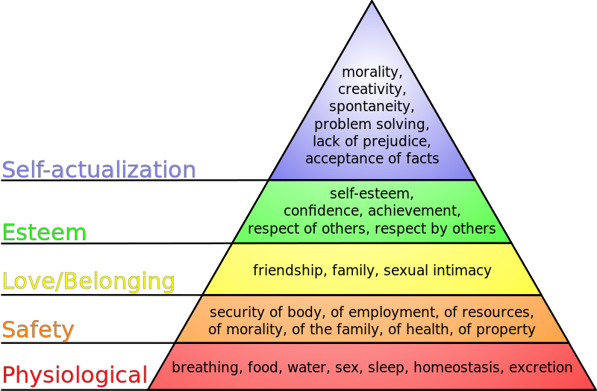
Maslow‘s Hierarchy of Needs
J. Finkelstein / CC BY-SA (http://creativecommons.org/licenses/by-sa/3.0/) https://commons.wikimedia.org/wiki/File:Maslow%27s_hierarchy_of_needs.svg
User Needs

Slide 11
Maslow‘s Hierarchy of Needs
Mini Exercise: How does Instagram, tinder, or maps relate to this?
J. Finkelstein / CC BY-SA (http://creativecommons.org/licenses/by-sa/3.0/) https://commons.wikimedia.org/wiki/File:Maslow%27s_hierarchy_of_needs.svg
User Needs

Slide 12
Hieronymus Bosch The Seven Deadly Sins
Mini Exercise: How does Instagram, tinder, or maps relate to this?
User Needs
Notes:
Eitelkeit
Geiz
Ausschweifung
SuperbiaHochmut (Stolz, Eitelkeit, Übermut)2. AvaritiaGeiz (Habgier, Habsucht)3. LuxuriaWollust (Ausschweifung, Genusssucht, Begehren, Unkeuschheit)4. IraZorn (Jähzorn, Wut, Rachsucht)5. GulaVöllerei (Gefräßigkeit, Maßlosigkeit, Unmäßigkeit, Selbstsucht)6. InvidiaNeid (Eifersucht, Missgunst)7. AcediaFaulheit (Feigheit, Ignoranz, Überdruss, Trägheit des Herzens)
https://de.wikipedia.org/wiki/Tods%C3%BCnde#Abgrenzung_vom_Laster

Slide 13
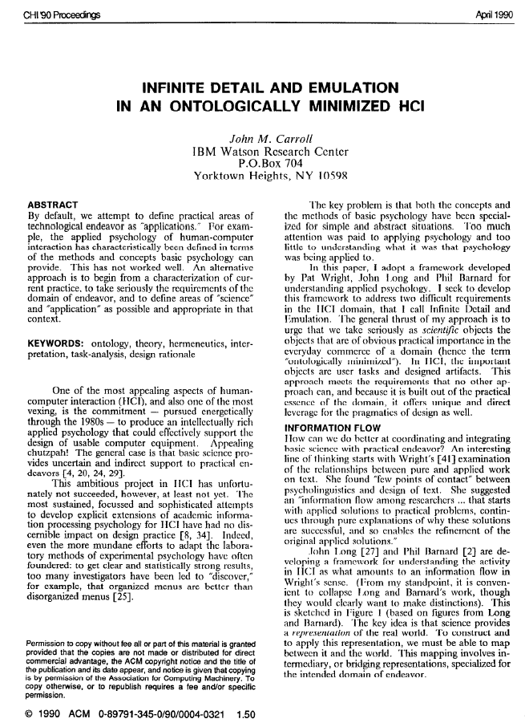
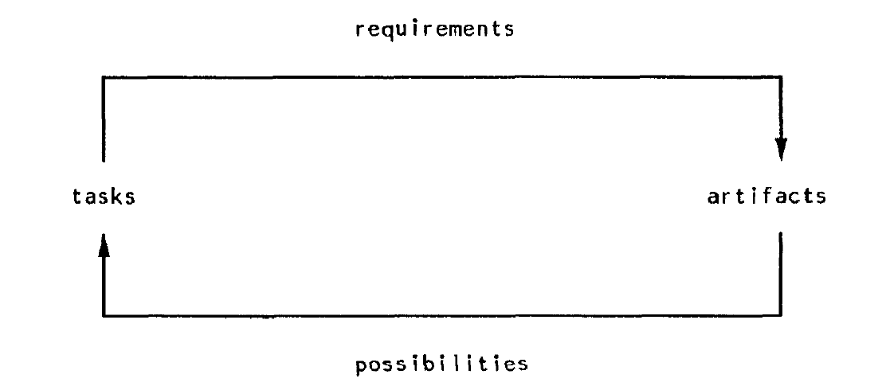
Task-Artifact Cycle
John Carroll 1990
Humans have needs and preferences
Technologies are created to suit these needs
As humans use the technologies needs and preferences change
Design ideas
adoption and use
John M. Carroll. 1990. Infinite detail and emulation in an ontologically minimized HCI. In Proceedings of the SIGCHI Conference on Human Factors in Computing Systems (CHI ’90). Association for Computing Machinery, New York, NY, USA, 321–328. DOI:https://doi.org/10.1145/97243.97303
User Needs
Notes:
John M. Carroll. 1990. Infinite detail and emulation in an ontologically minimized HCI. In Proceedings of the SIGCHI Conference on Human Factors in Computing Systems (CHI ’90). Association for Computing Machinery, New York, NY, USA, 321–328. DOI:https://doi.org/10.1145/97243.97303
Carroll, John M. (2013): Human Computer Interaction - brief intro. In: Soegaard, Mads and Dam, Rikke Friis (eds.). "The Encyclopedia of Human-Computer Interaction, 2nd Ed.". Aarhus, Denmark: The Interaction Design Foundation. Available online at http://www.interaction-design.org/encyclopedia/human_computer_interaction_hci.html

Slide 14
Task-Artifact Cycle
John Carroll 1990.
“Human activities implicitly articulate needs, preferences and design visions. Artifacts are designed in response, but inevitably do more than merely respond. Through the course of their adoption and appropriation, new designs provide new possibilities for action and interaction. Ultimately, this activity articulates further human needs, preferences, and design visions.”
Carroll, John M. (2013): Human Computer Interaction - brief intro. In: Soegaard, Mads and Dam, Rikke Friis (eds.). "The Encyclopedia of Human-Computer Interaction, 2nd Ed.". Aarhus, Denmark: The Interaction Design Foundation. Available online at http://www.interaction-design.org/encyclopedia/human_computer_interaction_hci.html
User Needs
Notes:
Aktivitäten drücken Bedürfnisse aus
Artefakte werden entworfen um diese zu befriedigen
Es entstehen aber auch neue Möglichkeiten
Und daraus entstehen neue Bedürfnisse…
→ Werbung funktioniert ähnlich!
Carroll, John M. (2013): Human Computer Interaction - brief intro. In: Soegaard, Mads and Dam, Rikke Friis (eds.). "The Encyclopedia of Human-Computer Interaction, 2nd Ed.". Aarhus, Denmark: The Interaction Design Foundation. Available online at http://www.interaction-design.org/encyclopedia/human_computer_interaction_hci.html
https://www.interaction-design.org/literature/book/the-encyclopedia-of-human-computer-interaction-2nd-ed/human-computer-interaction-brief-intro

Slide 15
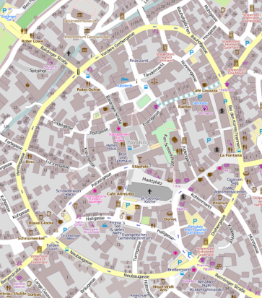
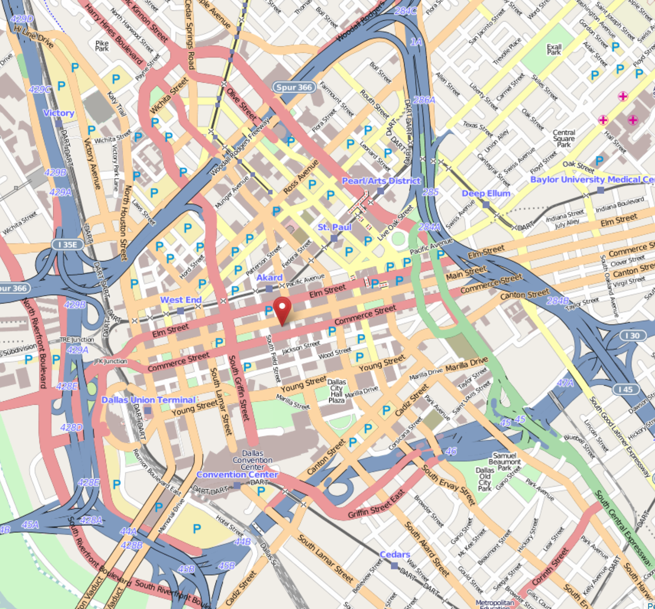
Task-Artifact Cycle: Example Mobility
Need for transport → car → changed mobility behavior and town layouts
Image from OpenStreetMap: http://www.openstreetmap.org/?lat=48.85154&lon=10.48856&zoom=17&layers=M
Image from OpenStreetMap: http://www.openstreetmap.org/?lat=49.48761&lon=8.46736&zoom=16&layers=M
User Needs
Notes:
Carroll, John M. (2013): Human Computer Interaction - brief intro. In: Soegaard, Mads and Dam, Rikke Friis (eds.). "The Encyclopedia of Human-Computer Interaction, 2nd Ed.". Aarhus, Denmark: The Interaction Design Foundation. Available online at http://www.interaction-design.org/encyclopedia/human_computer_interaction_hci.html

Slide 16
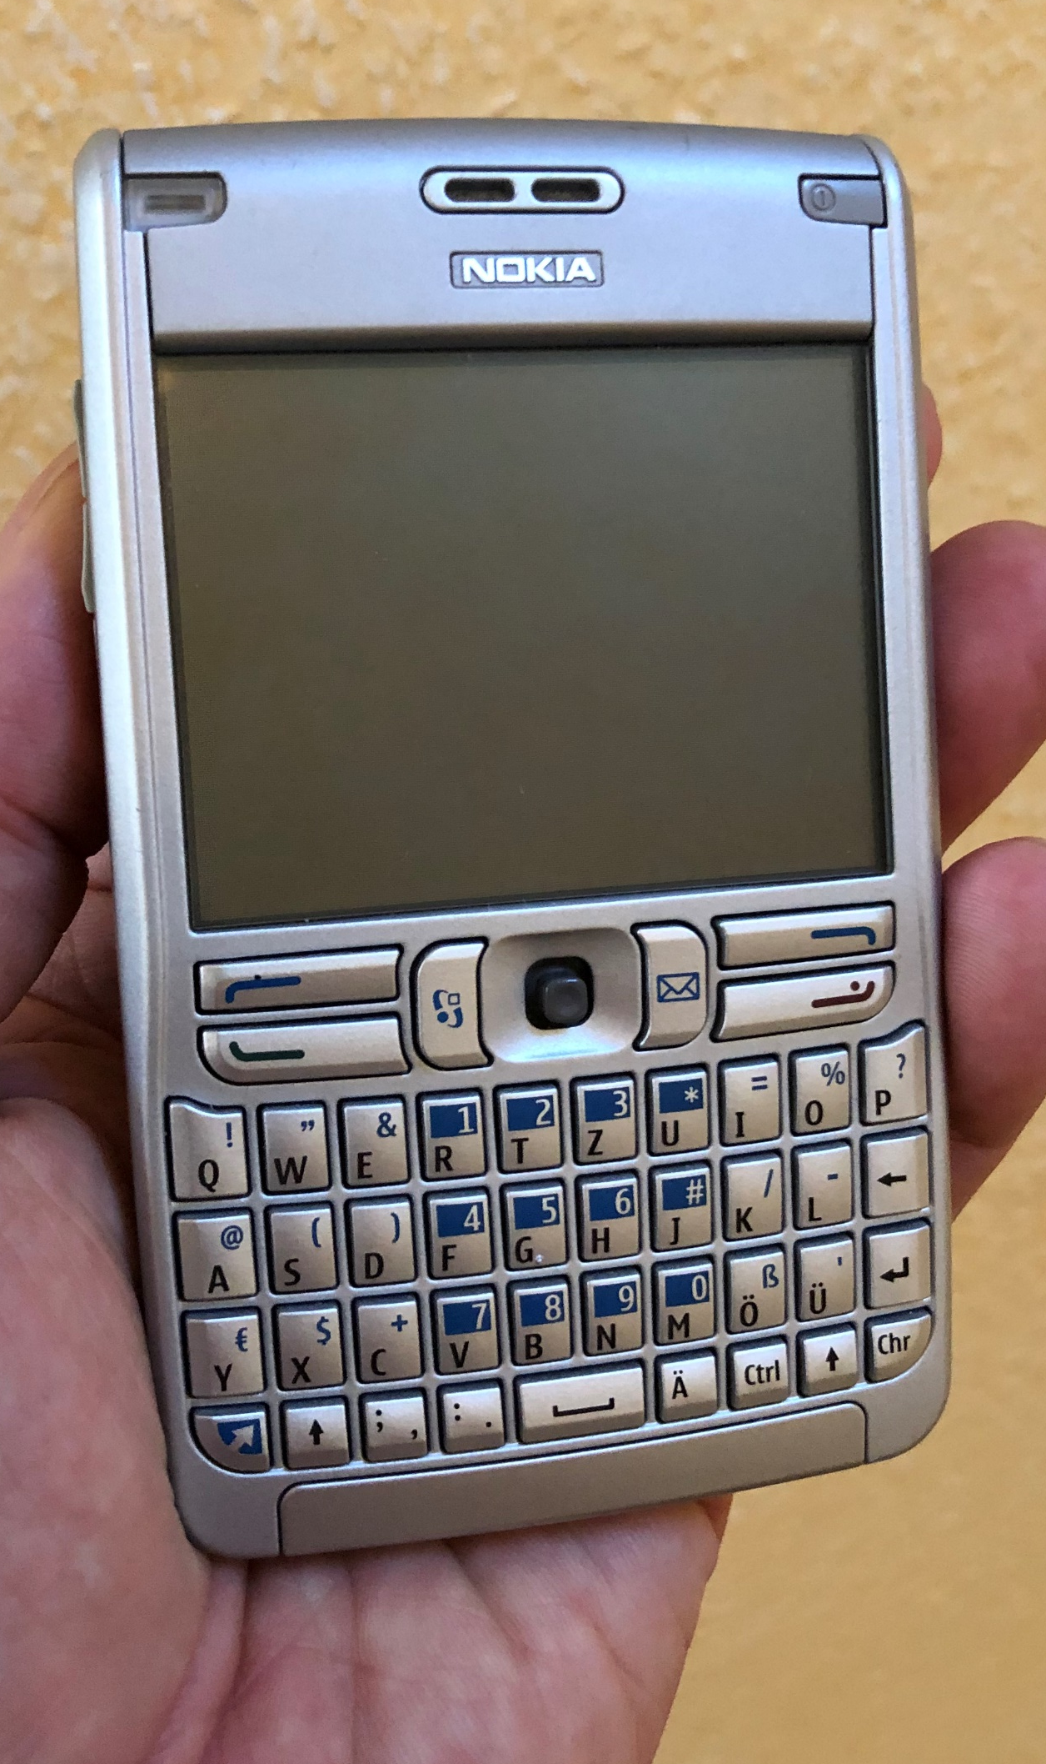
Task-Artifact Cycle
Mini Exercise: Mobile Phone
Desire to communicate
→ phone
→ changed social behavior
→ …
Explain the task-artifact cycle in the context of mobile telephony.
How did people meet in town 1990? An how in 2020? Discuss the impact beyond a single artifact.
User Needs
Notes:
Foto Albrecht Schmidt
Carroll, John M. (2013): Human Computer Interaction - brief intro. In: Soegaard, Mads and Dam, Rikke Friis (eds.). "The Encyclopedia of Human-Computer Interaction, 2nd Ed.". Aarhus, Denmark: The Interaction Design Foundation. Available online at http://www.interaction-design.org/encyclopedia/human_computer_interaction_hci.html

Slide 17
Conflicting User Needs
Designers make value decisions
User needs are a complex mix of (conflicting) needs
It is difficult to weight values against each other
Many values are not explicitly communicated
Example – ask people about explicit values:
Should it be free of charge?
Should it be privacy preserving?
Example – observe peoples implicit values:
Minimal effort in getting started and using it?
Using applications that are “sponsored” by ads
Social status of a technology (coolness factor)
User Needs

Slide 18
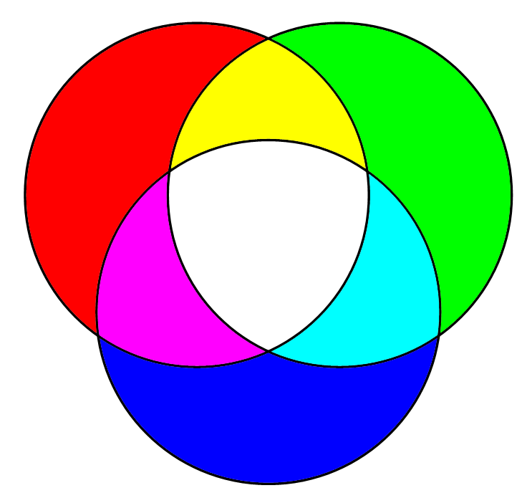
The Bigger Picture Building Successful Digital Products
It is not only about what the users want!
Tension
different objectives
different design goals
Context of a product design
1. What do
people desire?
3. What can
we build?
Objective: a product that is desirable and viable and buildable
2. What will
sustain a
business?
Cooper, Alan, Robert Reimann, and Hugh Dubberly. About face 2.0: The essentials of interaction design. John Wiley & Sons, Inc., 2003.
User Needs

Slide 19
Summary
Asking the user is not sufficient to reveal user needs.
Humans have a basic set of needs.
Maslow states a hierarchy of needs (physiological needs, safety needs, love needs, esteem needs, Need for Self-Actualization).
The task-artifact cycle describes how humans use the technologies changes needs.
In real world scenarios it is likely that user needs are conflicting.
Understanding user needs is essential, but this is not sufficient to create a successful product.
User Needs

Slide 20
Did you understand this block?
Can you answer these questions?
Sketch the task-artifact cycle according to Carroll et al.
How does this insight impact methods in human computer interaction?
Give one real example that is explained by the task-artifact-Cycle.
Name the levels in Maslow’s hierarchy of human needs.
Relate 3 widely use software products or web services to specific levels and explain this in one sentence each.
How do user needs fit into Alan Cooper’s concept for “Building Successful Digital Products”.
User Needs

Slide 21
References
Maslow, A. H. (1943): A theory of human motivation. Psychological Review, 50(4), 370-396. https://doi.org/10.1037/h0054346
John M. Carroll. (1990): Infinite detail and emulation in an ontologically minimized HCI. In Proceedings of the SIGCHI Conference on Human Factors in Computing Systems (CHI ’90). Association for Computing Machinery, New York, NY, USA, 321–328. DOI:https://doi.org/10.1145/97243.97303
John M. Carroll.(2013): Human Computer Interaction - brief intro. In: Soegaard, Mads and Dam, Rikke Friis (eds.). "The Encyclopedia of Human-Computer Interaction, 2nd Ed.". Aarhus, Denmark: The Interaction Design Foundation. http://www.interaction-design.org/encyclopedia/human_computer_interaction_hci.html
Alan Cooper, Robert Reimann, and Hugh Dubberly (2003): About face 2.0: The essentials of interaction design. John Wiley & Sons, Inc.
User Needs

Slide 22
License
This file is licensed under the Creative Commons Attribution-Share Alike 4.0 (CC BY-SA) license:
https://creativecommons.org/licenses/by-sa/4.0
Attribution: Albrecht Schmidt
For more content see: https://hci-lecture.de

