Slide 1
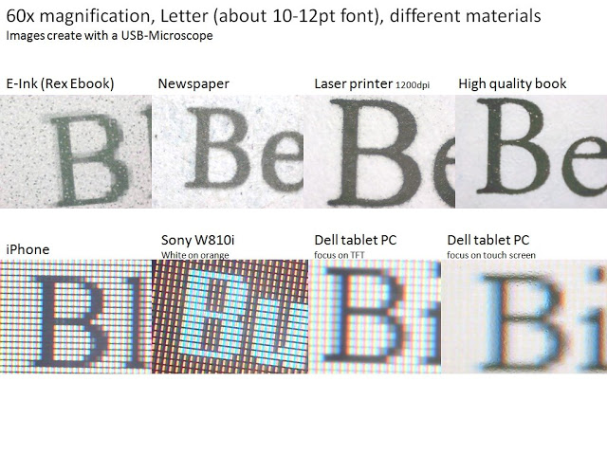
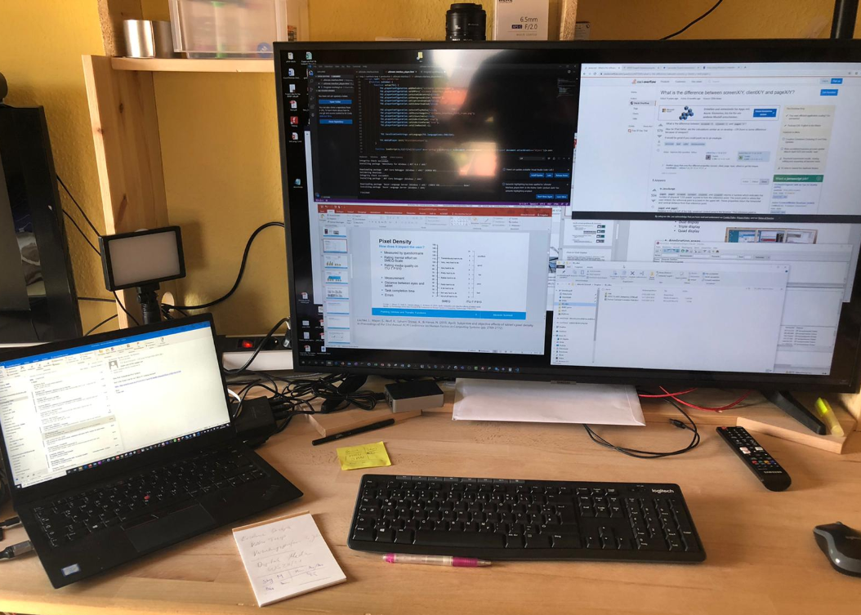

Visual Output
Notes:
Fotos Albrecht Schmidt

Slide 2
Learning Goals
Understand …
  Technical parameters for visual displays
  The impact of display resolution on the user experience
  The benefits and issues of large screen setups
Know
  How 3D content can be presented
  About different technologies that can be used to create a real 3D output
Visual Output

Slide 3
Visual Display: Screens
Technical Parameter
Display technology (e.g. LCD, LED, OLED)
Size (physical size, often the diagonal in inch, e.g. 65”)
Aspect ratio (width:height, e.g. 4:3, 16:9, or 21:9)
Resolution (number of pixel, width x height, e.g. 1920x1080)
Pixel density (how close are pixels together, size of pixels, pixels per inch, dots per inch, e.g. 320ppi)
Color depth (how many colors, per color, e.g. 8-bit / 10-bit)
Color gamut (which colors)
Mechanisms for color calibration
Refresh rate (related to images per second, 100Hz, 200Hz)
Spigget (CC BY-SA)
Visual Output
Notes:
https://dot-color.com/2011/10/08/the-difference-between-color-gamut-and-bit-depth/
Spigget / CC BY-SA (https://creativecommons.org/licenses/by-sa/3.0)

Slide 4
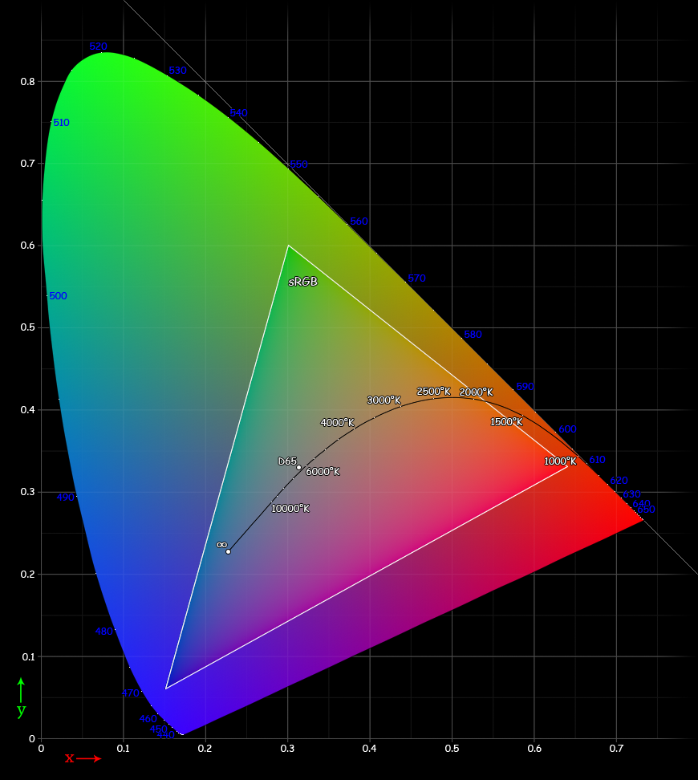
Visual Display: Screens
Technical Parameter
Display technology (e.g. LCD, LED, OLED)
Size (physical size, often the diagonal in inch, e.g. 65”)
Aspect ratio (width:height, e.g. 4:3, 16:9, or 21:9)
Resolution (number of pixel, width x height, e.g. 1920x1080)
Pixel density (how close are pixels together, size of pixels, pixels per inch, dots per inch, e.g. 320ppi)
Color depth (how many colors, per color, e.g. 8-bit / 10-bit)
Color gamut (which colors)
Mechanisms for color calibration
Refresh rate (related to images per second, 100Hz, 200Hz)
Spigget (CC BY-SA)
Visual Output
Notes:
https://dot-color.com/2011/10/08/the-difference-between-color-gamut-and-bit-depth/
Spigget / CC BY-SA (https://creativecommons.org/licenses/by-sa/3.0)

Slide 5
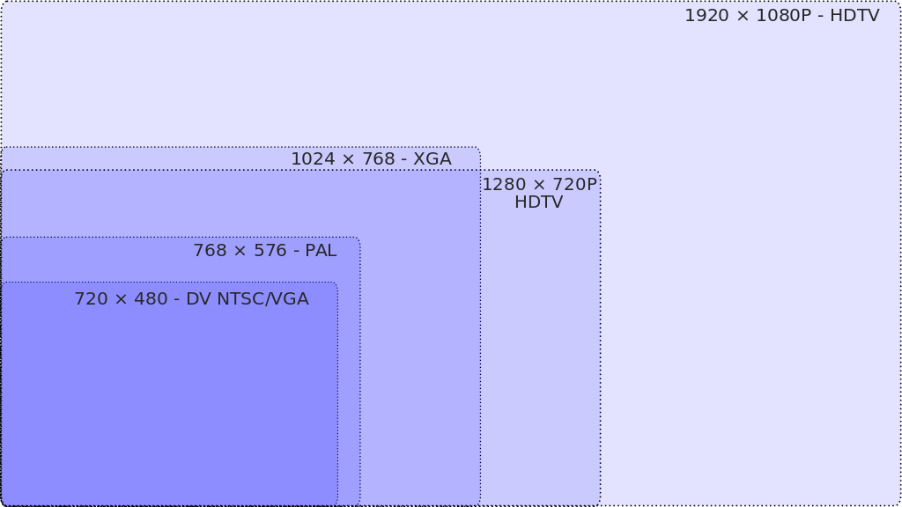
Visual Display: Screens
Aspect ration and resolution examples
Visual Output
Notes:
https://dot-color.com/2011/10/08/the-difference-between-color-gamut-and-bit-depth/
https://commons.wikimedia.org/wiki/File:Cie_Chart_with_sRGB_gamut_by_spigget.png

Slide 6
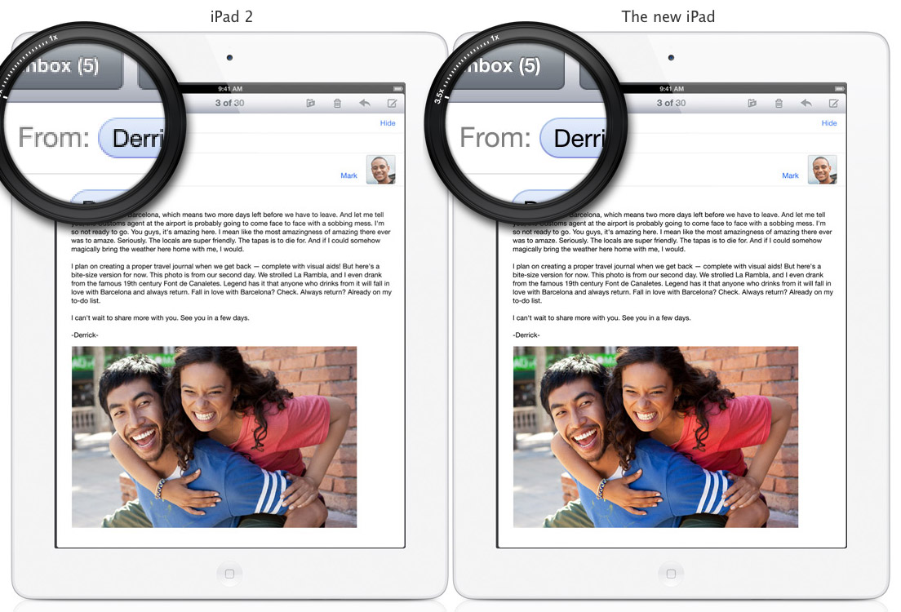
“Retina Display”
A resolution that your eyes cannot see the pixels
Example iPad 2 vs. iPad 3
  1024 × 768 pixel (132 ppi) vs. 2048 × 1536 pixel (264 ppi)
Angular resolution of the eye is about 1 arcminute ~ 0.02°
Assume the following viewing angle:
  60° ~ requires 3.000 pixel
  120° ~ requires 6.000 pixel
… hence 8K will be enough (with a reasonable viewing distance).
iPad2
iPad3
Visual Output

Slide 7
Pixel Density
Traditionally 72dpi (Apple) and 96dpi (Windows)
Rapid change in the last years
Visual Output

Slide 8
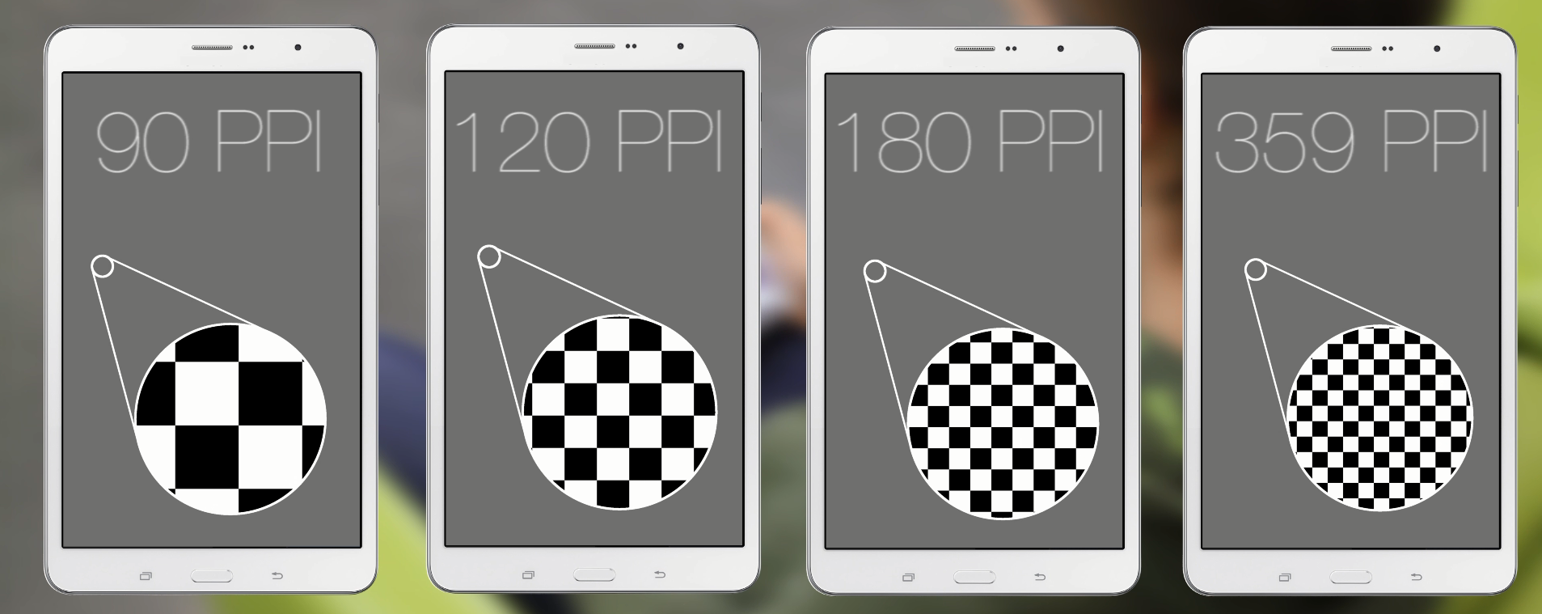
Pixel Density
How does it impact the user?
Three Tasks: image search, word counting, video analysis
16 participants, four Screen Resolutions
Lischke, L., Mayer, S., Wolf, K., Sahami Shirazi, A., & Henze, N. (2015, April). Subjective and objective effects of tablet's pixel density. In Proceedings of the 33rd Annual ACM Conference on Human Factors in Computing Systems (pp. 2769-2772).
Visual Output
Notes:
Lischke, L., Mayer, S., Wolf, K., Sahami Shirazi, A., & Henze, N. (2015, April). Subjective and objective effects of tablet's pixel density. In Proceedings of the 33rd Annual ACM Conference on Human Factors in Computing Systems (pp. 2769-2772).

Slide 9
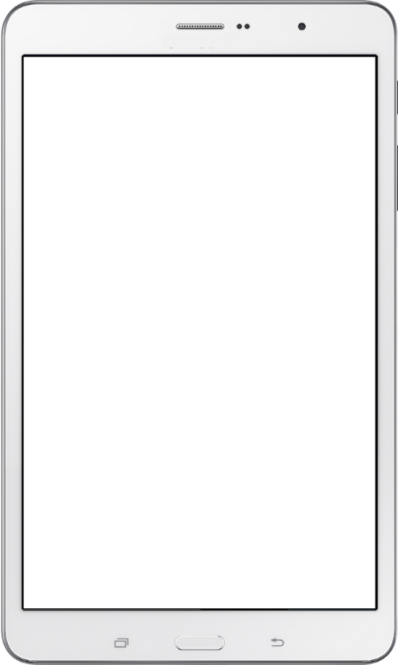
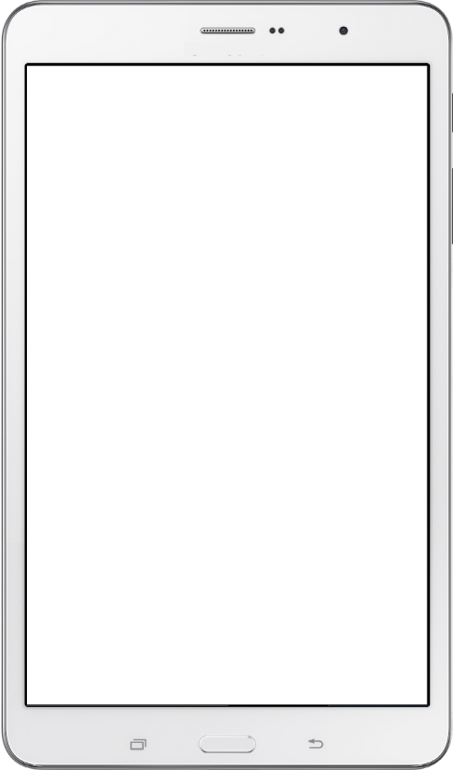
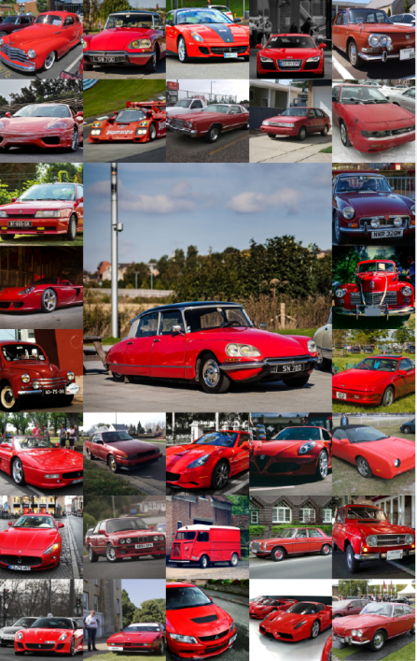


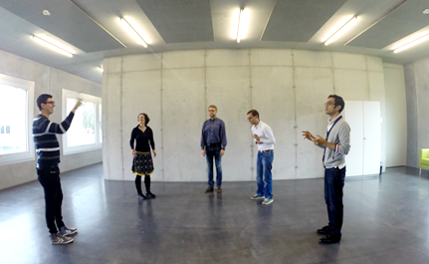
Pixel Density
How does it impact the user?
Three Tasks: image search, word counting, video analysis
16 participants, four Screen Resolutions
Lischke, L., Mayer, S., Wolf, K., Sahami Shirazi, A., & Henze, N. (2015, April). Subjective and objective effects of tablet's pixel density. In Proceedings of the 33rd Annual ACM Conference on Human Factors in Computing Systems (pp. 2769-2772).
Visual Output
Notes:
Lischke, L., Mayer, S., Wolf, K., Sahami Shirazi, A., & Henze, N. (2015, April). Subjective and objective effects of tablet's pixel density. In Proceedings of the 33rd Annual ACM Conference on Human Factors in Computing Systems (pp. 2769-2772).

Slide 10
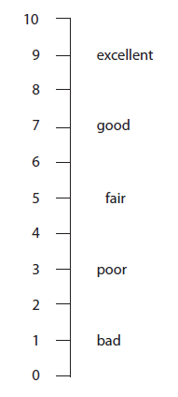
Pixel Density
How does it impact the user?
Measured by questionnaire
Rating mental effort on SMEQ-Scale
Rating media quality on ITU-T P.910
Measurement
Distance between eyes and tablet
Task completion time
Errors
  SMEQ
  ITU-T P.910
Lischke, L., Mayer, S., Wolf, K., Sahami Shirazi, A., & Henze, N. (2015, April). Subjective and objective effects of tablet's pixel density. In Proceedings of the 33rd Annual ACM Conference on Human Factors in Computing Systems (pp. 2769-2772).
Visual Output
Notes:
Lischke, L., Mayer, S., Wolf, K., Sahami Shirazi, A., & Henze, N. (2015, April). Subjective and objective effects of tablet's pixel density. In Proceedings of the 33rd Annual ACM Conference on Human Factors in Computing Systems (pp. 2769-2772).

Slide 11
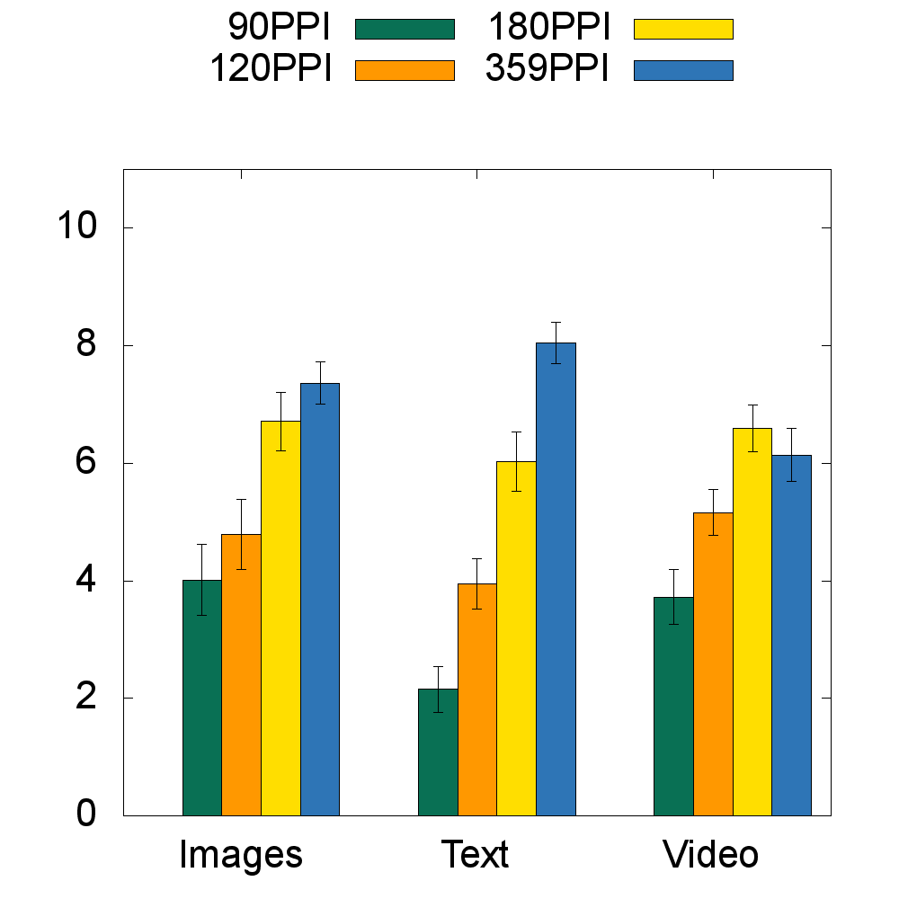
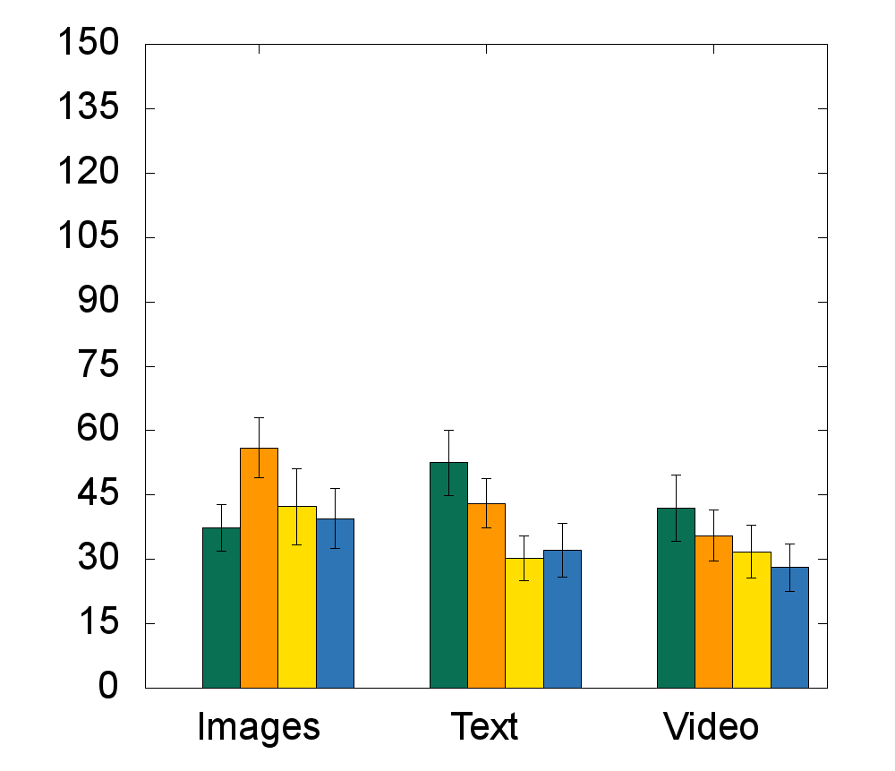
Pixel Density
How does it impact the user? Perceived Quality
Perceived Quality
Perceived Effort
Lischke, L., Mayer, S., Wolf, K., Sahami Shirazi, A., & Henze, N. (2015, April). Subjective and objective effects of tablet's pixel density. In Proceedings of the 33rd Annual ACM Conference on Human Factors in Computing Systems (pp. 2769-2772).
Visual Output
Notes:
Lischke, L., Mayer, S., Wolf, K., Sahami Shirazi, A., & Henze, N. (2015, April). Subjective and objective effects of tablet's pixel density. In Proceedings of the 33rd Annual ACM Conference on Human Factors in Computing Systems (pp. 2769-2772).

Slide 12
Pixel Density
How does it impact the user? Perceived Quality
Perceived Quality
Perceived Effort
But…
No differences in distance
No differences in task completion time
No differences in error rate
Lischke, L., Mayer, S., Wolf, K., Sahami Shirazi, A., & Henze, N. (2015, April). Subjective and objective effects of tablet's pixel density. In Proceedings of the 33rd Annual ACM Conference on Human Factors in Computing Systems (pp. 2769-2772).
Visual Output
Notes:
Lischke, L., Mayer, S., Wolf, K., Sahami Shirazi, A., & Henze, N. (2015, April). Subjective and objective effects of tablet's pixel density. In Proceedings of the 33rd Annual ACM Conference on Human Factors in Computing Systems (pp. 2769-2772).

Slide 13
Absolute Screen Space is Useful!
It is easier to move your gaze than to bring windows to the front, move between tabs, or scroll!
Many tasks benefit: comparison, overview, multiple documents…
Issues with large screens:
  Finding the mouse cursor
  Moving the mouse
Practices
  Working local in one region
  Periphery for other documents
Visual Output
Notes:
Foto Albrecht Schmidt

Slide 14
E-Paper vs. Paper Displays, other displays
60x magnification, 10-12 pt font
2009
Visual Output
Notes:
Foto Albrecht Schmidt

Slide 15
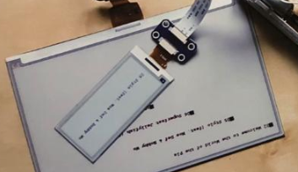
More Visual Display Technologies
Projection
Key aspects
  Resolution
  Brightness (daylight, outdoors)
  Noise
  Projection distance
  Lens and image correction
  Connectivity
  Size and weight
E-paper Displays
Slower update rate
Black and white or few colors
Readable outdoors
Require light (like paper)
Visual Output
Notes:
Foto Albrecht Schmidt

Slide 16
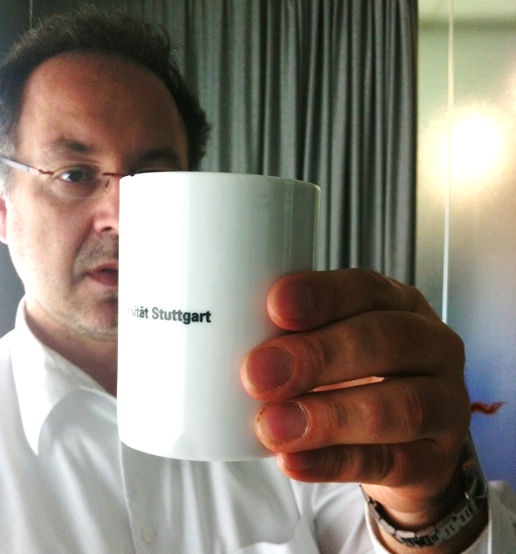
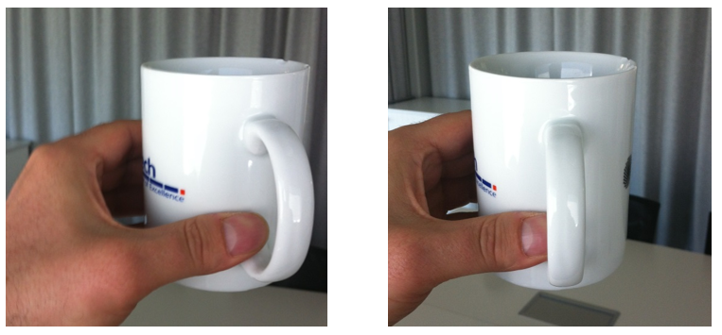
3D-Displays
Requirements
Different images
One image per eye
left eye right eye
Visual Output
Notes:
Foto Albrecht Schmidt

Slide 17
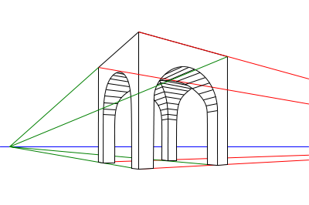
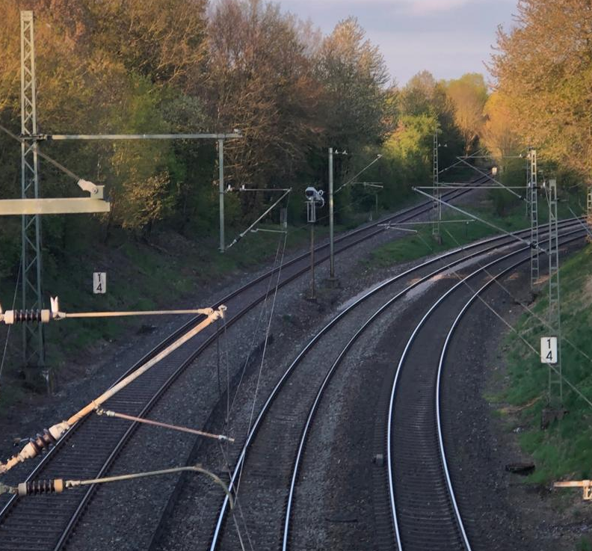
3D View on a 2D Canvas & Displays
Everything on a 2D display is 2D!
If we see it three dimensional we imagine it…
Expectations and experience as basis
Displaying a projection of a 3D model
“Options to visualize 3D graphics
  Create a 2D image that the user translates to 3D in his head
  Provide images (that represent a 3D model from a particular view point) for both eyes
Monocular cues (perceived with a single eye)
  Visual angle indicates how much of view object occupies
  Familiar objects perceived as constant size
  Overlapping help perception of size and depth
https://de.wikipedia.org/wiki/Perspektive
Visual Output
Notes:
Foto Albrecht Schmidt
Motion parallax
Depth from motion
Kinetic depth effect
Perspective
Relative size
Familiar size
Absolute size
Aerial perspective

Slide 18
Real 3D Displays
Real 3D requires an image for each eye
Real physical objects
Providing a display for each eye (headset)
Overlaying images an separating them for each eye
  Time synchronized, e.g. shutter glasses
  Polarization filter on projector and glasses
  Color anaglyph systems
Autostereoscopic displays
Volumetric displays
Visual Output
Notes:
https://en.wikipedia.org/wiki/Stereoscopy
https://commons.wikimedia.org/wiki/File:EmaginZ800.jpg
https://commons.wikimedia.org/wiki/File:Parallax_barrier_vs_lenticular_screen.svg
https://commons.wikimedia.org/wiki/File:2-punktperspektive.svg

Slide 19
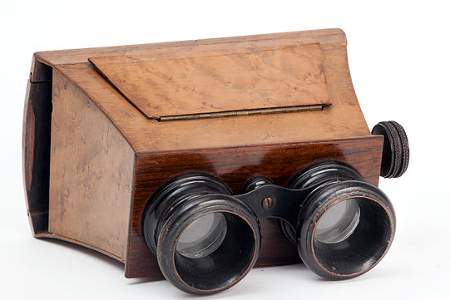
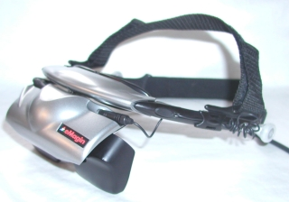
Real 3D Displays
Real 3D requires an image for each eye
Real physical objects
Providing a display for each eye (headset)
Overlaying images an separating them for each eye
  Time synchronized, e.g. shutter glasses
  Polarization filter on projector and glasses
  Color anaglyph systems
Autostereoscopic displays
Volumetric displays
By Alessandro Nassiri (CC BY-SA)
wikimedia.org
User Psoreilly on en.wikipedia (CC BY-SA)
Visual Output
Notes:
https://en.wikipedia.org/wiki/Stereoscopy
https://commons.wikimedia.org/wiki/File:EmaginZ800.jpg
https://commons.wikimedia.org/wiki/File:Parallax_barrier_vs_lenticular_screen.svg
https://commons.wikimedia.org/wiki/File:2-punktperspektive.svg

Slide 20
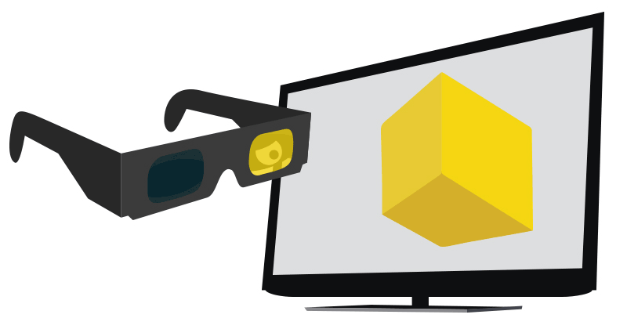
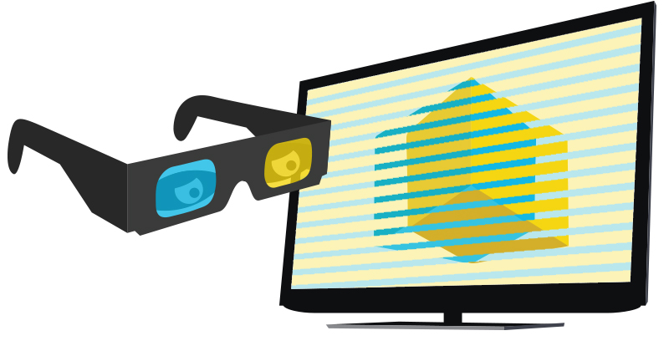
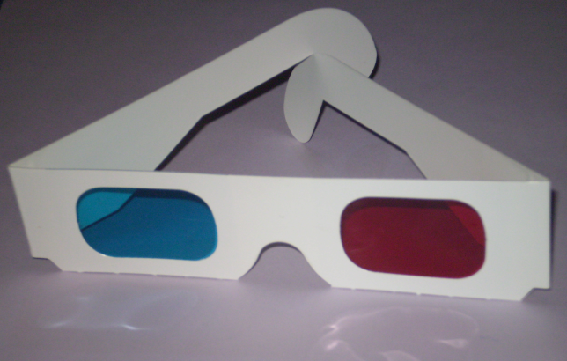

Real 3D Displays
Real 3D requires an image for each eye
Real physical objects
Providing a display for each eye (headset)
Overlaying images an separating them for each eye
  Time synchronized, e.g. shutter glasses
  Polarization filter on projector and glasses
  Color anaglyph systems
Autostereoscopic displays
Volumetric displays
By Locafox.de
(CC BY-SA) wikimedia.org
Snaily (CC BY-SA)
Visual Output
Notes:
https://en.wikipedia.org/wiki/Stereoscopy
Cmglee / CC BY-SA (https://creativecommons.org/licenses/by-sa/3.0)
https://en.wikipedia.org/wiki/Anaglyph_3D
https://upload.wikimedia.org/wikipedia/commons/a/ac/3D_dusk_on_Desert.jpg
https://commons.wikimedia.org/wiki/File:Parallax_barrier_vs_lenticular_screen.svg
https://commons.wikimedia.org/wiki/File:2-punktperspektive.svg

Slide 21
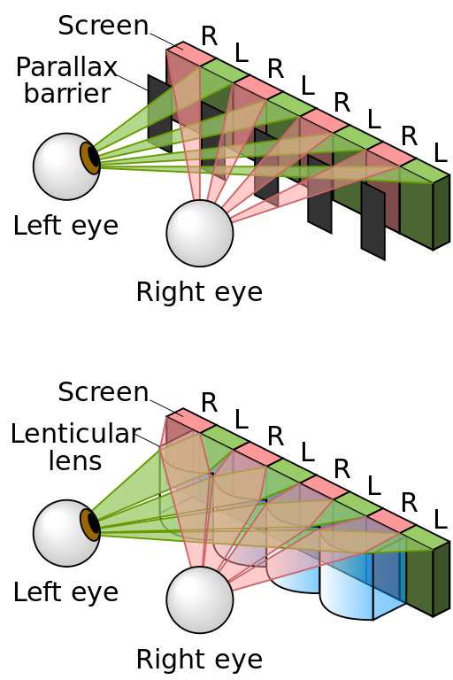
Real 3D Displays
Real 3D requires an image for each eye
Real physical objects
Providing a display for each eye (headset)
Overlaying images an separating them for each eye
  Time synchronized, e.g. shutter glasses
  Polarization filter on projector and glasses
  Color anaglyph systems
Autostereoscopic displays
Volumetric displays
By Cmglee (CC BY-SA)
wikimedia.org
Visual Output
Notes:
https://en.wikipedia.org/wiki/Stereoscopy
Cmglee / CC BY-SA (https://creativecommons.org/licenses/by-sa/3.0)
https://commons.wikimedia.org/wiki/File:Parallax_barrier_vs_lenticular_screen.svg
https://commons.wikimedia.org/wiki/File:2-punktperspektive.svg

Slide 22
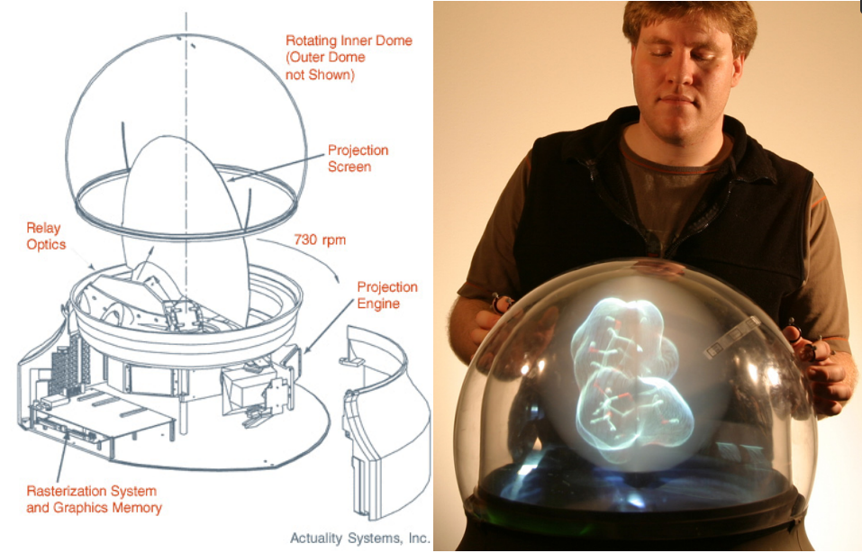
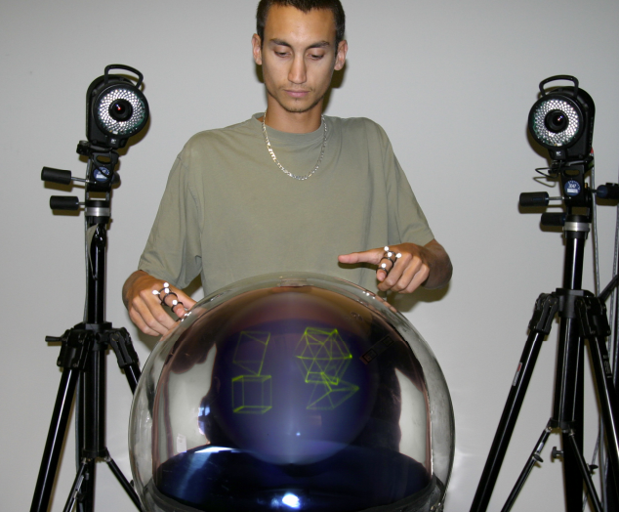
Real 3D Displays
Real 3D requires an image for each eye
Real physical objects
Providing a display for each eye (headset)
Overlaying images an separating them for each eye
  Time synchronized, e.g. shutter glasses
  Polarization filter on projector and glasses
  Color anaglyph systems
Autostereoscopic displays
Volumetric displays
Tovi Grossman, Daniel Wigdor, and Ravin Balakrishnan. 2004. Multi-finger gestural interaction with 3d volumetric displays. In Proceedings of the 17th annual ACM symposium on User interface software and technology (UIST '04). ACM, New York, NY, USA, 61-70.
Swept-screen multiplanar volumetric display
198 2-D slices
768 x 768 pixel slice resolution
100 million voxels
24 Hz volume refresh
Viewing Angle: 360º horizontal, 270º vertical
Visual Output
Notes:
Tovi Grossman, Daniel Wigdor, and Ravin Balakrishnan. 2004. Multi-finger gestural interaction with 3d volumetric displays. In Proceedings of the 17th annual ACM symposium on User interface software and technology (UIST '04). ACM, New York, NY, USA, 61-70.

Slide 23

Did you understand this block?
Can you answer these questions?
Discuss technical parameters that are relevant for visual displays?
What is the difference between a tablet screen and an e-paper display with regard to different parameters?
How does an autostereoscopic display work?
How does the shutter technology work in principle?
Why can we “see” 3D images on 2D screens?
Visual Output
Notes:
Understand …
Technical parameters for visual displays
The impact of display resolution on the user experience
The benefits and issues of large screen setups
Know
How 3D content can be presented
About different technologies that can be used to create a real 3D output

Slide 24
Reference
Lischke, L., Mayer, S., Wolf, K., Sahami Shirazi, A., & Henze, N. (2015, April). Subjective and objective effects of tablet's pixel density. In Proceedings of the 33rd Annual ACM Conference on Human Factors in Computing Systems (pp. 2769-2772).
Tovi Grossman, Daniel Wigdor, and Ravin Balakrishnan. 2004. Multi-finger gestural interaction with 3d volumetric displays. In Proceedings of the 17th annual ACM symposium on User interface software and technology (UIST '04). ACM, New York, NY, USA, 61-70.
Visual Output

Slide 25

License
This file is licensed under the Creative Commons Attribution-Share Alike 4.0 (CC BY-SA) license:
https://creativecommons.org/licenses/by-sa/4.0
Attribution: Albrecht Schmidt
For more content see: https://hci-lecture.de

