Slide 1
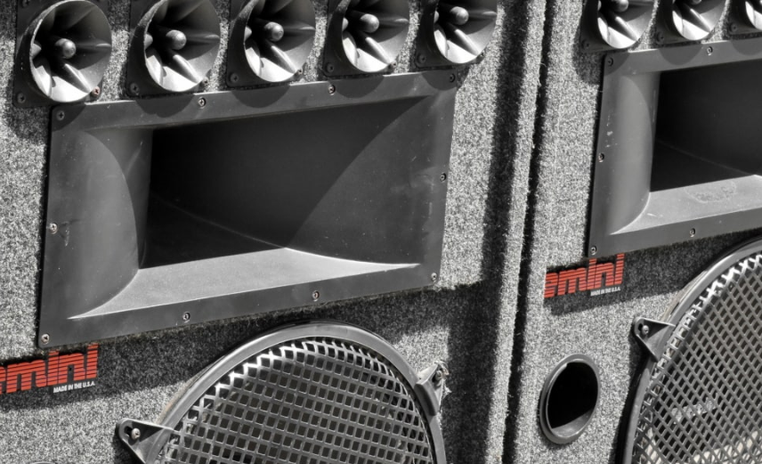
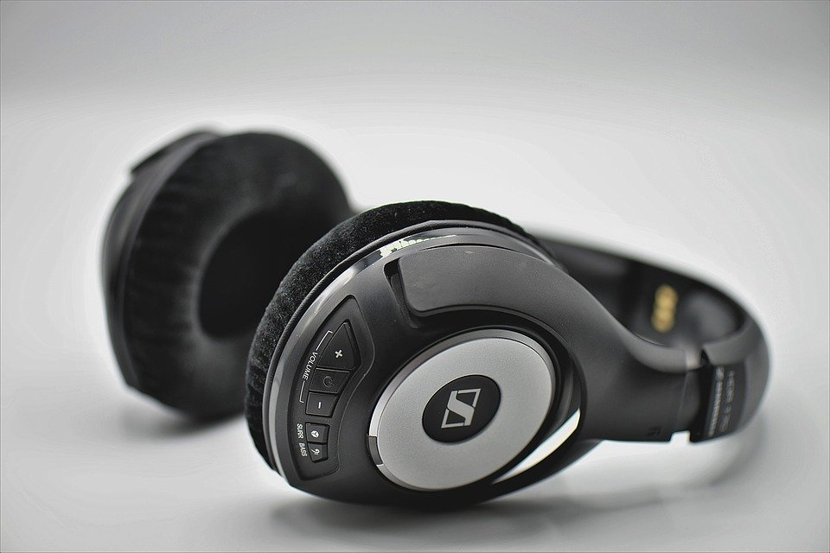
Audio Output
Notes:
https://pixnio.com/media/loudspeaker-equipment-speaker-metallic-old
https://pixnio.com/media/boy-headphones-headset-music-teenager
https://cdn.pixabay.com/photo/2018/09/17/14/27/headphones-3683983_960_720.jpg

Slide 2
Learning Goals
Understand …
Available audio output technologies
Different types of sounds that can be used
How information is communicated using audio
The basics of sonification
Know
Advantages and disadvantages of using sound for information presentation
How data can be mapped to sounds
How to design auditory icons and Earcon
Audio Output
Notes:
Sonifikation („Verklanglichung“) ist die Darstellung von Daten in Klängen.

Slide 3
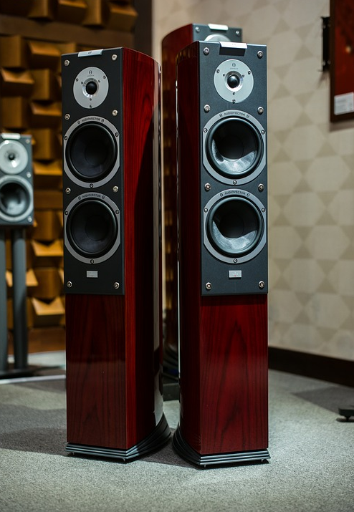
Audio Output Technologies
Technologies and Parameter
Speakers
Mono, stereo
Multi-speaker system
Headphones
Over-ear / on-ear
In-ear / earbuds
Bone conduction
Parameters:
Frequency range and Frequency response
Volume range
Directionality
Physical setup and size
Connections and data transmission
Audio Output
Notes:
https://pixabay.com/de/photos/menschen-frau-kopfh%C3%B6rer-musik-ton-2572972/
https://pixabay.com/de/photos/techland-audio-audiovector-stereo-1822627/

Slide 4
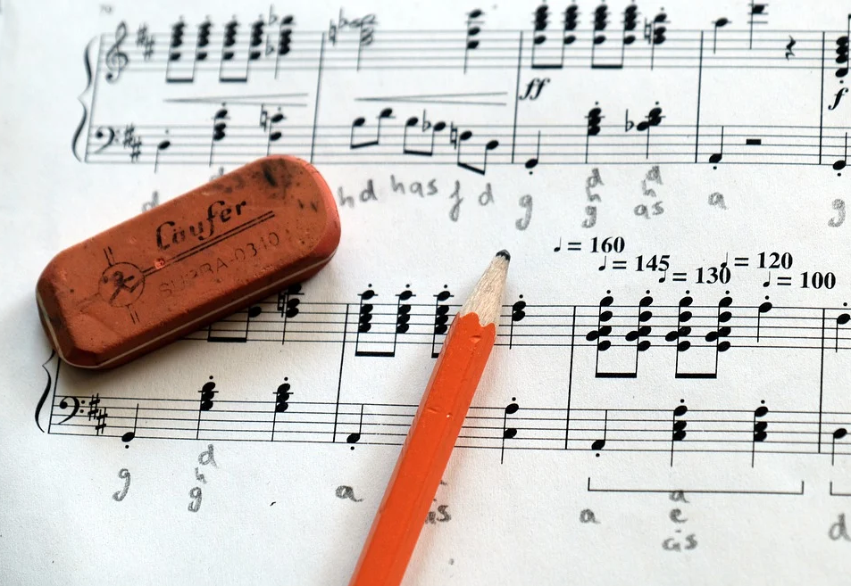
Audio Output Types
What sound is it?
Simple sounds
Beeps, e.g. warnings
Single frequency
Designed sounds
Auditory icons
Earcons
Composed / Music
Sonification
Turning other media into sound
Existing sounds
Speech, nature, music
Audio Output
Notes:
https://pixabay.com/de/photos/noten-musik-notenschl%C3%BCssel-4768600/

Slide 5
Audio Output
How is the sound created on a computer?
Synthesized audio, e.g.
Midi
Text to speech
Playback of captured audio
Spigget (CC BY-SA)
Audio Output

Slide 6
Auditory Icons vs. Earcons
Icons that you can hear
Auditory Icons
“informative sounds as an auditory icon” (Gaver, 1986)
“Gaver’s auditory icons have been used in several systems […] These use environmental sounds that have a semantic link with the object or action they represent.” (Brewster et al.,1994)
Earcons
“We call such structured sounds earcons, which are defined as nonverbal audio messages used in the user-computer interface to provide information to the user about some computer object, operation, or interaction. Examples of computer objects are files, menus, and prompts. Editing, compiling, and executing are examples of operations. An example of an interaction between an object and an operation is editing a file.” (Blattner et al. 1989)
-Gaver, W. W. (1986). Auditory icons: Using sound in computer interfaces. Human-computer interaction, 2(2), 167-177.
-Brewster, Stephen A., Peter C. Wright, and Alastair DN Edwards. "A detailed investigation into the effectiveness of earcons." SANTA FE INSTITUTE STUDIES IN THE SCIENCES OF COMPLEXITY-PROCEEDINGS VOLUME-. Vol. 18. ADDISON-WESLEY PUBLISHING CO, 1994.
-Blattner, M. M., Sumikawa, D. A., & Greenberg, R. M. (1989). Earcons and icons: Their structure and common design principles. Human–Computer Interaction, 4(1), 11-44.
Audio Output

Slide 7
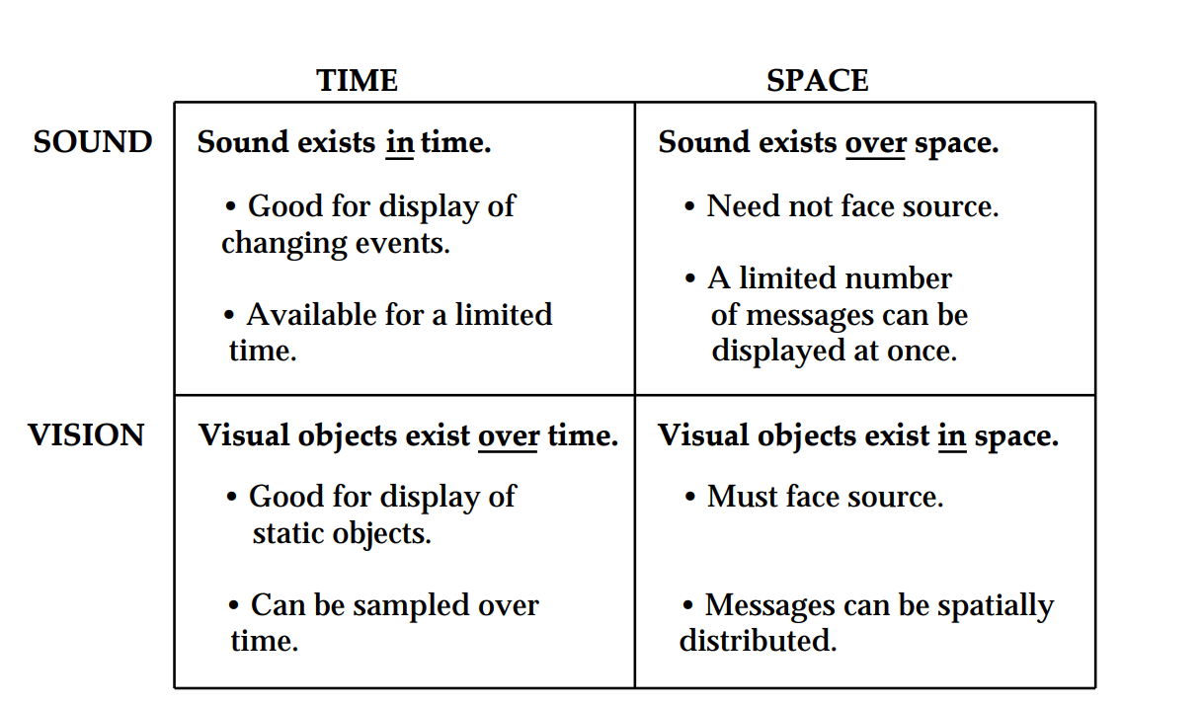
Auditory Icons
Bill Gaver, 1986
Sound vs. Vision
Gaver, W. W. (1986). Auditory icons: Using sound in computer interfaces. Human-computer interaction, 2(2), 167-177.
Audio Output

Slide 8
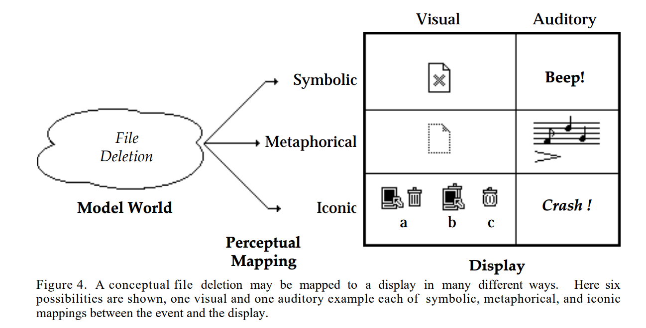
Auditory Icons
Bill Gaver, 1986
Example: Deleting a File
Gaver, W. W. (1986). Auditory icons: Using sound in computer interfaces. Human-computer interaction, 2(2), 167-177.
Audio Output

Slide 9
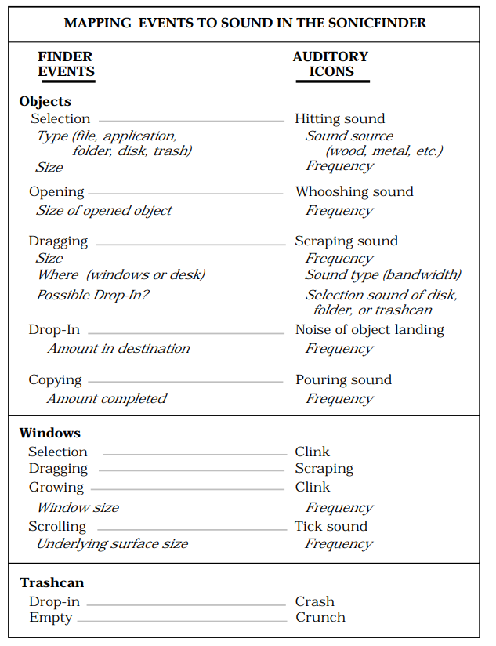
Auditory Icons
Bill Gaver, 1986
Creating sounds that can be linked to events
Sound helps to discriminate
Objects
Activities
Properties (e.g. size, number)
Gaver, W. W. (1986). Auditory icons: Using sound in computer interfaces. Human-computer interaction, 2(2), 167-177.
Audio Output

Slide 10
One Element Earcons
“One-element earcons may be digitized sounds, a sound created by a synthesizer, a single note, or a motive. An element may be compared to a word, whereas a note may be compared to a letter of the alphabet.”
“A single-motive earcon has the attributes of rhythm, pitch, timbre, register, and dynamics. Because single-motive earcons are relatively simple, they can represent basic, common computer entities such as certain error messages, system information, windows, and files.”
“The user hears the click each time a character is deleted.”
Blattner, M. M., Sumikawa, D. A., & Greenberg, R. M. (1989). Earcons and icons: Their structure and common design principles. Human–Computer Interaction, 4(1), 11-44.
Audio Output

Slide 11
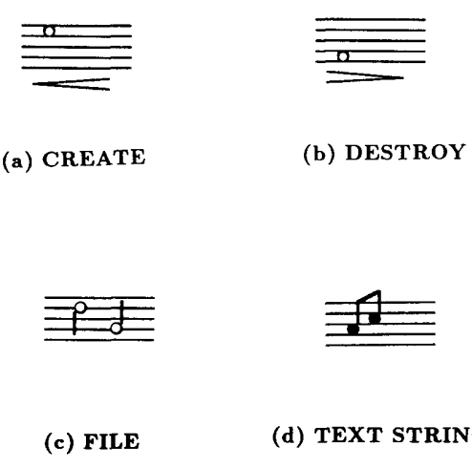
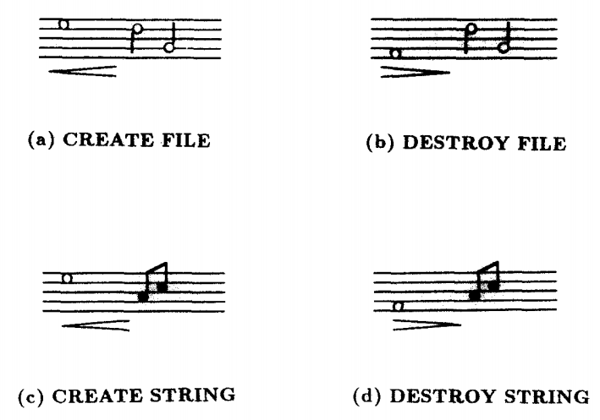
Combined Earcons
“The three construction principles for compound earcons are combining, inheriting, and transforming.” p29
“Combined earcons are formed by placing two or more audio elements in succession.” p29
Blattner, M. M., Sumikawa, D. A., & Greenberg, R. M. (1989). Earcons and icons: Their structure and common design principles. Human–Computer Interaction, 4(1), 11-44.
Audio Output

Slide 12
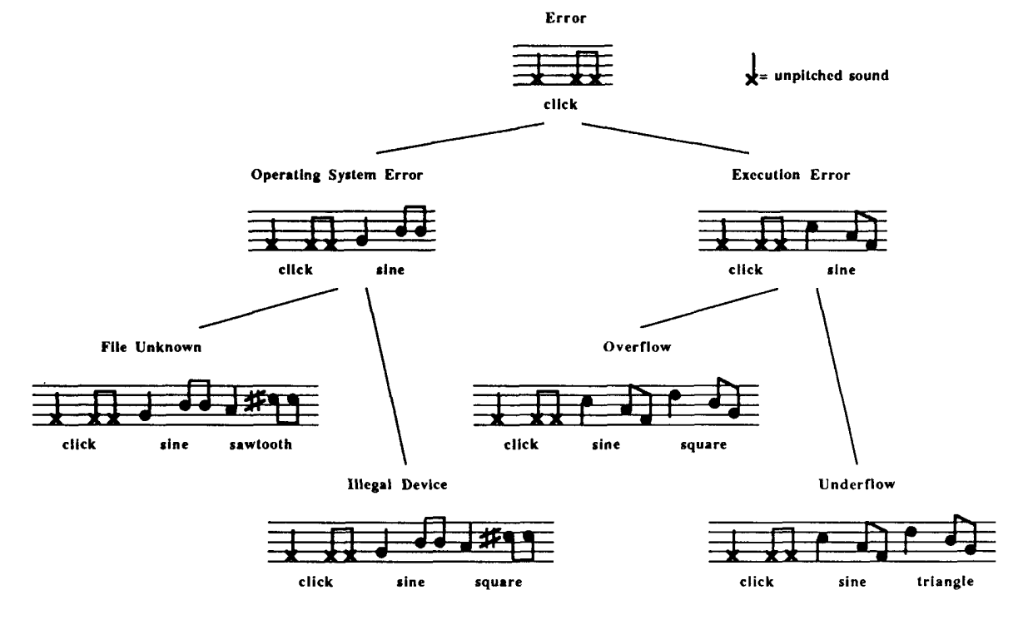
Composed Earcons
Example Hierarchy – for Expert Users one?
Blattner, M. M., Sumikawa, D. A., & Greenberg, R. M. (1989). Earcons and icons: Their structure and common design principles. Human–Computer Interaction, 4(1), 11-44.
Audio Output

Slide 13
What do you hear?
Geiger Counter
Sound of Radiation
Sound from BBC - http://bbcsfx.acropolis.org.uk/?q=geiger
Audio Output

Slide 14
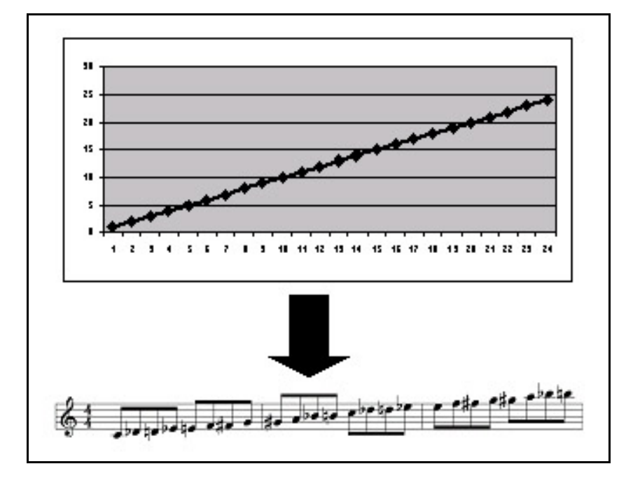
Sonification
Basics
non-speech audio
convey information
Make data / information audible
alternative or complement to visualizations
Brown, L.M. and Brewster, S.A. and Ramloll, S.A. and Burton, R. and Riedel, B. (2003) Design guidelines for audio presentation of graphs and tables. In.9th Int. Conf. on Auditory Display (ICAD), 2003, pp. 284- 287, Boston.
Audio Output

Slide 15
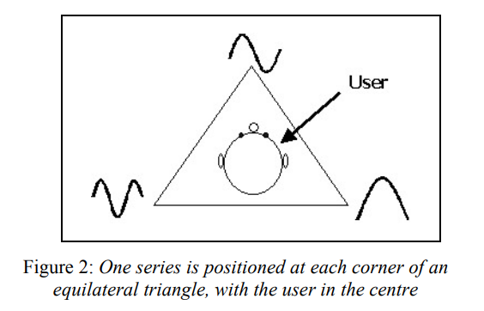
Sonification
Mapping Data to Sounds
“which specific sound dimension is chosen to represent a given data dimension. […]”
Typical acoustic dimensions:
Pitch / Frequency
Amplitude / Volume
Tempo / Duration
Spatial arrangements
Brown, L.M. and Brewster, S.A. and Ramloll, S.A. and Burton, R. and Riedel, B. (2003) Design guidelines for audio presentation of graphs and tables. In.9th Int. Conf. on Auditory Display (ICAD), 2003, pp. 284- 287, Boston.
Walker, B. N., & Nees, M. A. (2011). Theory of sonification. The sonification handbook, 9-39.
Audio Output

Slide 16
Functions of Sonification
Alerting functions
Status and progress indicating functions
Data exploration functions
Auditory graphs
Interactive sonification
Art and entertainment
Walker, B. N., & Nees, M. A. (2011). Theory of sonification. The sonification handbook, 9-39.
Audio Output

Slide 17
Tasks supported by Sonification
Monitoring
Providing Awareness of a process or situation
Data exploration, exploratory inspection
Point estimation and point comparison
Trend identification
Identification of data structure
Walker, B. N., & Nees, M. A. (2011). Theory of sonification. The sonification handbook, 9-39.
Audio Output

Slide 18
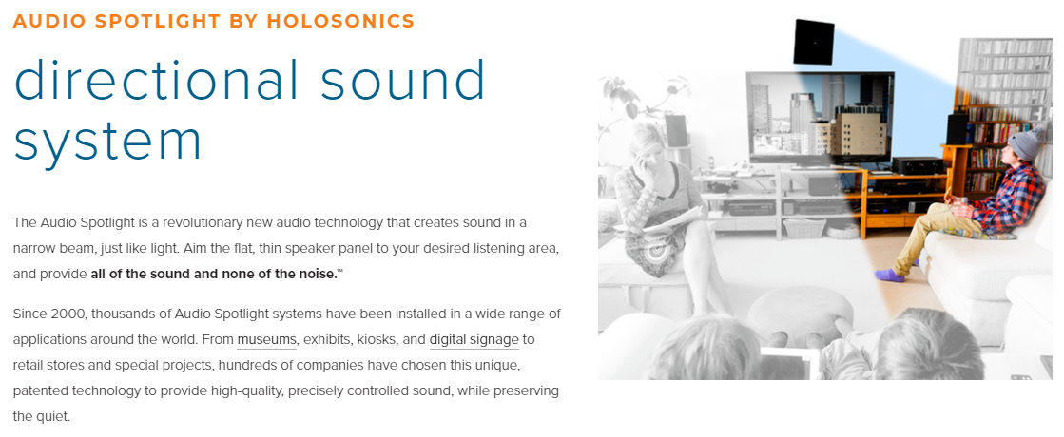
Further topics in this space
optional
Speech interaction and speech dialog system
Spatial audio algorithms and toolkits
E.g. Omnitone (Spatial Audio Rendering on the Web) https://googlechrome.github.io/omnitone/
Speaker systems that provided directed sound
E.g. Audio Spot lights, https://www.holosonics.com/
https://www.youtube.com/watch?v=lk7PVZYS_TQ
Audio Output

Slide 19
Did you understand this block?
Can you answer these questions?
What technologies are available for presenting audio?
Discuss how sounds can be used to convey information?
What is the difference between auditory icons and Earcons?
What is a combined Earcon?
What are typical functions of sonification?
What tasks can be supported by sonification?
What auditory dimensions can be used to map data onto?
Audio Output
Notes:
Understand …
Available audio output technologies
Different types of sounds that can be used
How information is communicated using audio
The basics of sonification
Know
Advantages and disadvantages of using sound for information presentation
How data can be mapped to sounds
How to design auditory icons and Earcon

Slide 20
Reference
Gaver, W. W. (1986). Auditory icons: Using sound in computer interfaces. Human-computer interaction, 2(2), 167-177.
Brewster, Stephen A., Peter C. Wright, and Alastair DN Edwards. "A detailed investigation into the effectiveness of earcons." SANTA FE INSTITUTE STUDIES IN THE SCIENCES OF COMPLEXITY-PROCEEDINGS VOLUME-. Vol. 18. ADDISON-WESLEY PUBLISHING CO, 1994.
Blattner, M. M., Sumikawa, D. A., & Greenberg, R. M. (1989). Earcons and icons: Their structure and common design principles. Human–Computer Interaction, 4(1), 11-44.
Brown, L.M. and Brewster, S.A. and Ramloll, S.A. and Burton, R. and Riedel, B. (2003) Design guidelines for audio presentation of graphs and tables. In.9th Int. Conf. on Auditory Display (ICAD), 2003, pp. 284- 287, Boston.
Walker, B. N., & Nees, M. A. (2011). Theory of sonification. The sonification handbook, 9-39.
Sound library from BBC - http://bbcsfx.acropolis.org.uk/?q=geiger
Audio Output

Slide 21
License
This file is licensed under the Creative Commons Attribution-Share Alike 4.0 (CC BY-SA) license:
https://creativecommons.org/licenses/by-sa/4.0
Attribution: Albrecht Schmidt
For more content see: https://hci-lecture.de

