Slide 1
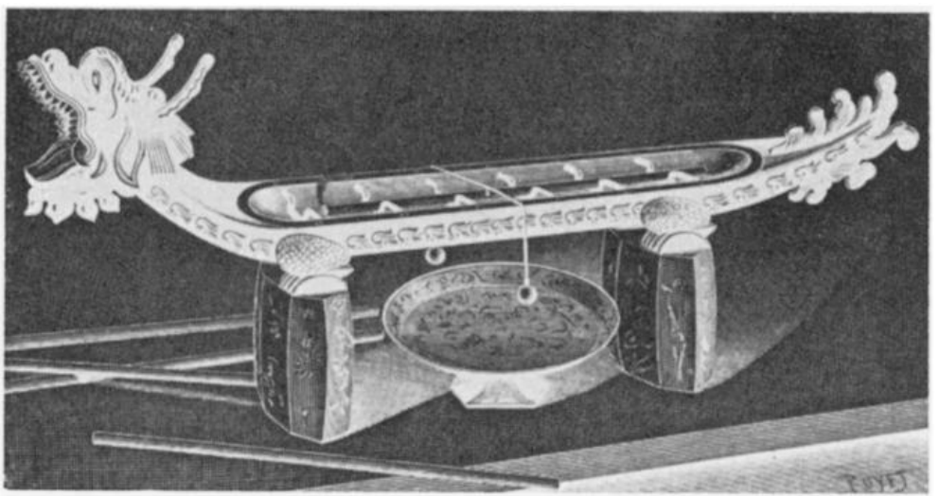
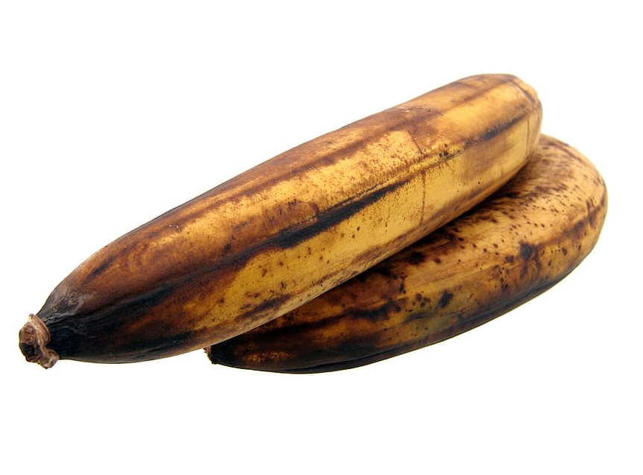
Olfactory Output
Fig. 23. Dragon vessel timepiece.
Taste Output

Slide 2
Learning Goals
Understand …
The challenges of olfactory output devices
What parameters are used to create an artificial taste
Know
Historic an example of using smell as information display
The basic components and functions of an olfactory output devices
Printing and Physical Output

Slide 3
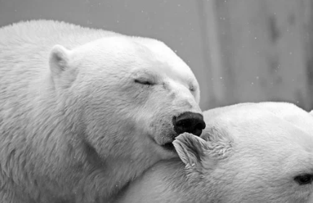
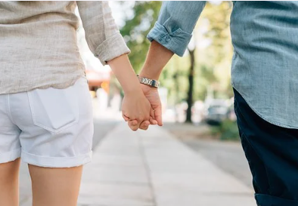
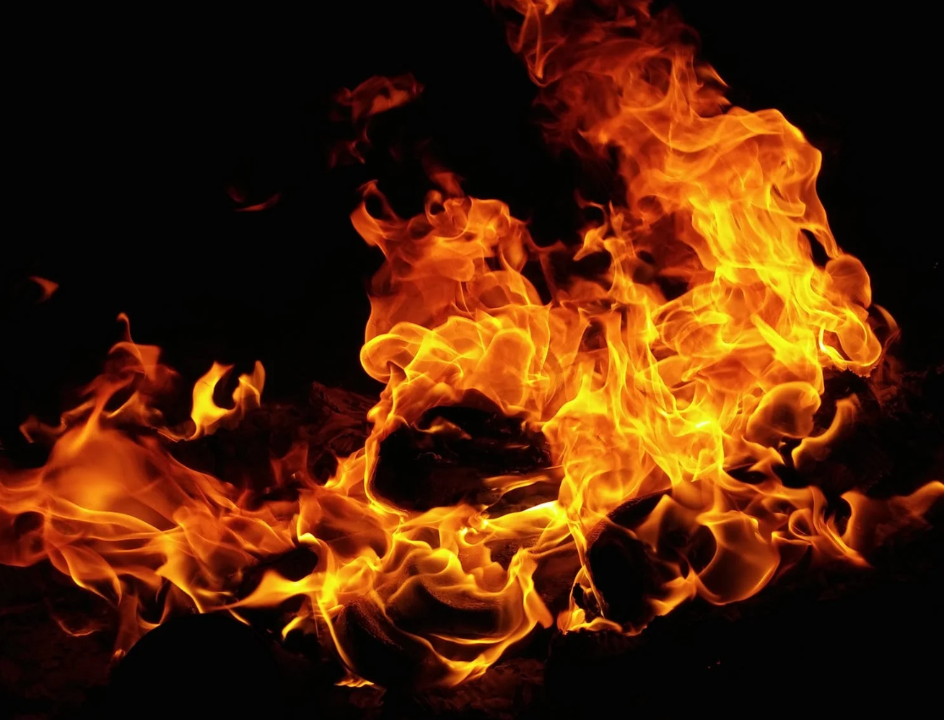
Aromatic Output for Interaction
Humans use their sense of smell
Is food save to eat?
Is there danger due to a fire?
Relationships
Unexplored medium in human computer interaction
technical difficulties in emitting scent on demand
chemical difficulties in creating accurate and pleasant scents
Joseph "Jofish" Kaye, Making scents: aromatic output for HCI, Interactions, Volume 10, Number 1 (2004), Pages 48-61
Printing and Physical Output
Notes:
https://pixabay.com/photos/search/relationship/

Slide 4
Incense Clocks
Historic smell output devices: Dragon vessel timepiece
Fig. 23. Dragon vessel timepiece. Bedini, S. A. (1963). The scent of time. A study of the use of fire and incense for time measurement in oriental countries. Transactions of the American Philosophical Society, 53(5), 1-51.
Printing and Physical Output

Slide 5
Incense Clocks
Fig. 23. Dragon vessel timepiece.
Historic smell output devices
timekeeping device (China, East Asia)
Clock body holds incense sticks or powdered incense
Different incenses along the body
Calibrated brining rate to measure time
Can include bells (auditory signal)
Used in homes and temples
New smell / other incense signals passage of time
…you can smell the time
Bedini, S. A. (1963). The scent of time. A study of the use of fire and incense for time measurement in oriental countries. Transactions of the American Philosophical Society, 53(5), 1-51.
Printing and Physical Output
Notes:
https://en.wikipedia.org/wiki/Incense_clock

Slide 6
Physiology and Chemistry of Smell
A thousand different kinds of olfactory receptors in our nose,
each can sense a single kind of chemical bond in a molecule
No abstract classification of smell
Examples: how does mint taste? It tastes like …mint
Compared to colors: green vs. spinach colored
Rapidly acclimatized - Less than 1 minute
Human Olfactory Bandwidth… … hard to tell
Perfumers and florist can distinguish many different smells - potentially thousands
Joseph "Jofish" Kaye, Making scents: aromatic output for HCI, Interactions, Volume 10, Number 1 (2004), Pages 48-61
Printing and Physical Output
Notes:
https://en.wikipedia.org/wiki/Incense_clock

Slide 7
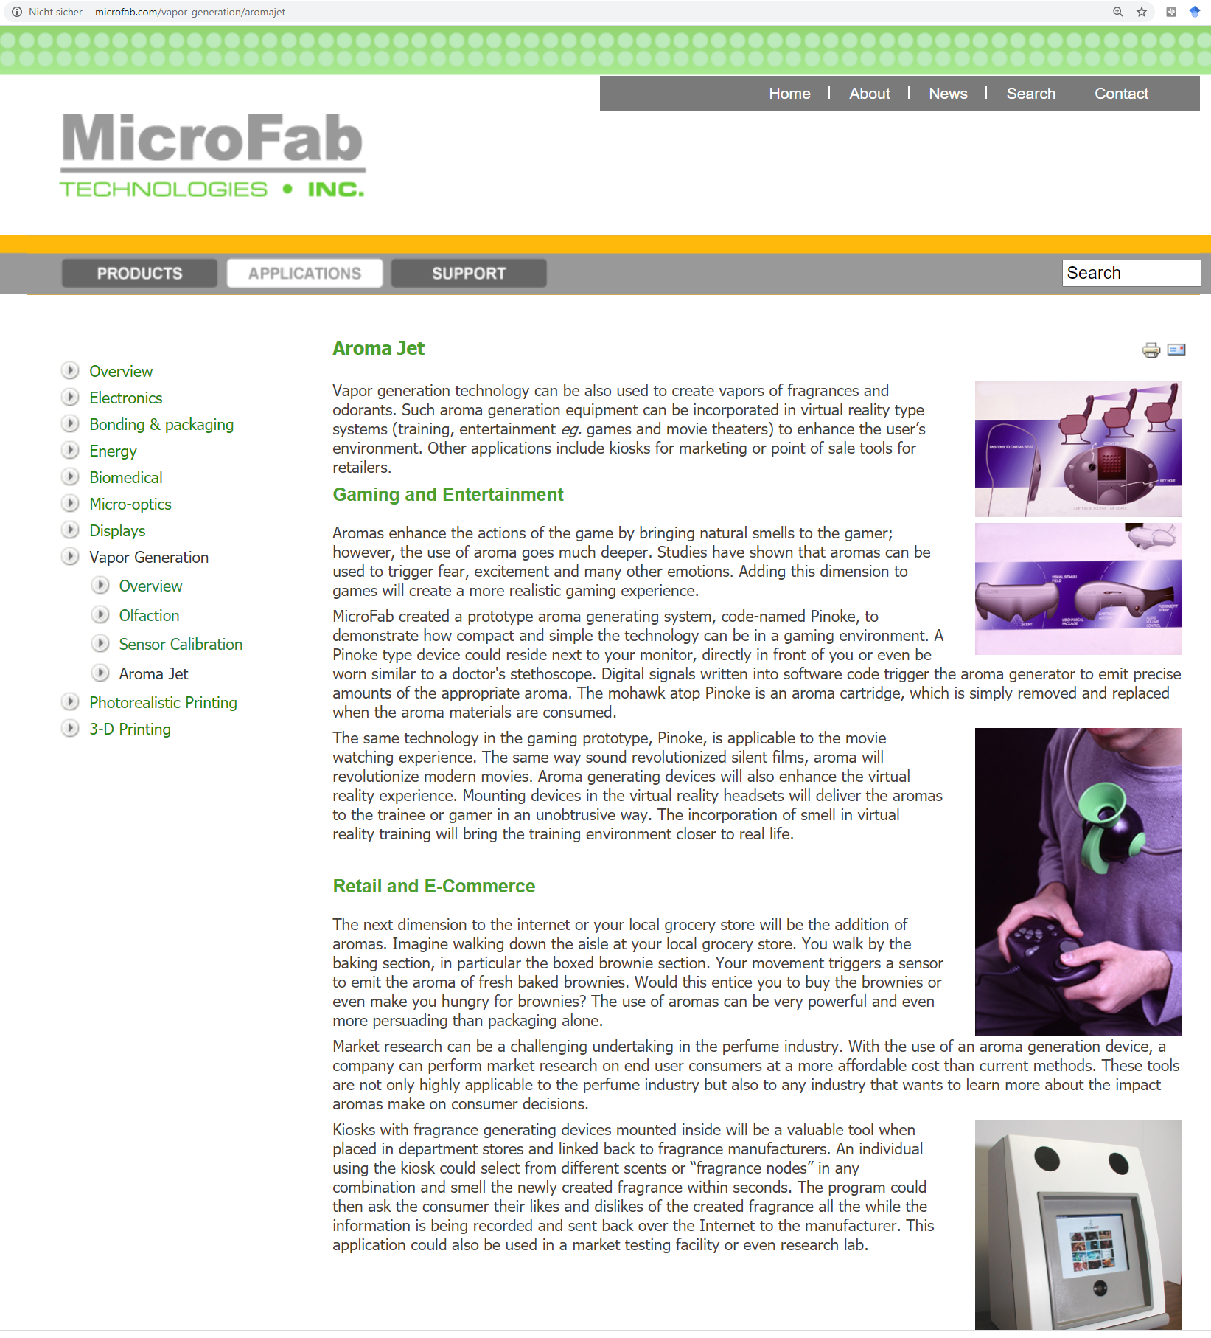
Smell output
Explored in movie theaters and VR… but so far not really successful
Olfactory Icons
Smell a “shot” fired each time you press the trigger in your game
Ambient Notification, e.g. Smell of rose to notify you of a date or an incoming message
What information should be displayed?
An Olfactory display is useful for slowly-moving, medium-duration information or information for which an aggregate representation is slowly changing.
http://www.microfab.com/vapor-generation/aromajet
Joseph "Jofish" Kaye, Making scents: aromatic output for HCI, Interactions, Volume 10, Number 1 (2004), Pages 48-61
Printing and Physical Output

Slide 8
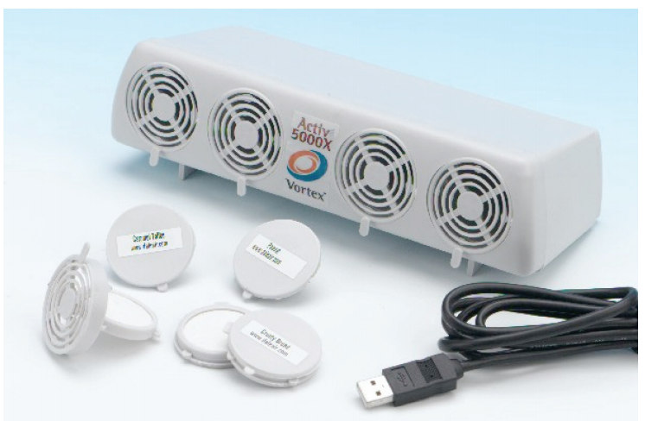
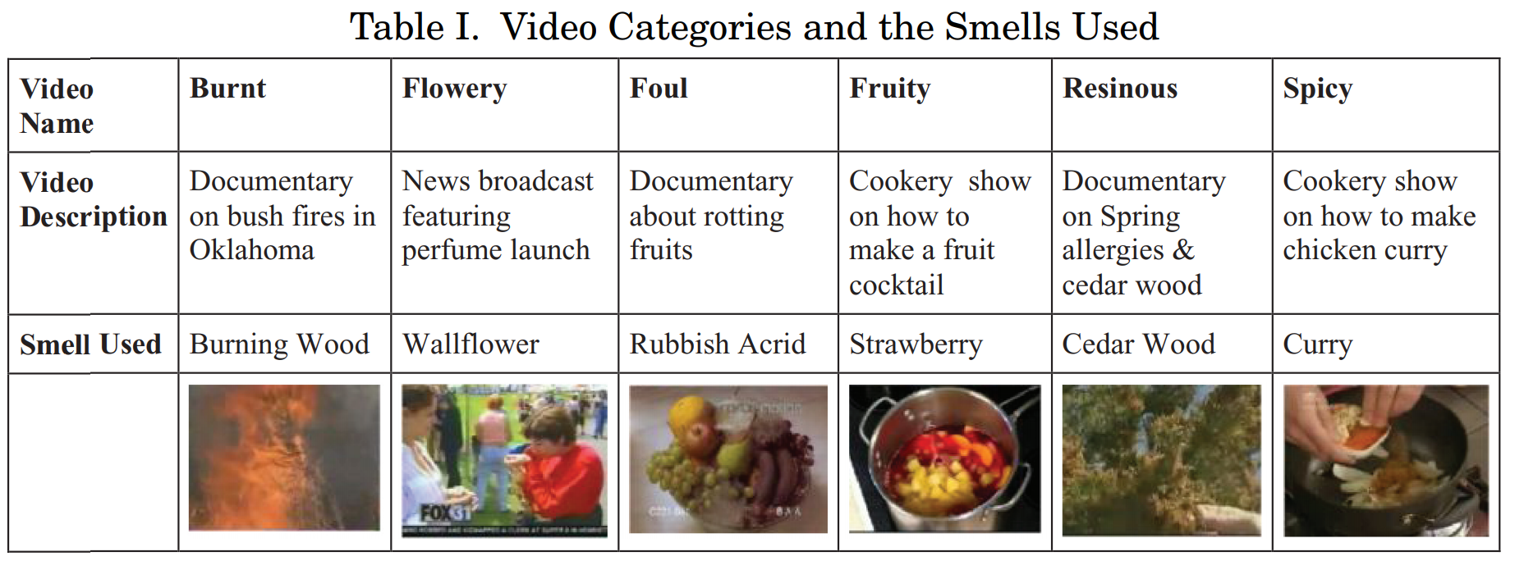
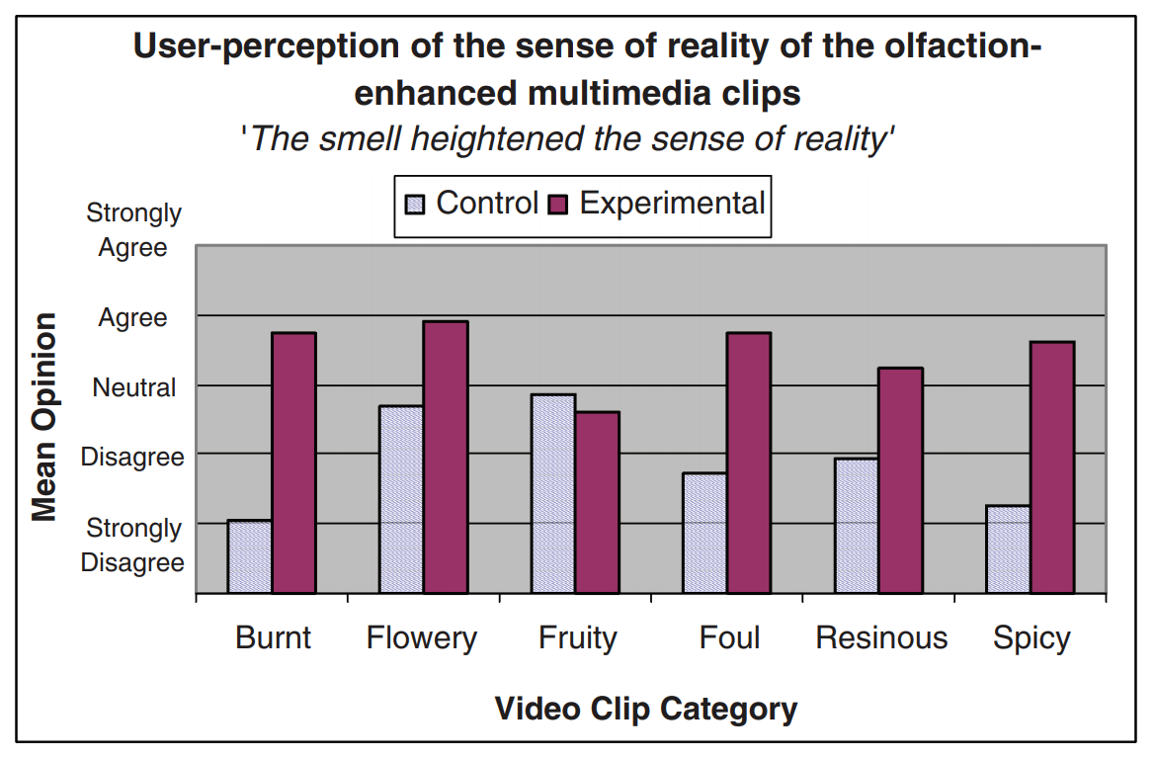
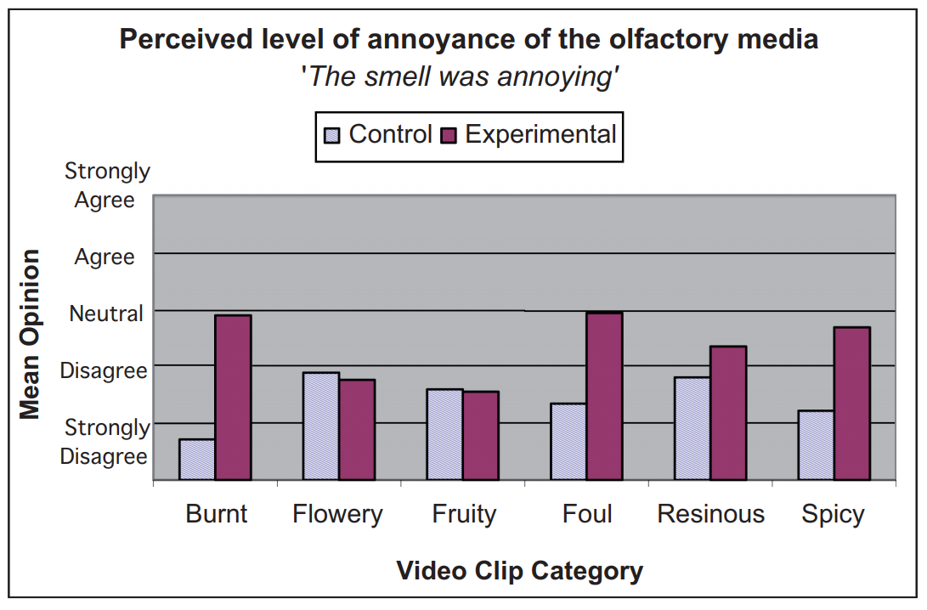
Multimedia Applications with Olfaction
Gheorghita Ghinea and Oluwakemi Ademoye. 2012. The sweet smell of success: Enhancing multimedia applications with olfaction. ACM Trans. Multimedia Comput. Commun. Appl. 8, 1, Article 2 (January 2012), 17 pages. DOI:https://doi.org/10.1145/2071396.2071398
Printing and Physical Output

Slide 9
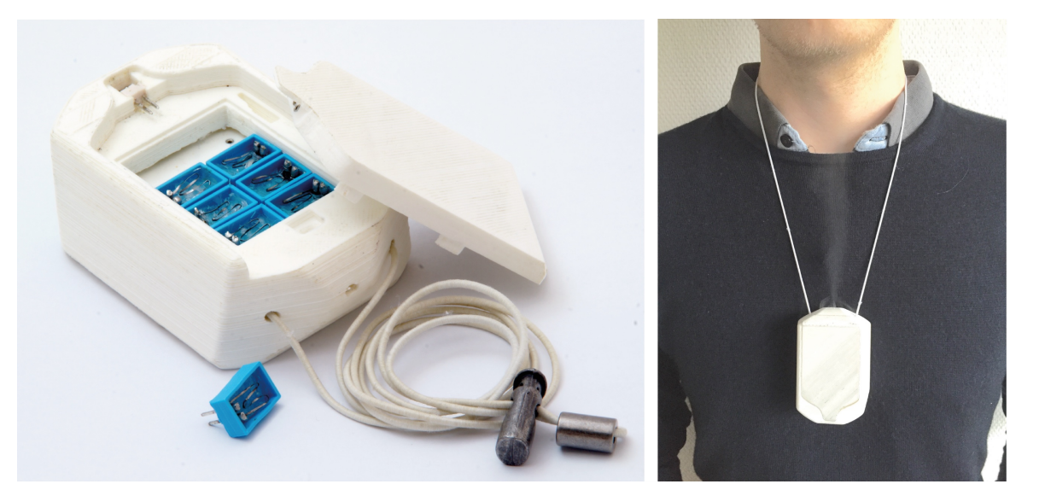
Wearable Olfactory Output Device (Research)
Dobbelstein, D., Herrdum, S., & Rukzio, E. (2017, September). inScent: A wearable olfactory display as an amplification for mobile notifications. In Proceedings of the 2017 ACM International Symposium on Wearable Computers (pp. 130-137).
Printing and Physical Output

Slide 10
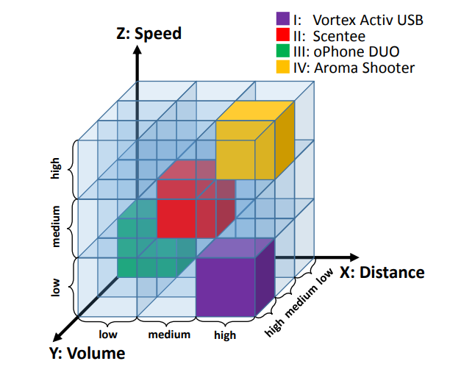
Olfactory Output Device
Key challenges
Creating a certain smell
Storing and providing the smell
Timed delivery of the smell to the user
Neutralizing / replacing the smell
Parameters of scent delivery
Distance
Volume
Speed
Dmitrenko, D., Vi, C. T., & Obrist, M. (2016, October). A comparison of scent-delivery devices and their meaningful use for in-car olfactory interaction. In Proceedings of the 8th International Conference on Automotive User Interfaces and Interactive Vehicular Applications (pp. 23-26).
Printing and Physical Output

Slide 11
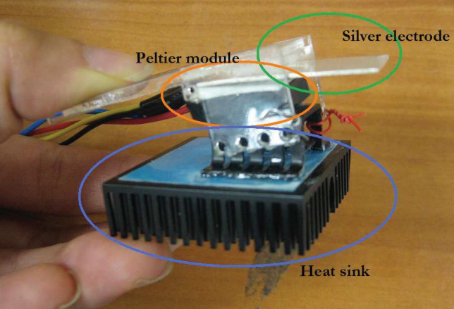
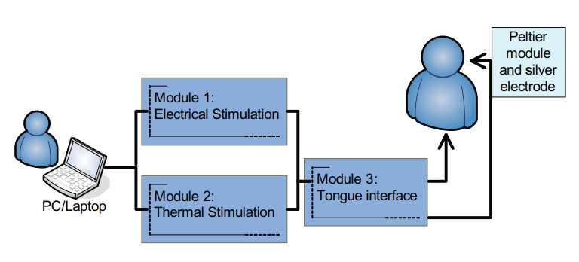
Taste Output Device (Research)
Tongue interface
Peltier Element
Silver electrode
Output Parameters
Electro stimulation (polarity, frequency, 0μA to 200μA, 50Hz to 1000Hz.)
Temperature (cooling/heating, 20°C to 35°)
Ranasinghe, N., Karunanayaka, K., Cheok, A. D., Fernando, O. N. N., Nii, H., & Gopalakrishnakone, P. (2011, November). Digital taste and smell communication. In Proceedings of the 6th international conference on body area networks (pp. 78-84).
Printing and Physical Output

Slide 12
Did you understand this block?
Can you answer these questions?
What are the key challenges when creating an olfactory display?
What components do you need for outputting smell?
What parameters are relevant for olfactory output devices?
How is artificial taste created?
Give a historical example of a smell output device and explain its basic function-
Printing and Physical Output
Notes:
Understand …
The challenges of olfactory output devices
What parameters are used to create an artifical taste
Know
Historic an example of using smell as information display
The basic components and functions of an olfactory output devices

Slide 13
References
Joseph "Jofish" Kaye, Making scents: aromatic output for HCI, Interactions, Volume 10, Number 1 (2004), Pages 48-61
Bedini, S. A. (1963). The scent of time. A study of the use of fire and incense for time measurement in oriental countries. Transactions of the American Philosophical Society, 53(5), 1-51.
Gheorghita Ghinea and Oluwakemi Ademoye. 2012. The sweet smell of success: Enhancing multimedia applications with olfaction. ACM Trans. Multimedia Comput. Commun. Appl. 8, 1, Article 2 (January 2012), 17 pages. DOI:https://doi.org/10.1145/2071396.2071398
Dobbelstein, D., Herrdum, S., & Rukzio, E. (2017, September). inScent: A wearable olfactory display as an amplification for mobile notifications. In Proceedings of the 2017 ACM International Symposium on Wearable Computers (pp. 130-137).
Dmitrenko, D., Vi, C. T., & Obrist, M. (2016, October). A comparison of scent-delivery devices and their meaningful use for in-car olfactory interaction. In Proceedings of the 8th International Conference on Automotive User Interfaces and Interactive Vehicular Applications (pp. 23-26).
Ranasinghe, N., Karunanayaka, K., Cheok, A. D., Fernando, O. N. N., Nii, H., & Gopalakrishnakone, P. (2011, November). Digital taste and smell communication. In Proceedings of the 6th international conference on body area networks (pp. 78-84).
Printing and Physical Output

Slide 14
License
This file is licensed under the Creative Commons Attribution-Share Alike 4.0 (CC BY-SA) license:
https://creativecommons.org/licenses/by-sa/4.0
Attribution: Albrecht Schmidt
For more content see: https://hci-lecture.de

