Slide 1
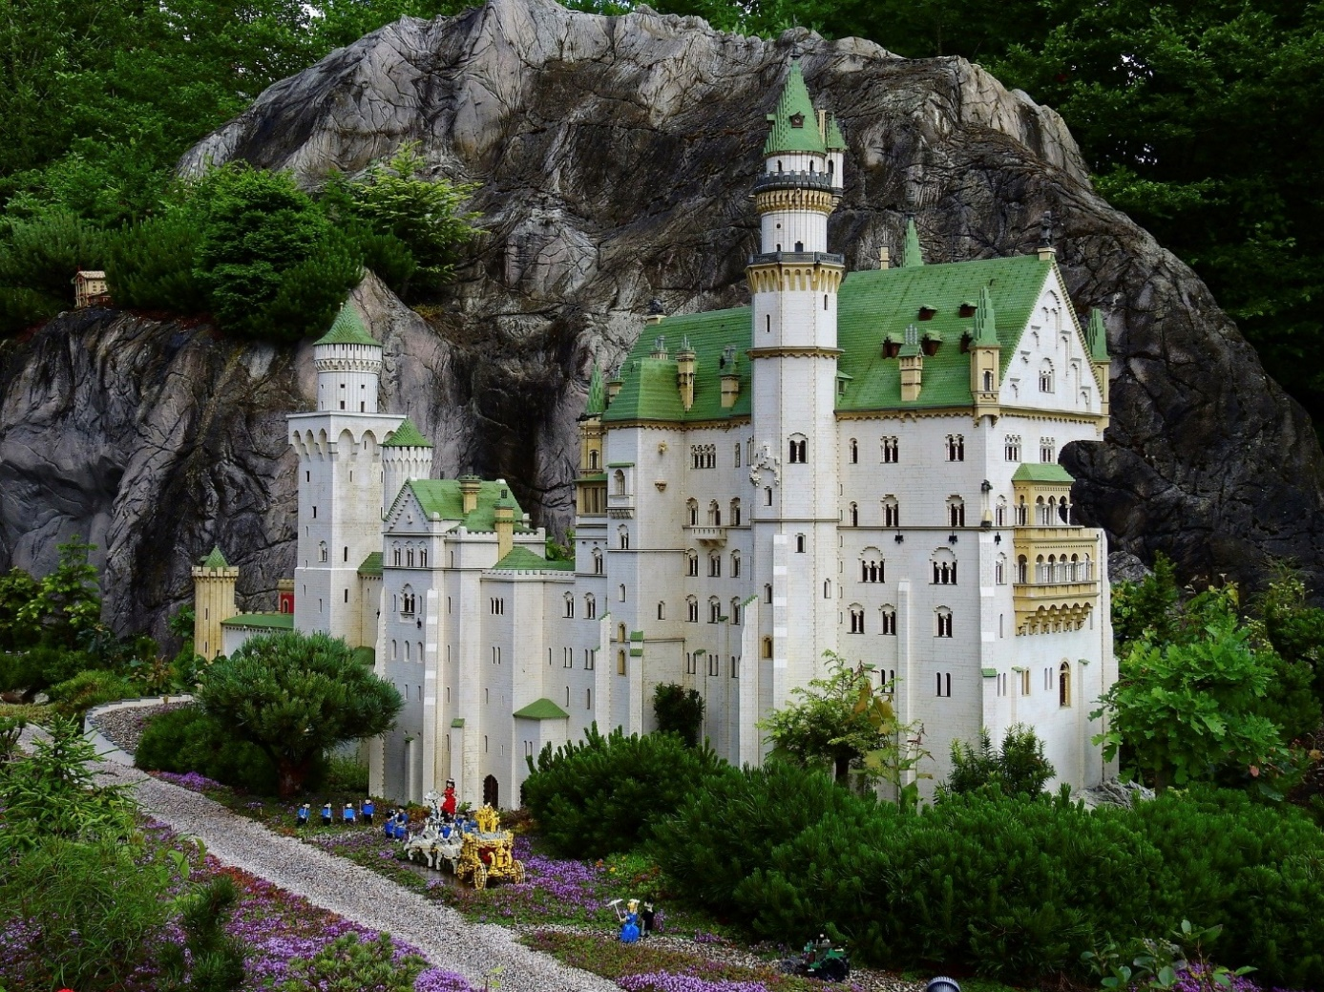


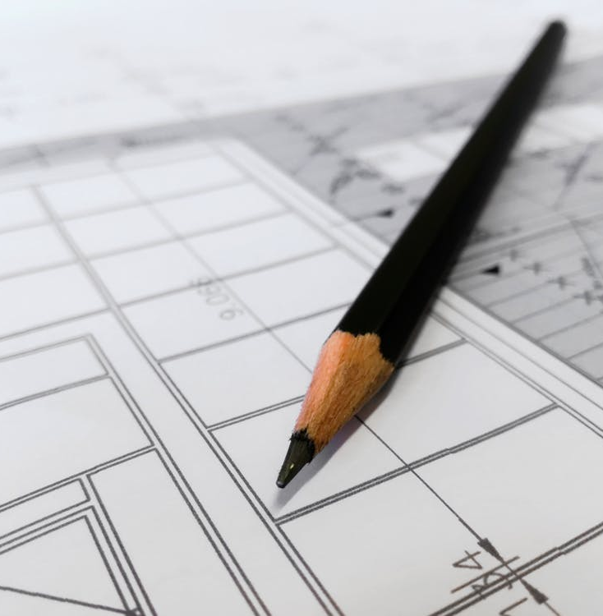

Introduction to Models
Notes:
https://pixabay.com/de/photos/lego-legoland-bauen-spielen-2383096/
https://www.pexels.com/photo/woman-wearing-pink-overcoat-and-black-inner-top-2043590/
https://www.pexels.com/photo/earth-desert-dry-hot-60013/
https://www.pexels.com/photo/architect-architecture-artist-blur-268362/

Slide 2
Learning Goals
Understand what models are and why they are useful
Now about their limitations
Have a rough overview of models in HCI
Introduction to Models

Slide 3
What is a model?
Introduction to Models

Slide 4

Photo models
By Godisable Jacob from https://www.pexels.com/photo/woman-sitting-on-sofa-bed-wearing-sunglasses-965324/ (PD)
Introduction to Models

Slide 5
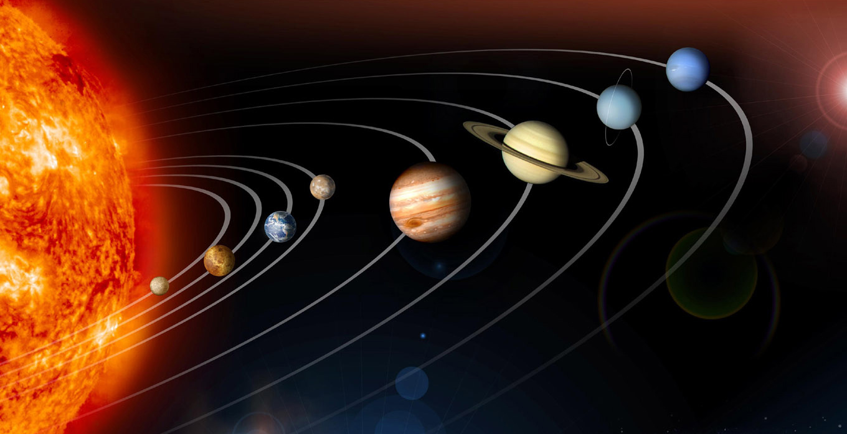
Copernican heliocentrism
From https://www.jpl.nasa.gov/spaceimages/details.php?id=PIA12114 (PD)
Introduction to Models

Slide 6
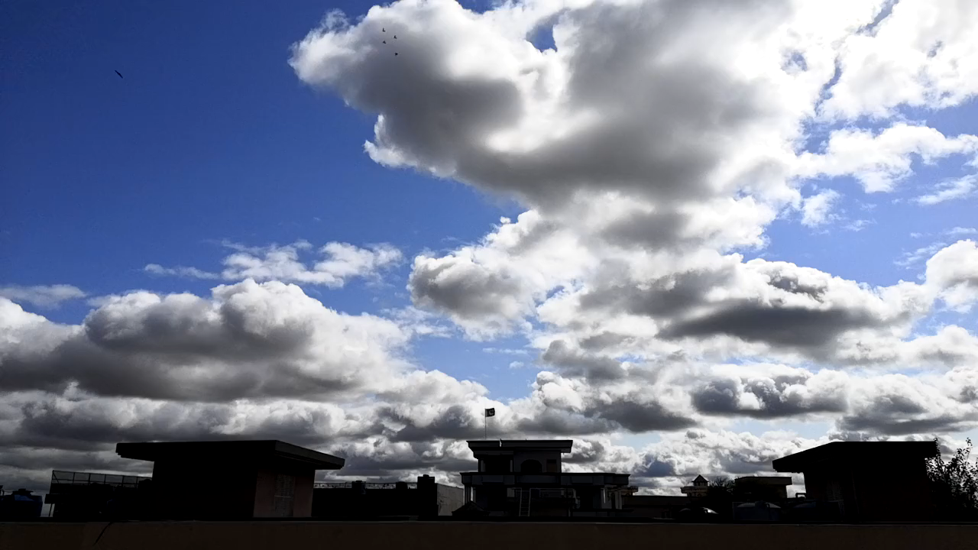
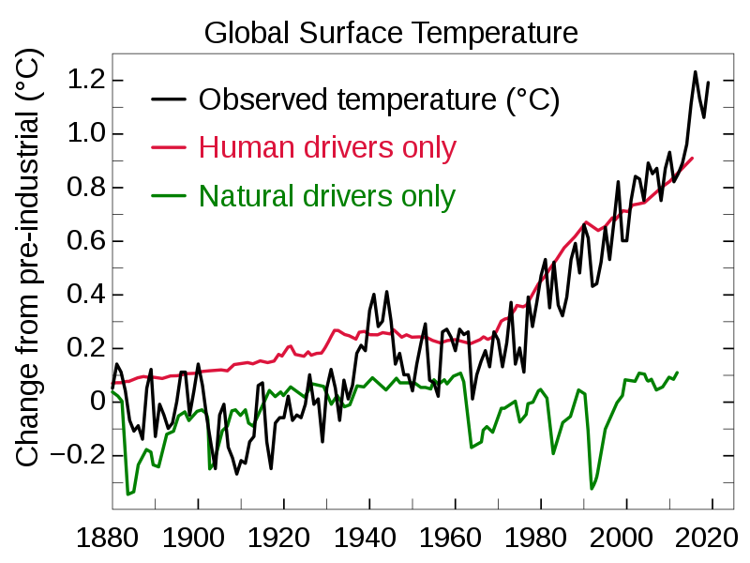
Weather and Climate Models
Video by Saif Ullah from https://www.pexels.com/video/dark-clouds-in-the-sky-1686599/ (PD)
Image by Efbrazil from https://en.wikipedia.org/wiki/File:Global_Temperature_And_Forces.svg (CC BY-SA 4.0)
Introduction to Models

Slide 7
Models
Are representations of phenomena that help us to understand how something works or how it will work.
Models are never perfects. There will always be one that is better for specific questions.
A model is only useful for specific phenomena but not is not useful for most phenomena.
Introduction to Models

Slide 8
Models in Human-Computer Interaction
Can you think about phenomena that we could model in HCI?
Introduction to Models

Slide 9
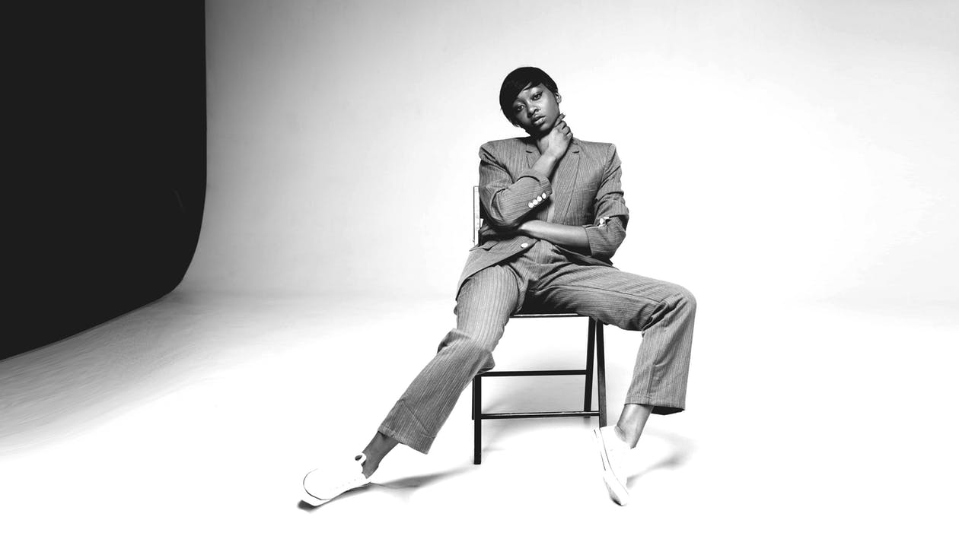
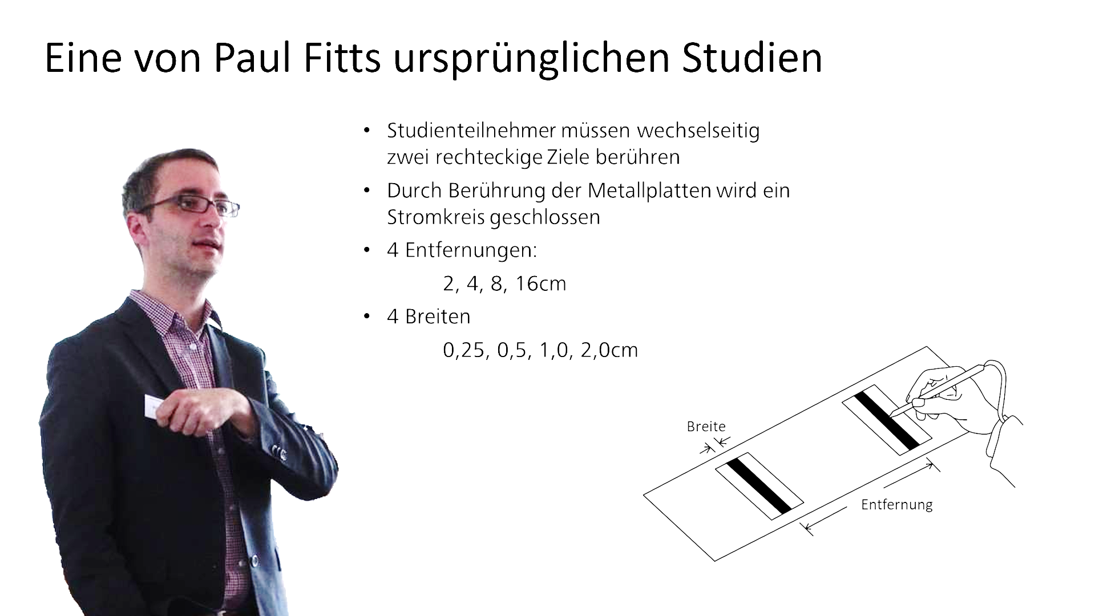
https://www.pexels.com/photo/grayscale-photo-of-person-sitting-on-chair-952212/
https://www.pexels.com/photo/woman-sitting-on-sofa-bed-wearing-sunglasses-965324/
Introduction to Models

Slide 10
Weather and Climate Models
Video by Saif Ullah from https://www.pexels.com/video/dark-clouds-in-the-sky-1686599/ (PD)
Introduction to Models

Slide 11
Weather models
Video by Saif Ullah from https://www.pexels.com/video/dark-clouds-in-the-sky-1686599/ (PD)
Image by Efbrazil from https://en.wikipedia.org/wiki/File:Global_Temperature_And_Forces.svg (CC BY-SA 4.0)
Introduction to Models

Slide 12
Prototypes
Prototypes are representations of systems and help us to understand how they will work.
Perfectly valid models and used in HCI
Covered in a dedicated block
From Le, H. V., Mayer, S., Bader, P., & Henze, N. (2017). A smartphone prototype for touch interaction on the whole device surface. MobileHCI.
Introduction to Models

Slide 13
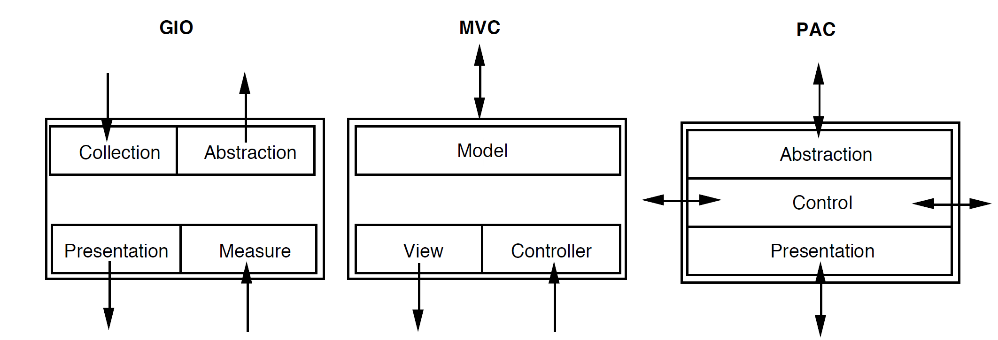
Software architecture models
Conceptual software architecture models are representations of our systems
Similar to prototypes they help us to build better systems
Yet another topic for another time
From Coutaz, J., Nigay, L., & Salber, D. (1993). Conceptual software architecture models for interactive system. ESPRIT BRA, 7040.
Introduction to Models

Slide 14

Mental models
Mental models are models users form about our systems
While we want to influence them, we cannot develop them
Also covered in another block
Image by Andrea Piacquadio from https://www.pexels.com/photo/photo-of-a-woman-thinking-941555/
Introduction to Models

Slide 15
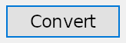

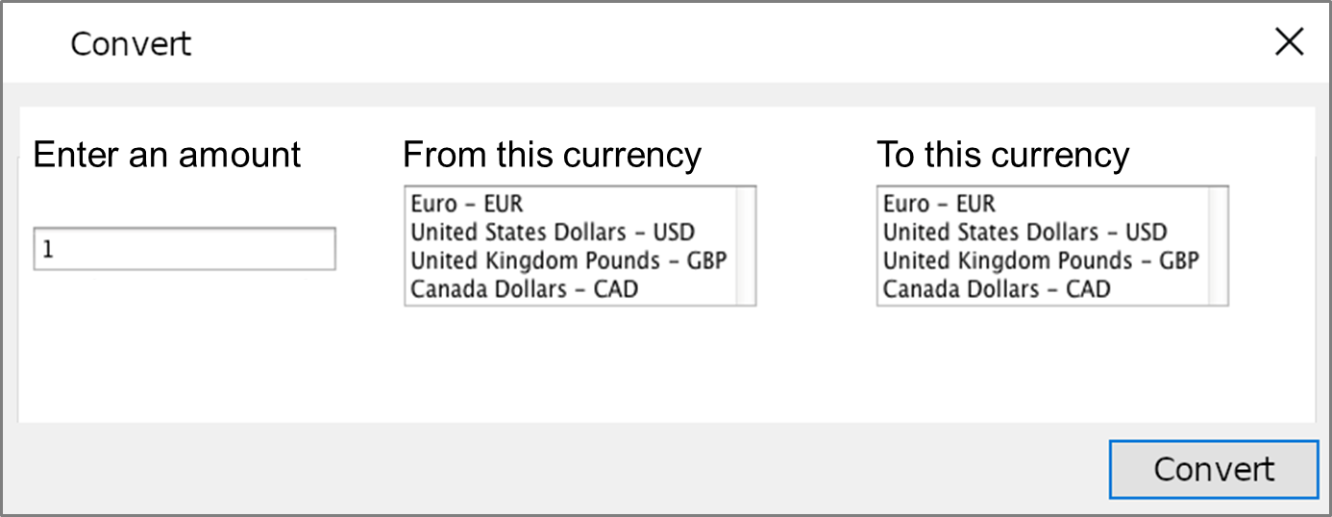

Models of users
task complexity
Bottom image by Andrea Piacquadio from https://www.pexels.com/photo/photo-of-woman-using-her-laptop-935756/

Slide 16
License
This file is licensed under the Creative Commons Attribution-Share Alike 4.0 (CC BY-SA) license:
https://creativecommons.org/licenses/by-sa/4.0
Attribution: Niels Henze
For more content see: https://hci-lecture.de

