Slide 1
GOMS
By Andrea Piacquadio from https://www.pexels.com/photo/man-in-black-suit-holding-banknotes-and-credit-card-3831185 (PD)

Slide 2
Learning Goals
Know about the GOMS family
Be able to use GOMS for simple tasks
GOMS

Slide 3
GOMS Family
GOMS
(CMN-)GOMS
KLM
NGOMSL
CPM-GOMS
Plain GOMS
Pseudo-code
First introduced by Card, Moran and Newell
Keystroke-Level Model
Simplified version of GOMS
Natural GOMS Language
Stricter version of GOMS
Provides more well-defined, structured natural language
Estimates learning time
Cognitive Perceptual Motor analysis of activity
Critical Path Method
Based on the parallel multi-processor stage of human information processing
GOMS

Slide 4
Getting Cash
By Erol Ahmed from https://unsplash.com/photos/ln8zRaM3VmI (PD)
GOMS
Notes:
GOAL: GET-MONEY
GOAL: USE-CASH-MACHINE
INSERT-CARD
ENTER-PIN
SELECT-GET-CASH
ENTER-AMOUNT
COLLECT-MONEY

Slide 5
The Process of Getting Cash
By Erol Ahmed from https://unsplash.com/photos/ln8zRaM3VmI (PD)
GOAL: GET-MONEY
GOAL: USE-CASH-MACHINE
INSERT-CARD
ENTER-PIN
SELECT-GET-CASH
ENTER-AMOUNT
COLLECT-MONEY
outer goal satisfied
GOMS

Slide 6
The Process of Getting Cash
By Erol Ahmed from https://unsplash.com/photos/ln8zRaM3VmI (PD)
GOAL: GET-MONEY
GOAL: USE-CASH-MACHINE
INSERT-CARD
ENTER-PIN
SELECT-GET-CASH
ENTER-AMOUNT
COLLECT-CARD
COLLECT-MONEY
outer goal satisfied
GOMS

Slide 7
The GOMS Model
Goals
(Verbal) description of what a user wants to accomplish
Various levels of complexity possible
Operators
Possible actions in the system
Various levels of abstraction possible (sub-goals / ... / keystrokes)
Methods
Sequences of operators that achieve a goal
Selection rules
Rules that define when a user employs which method (among alternatives)
GOMS

Slide 8
GOMS Example: Closing a Window
GOMS

Slide 9
GOMS Example: Closing a Window
GOMS

Slide 10
GOMS Example: Closing a Window
GOAL: CLOSE-WINDOW
[select
GOAL: USE-MENU-METHOD
MOVE-MOUSE-TO-FILE-MENU
PULL-DOWN-FILE-MENU
CLICK-OVER-CLOSE-OPTION
GOAL: USE-ALT-F4-METHOD
HOLD-ALT-KEY
PRESS-F4-KEY]
VERIFY-CLOSE
For a particular user:
Rule 1: Select USE-MENU-METHOD unless
another rule applies
Rule 2: If the application is GAME,
select CTRL-F4-METHOD
GOMS

Slide 11
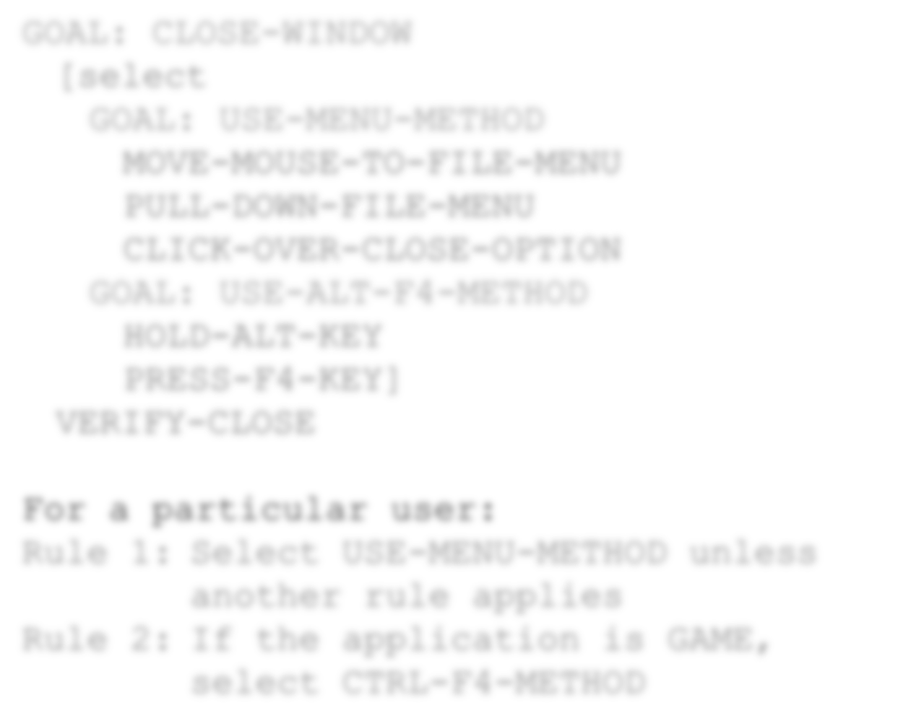
Goals
GOMS

Slide 12
Operators
GOMS

Slide 13
Methods
GOMS

Slide 14
Selection Rules
GOMS

Slide 15
GOMS – Characteristics
Can be used to model complex tasks
Cannot predict completion times
But the simpler KLM can
Predictions
More operators, longer completion
Deep depth of goal structure → high short term-memory load
Users stop when goals are satisfied
GOMS

Slide 16
License
This file is licensed under the Creative Commons Attribution-Share Alike 4.0 (CC BY-SA) license:
https://creativecommons.org/licenses/by-sa/4.0
Attribution: Niels Henze
For more content see: https://hci-lecture.de

