Slide 1
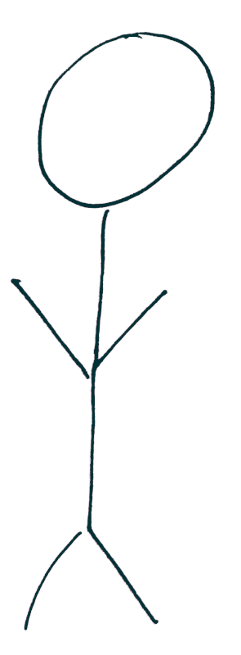
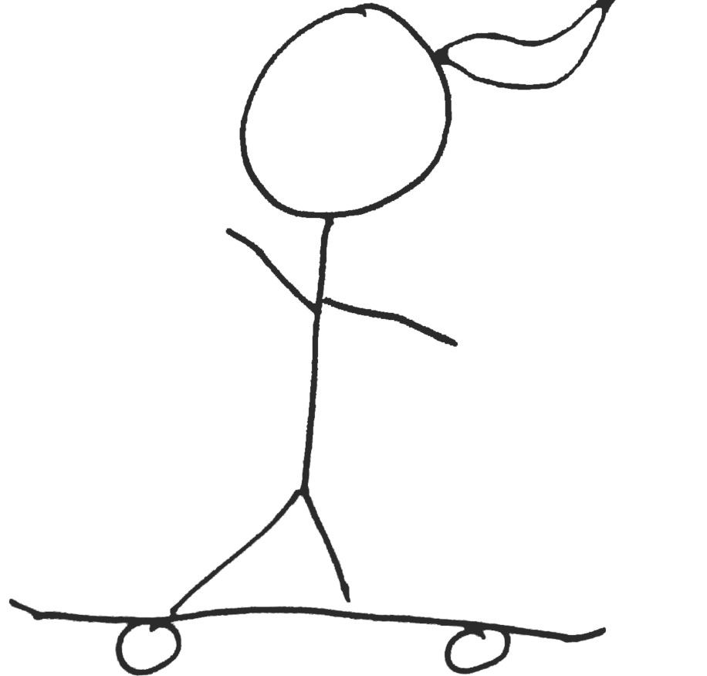
Introduction to Prototyping

Slide 2
Learning Goals
Being able to put different prototyping techniques into perspective
Know when to use which technique
Have an overview of prototyping approaches
Introduction to Prototyping

Slide 3
Prototyping Videos
Introduction to Prototyping

Slide 4
Definition of Prototypes
Prototype, a definition:
“A concrete representation of part or all of an interactive system” (based on [1])
[1] Beaudouin-Lafon, M., & Mackay, W. E. (2009). Prototyping tools and techniques. In Human-Computer Interaction (pp. 137-160). CRC Press.

Slide 5
Fidelity
software
prototypes
mockups
effort
wireframe
sketches
fidelity
Introduction to Prototyping

Slide 6
Getting Married
Photo by Anna Shvets from https://www.pexels.com/photo/women-standing-on-wooden-planks-3727647 (PD)
Introduction to Prototyping

Slide 7
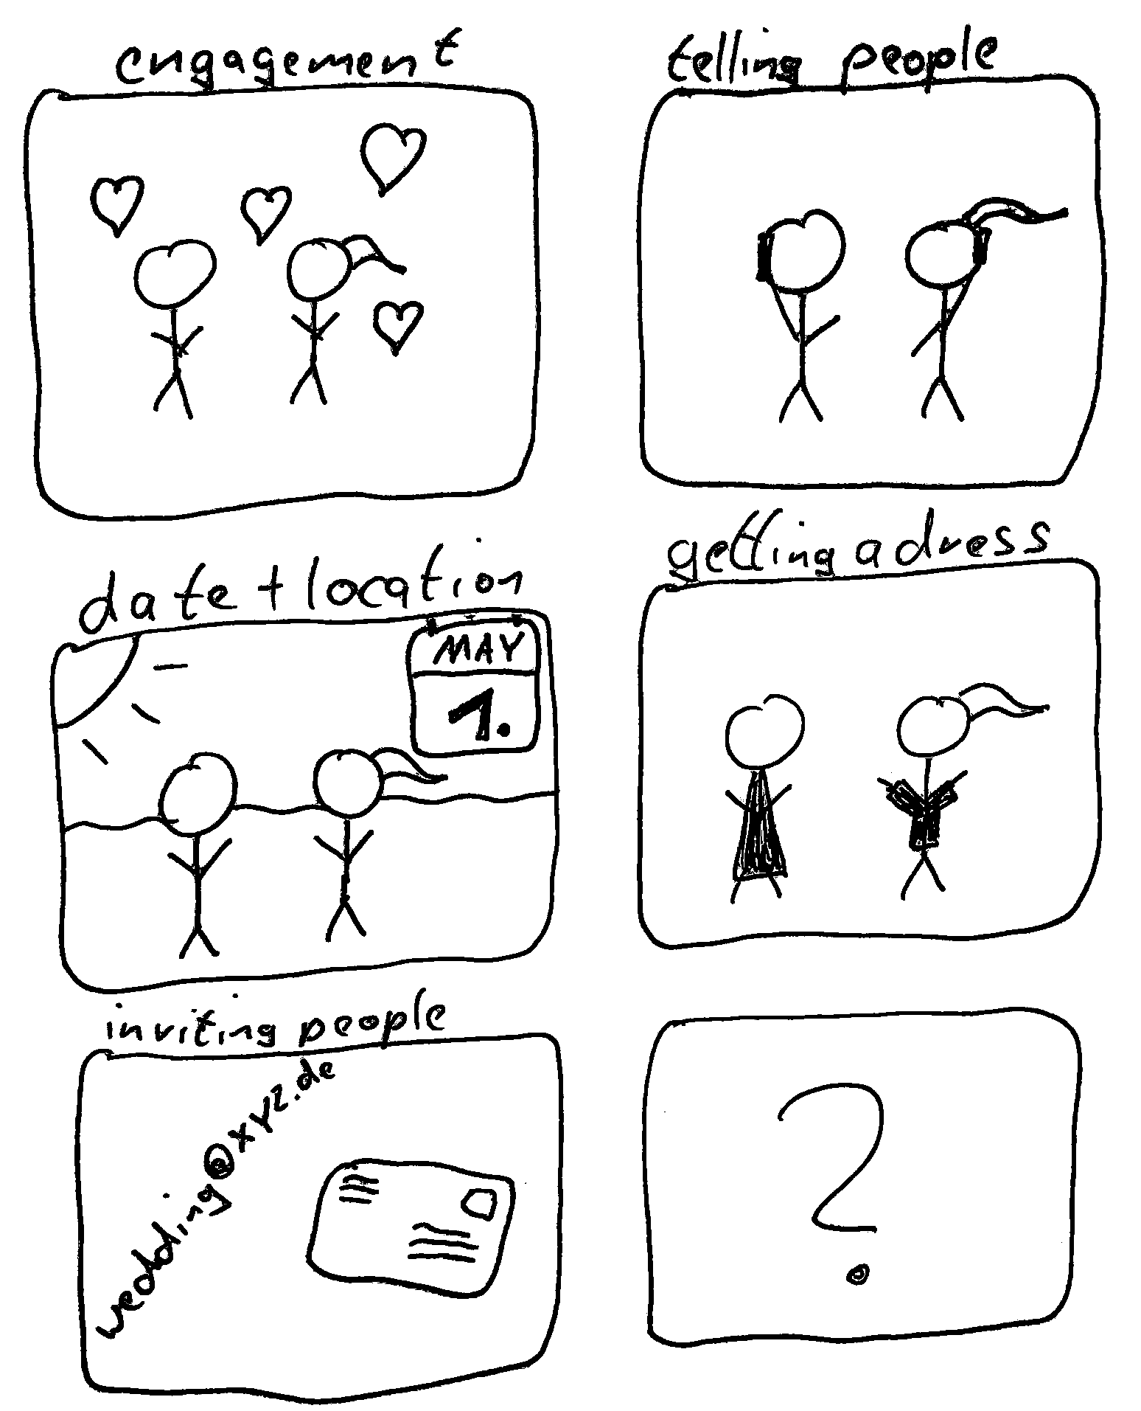
Storyboards
Introduction to Prototyping

Slide 8
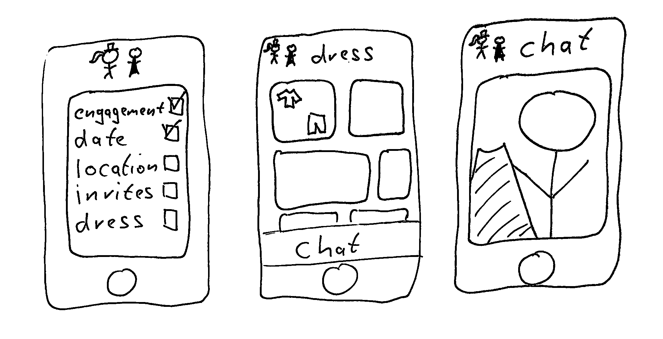
Sketches
Introduction to Prototyping

Slide 9
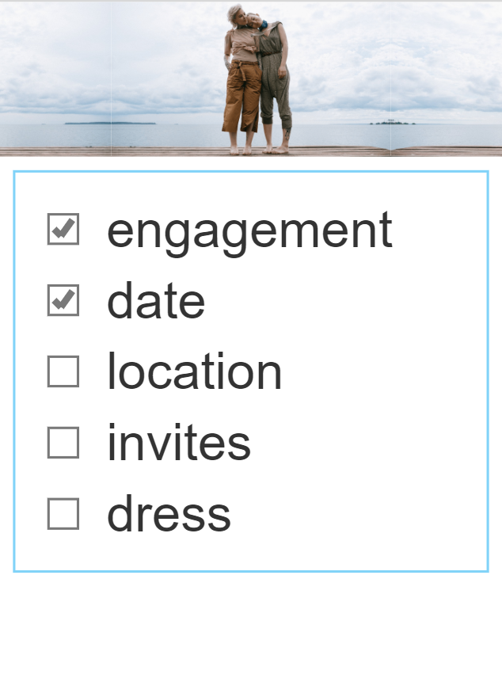
Mockups
Introduction to Prototyping

Slide 10
Software Prototypes
Introduction to Prototyping
Notes:
https://www.pexels.com/photo/code-projected-over-woman-3861969/

Slide 11
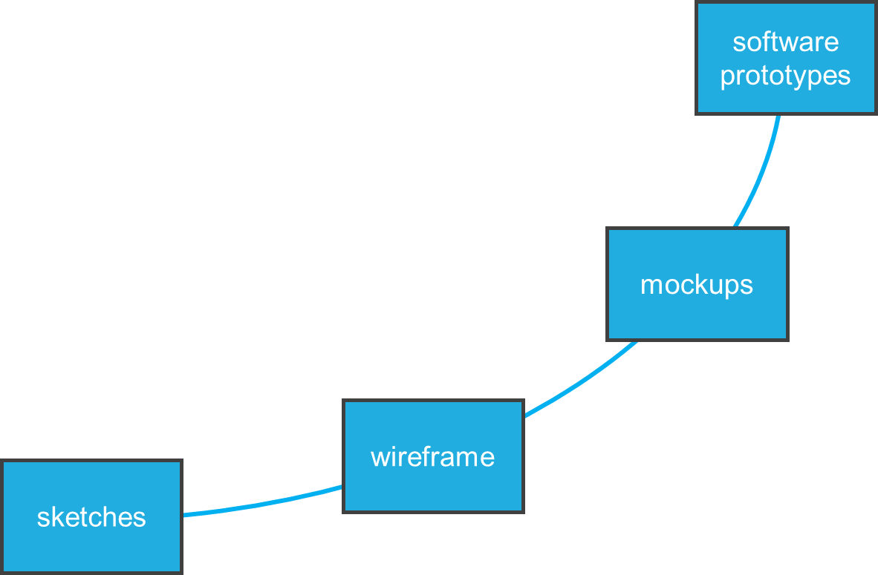
Fidelity
effort
design iteration
fidelity
Introduction to Prototyping

Slide 12
License
This file is licensed under the Creative Commons Attribution-Share Alike 4.0 (CC BY-SA) license:
https://creativecommons.org/licenses/by-sa/4.0
Attribution: Niels Henze
For more content see: https://hci-lecture.de

